Slide 1

Trace Evidence
Melissa Valadez
Trace Evidence Section Manager
DPS Austin Crime Laboratory
Joint Conference on Forensic Science 2012

Slide 2
Types of Trace Evidence
Hair
Fibers
Paint
Glass
Gunshot Residues
Shoe/Tire Impressions
Other: Filaments, tape, rope/cordage, unknown substances, pepper spray, lotions, lubricants, explosives

Slide 3
Locard Exchange Principle
Every contact leaves a trace
When two objects come into contact with each other, a transfer of material will occur
  Material may not be detectable
  Material may be lost
  Material may be visualized and collected
Comparison of a questioned sample to a known sample or identification of material

Slide 4
Hair Evidence
100,000 – 150,000 head hairs per scalp
Average life span of hair is 2 – 6 years
100 – 150 hairs can be shed in 1 day
“It has been found that when two hair samples are randomly selected from the population and compared microscopically, it is very unusual that they cannot be distinguished. However, the possibility cannot be dismissed that there may be two hair samples whose ranges of variation overlap and, therefore, a positive identification cannot be made” –Microscopy of Hair, FBI

Slide 5
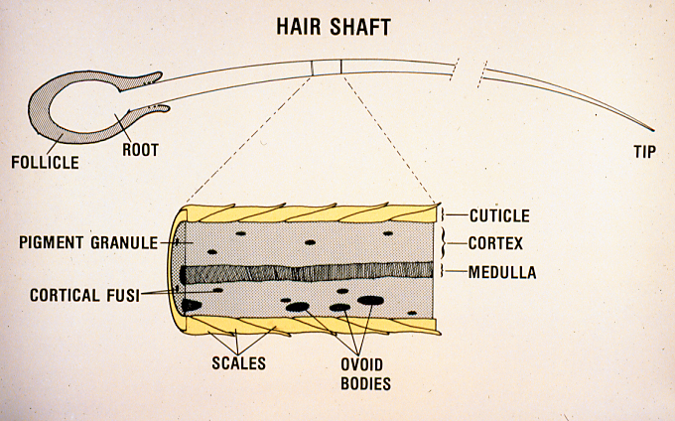
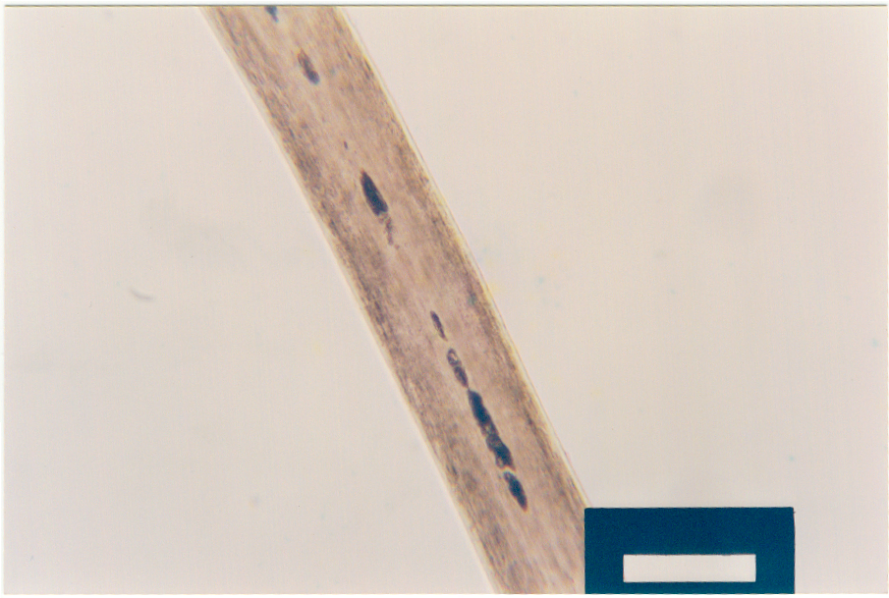
Hair Characteristics
Pigment
Cuticle
Fragmented Medulla
Notes:
Hair consists of a root portion, shaft (middle) and a tip that can be cut, tapered, broken, etc.
Microscopically hair consists of 3 regions: Cuticle, cortex and medulla
Cuticle: Outside layer, like fish scales, used to protect the hair, have a defined shape depending on the type of animal the hair belongs to
Cortex: Center (light gray portion), contains the pigment of the hair and other special features used for comparisons such as cortical fusi and ovoid bodies
Medulla: Central core, thought to give structure and strength to the hair, air filled sack, some people have them and some don’t

Slide 6
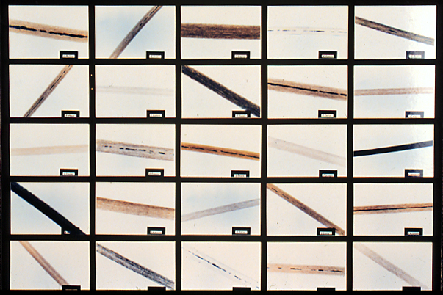
Head hair from 25 people
Notes:
Photomicrographs of 25 Caucasian individuals to show that visually you can tell these hairs apart without even doing a microscopic examination.

Slide 7
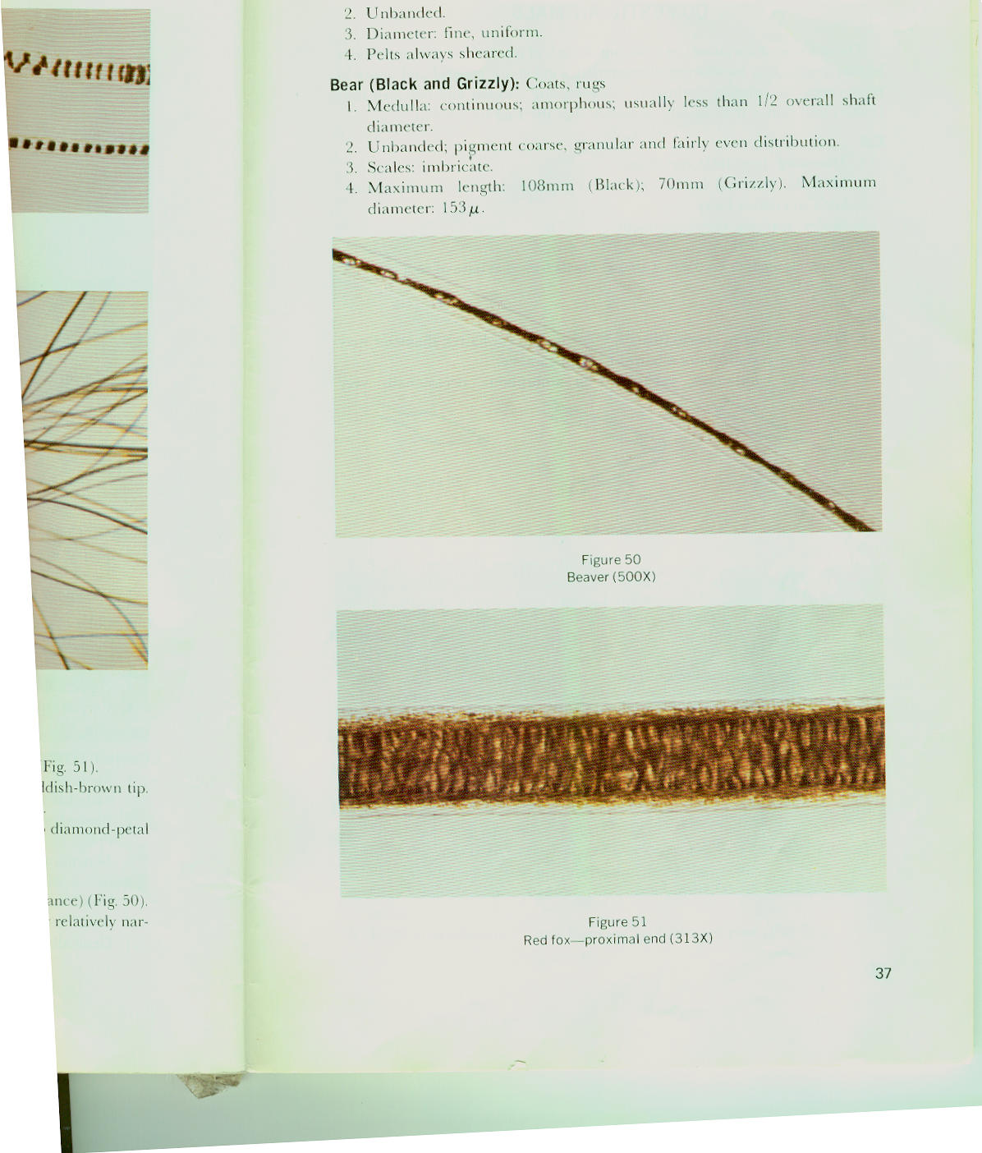
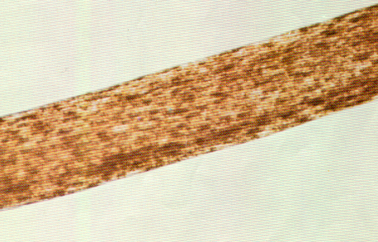
Determinations from Hair
Hair characteristics
  Length, color, pigmentation, etc.
  Artificially treated
  Shed or forcibly removed
Origin of hair
  Human
  Animal
Racial characteristics
  Caucasian (Hispanic included)
  Negroid (African ancestry)
  Mongoloid (Asian, Indian ancestry)

Slide 8
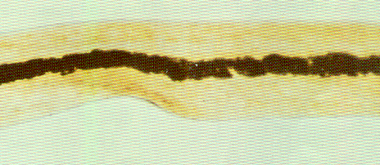
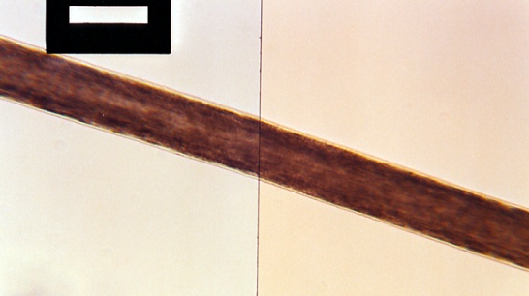
Determinations from Hair
Body origin characteristics
  Head hair
  Pubic hair
  Body (arm & leg, facial, etc.)
Comparisons
  Macroscopic (visual)
  Microscopic
DNA typing
  Nuclear DNA - typing of any tissue on the hair root
  Mitochondrial DNA typing - hair shaft is tested, must be sent to outside laboratory

Slide 9
Hair Evidence - Conclusions
Exclusion of hair associations
  Differences detected (not from source)
Inconclusive Results
  Insufficient microscopic characteristics
  Similarities and differences
Inclusion of hair associations
  Similar characteristics
  “Could have come from individual”
Notes:
Exclusion: Significant differences were detected that allow for the conclusion that the Q hair did not originate from the submitted sample.
Inconclusive: The hairs may not have enough features for comparison (colorless, gray or blonde hairs often fall into this category)
The hairs may exhibit similarities and differences. The differences are not significant enough for exclusion but an
inclusive statement cannot be made.
Inclusion: No significant differences between the Q and K hairs. The Q hair could have come from the K sample. “it is noted that hairs do not possess a sufficient number of unique microscopic characteristics to be positively identified as having originated from a particular person to the exclusion of all others”

Slide 10
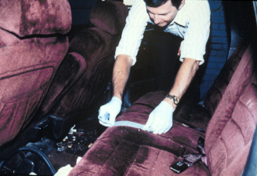

Fiber Evidence
Vegetable fiber
  Cotton, Hemp, Ramie
Animal fiber
  Wool and Silk
Mineral
  Asbestos
Man-made
  Acetate, Acrylic, Nylon, Polyester, Olefin, Rayon, Spandex
Notes:
Two categories of fibers exist: Natural and Synthetic
This is a list of the natural fibers that are out there. The lab primarily deals with cotton, wool and silk

Slide 11
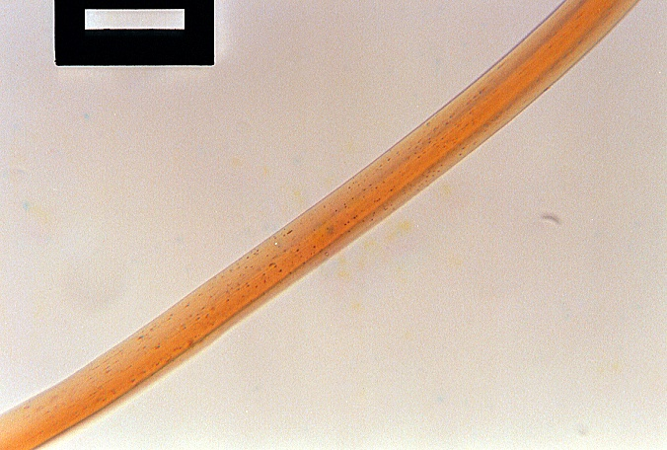
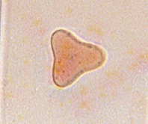
Lab Analysis
Optical Properties
Diameter
Delusterant
Cross-section
Polymer type
Color comparisons
Cross Sectional Shape
Delusterant
Notes:
Microscopic characteristics:
Diameter
Cross-sectional shapes
Internal features such as delusterant
Optical properties
Color

Slide 12
Fiber Evidence - Conclusions
Exclusion of fiber associations
  Differences detected (not from source)
Inclusion of fiber associations
  No differences detected between fibers
  “Could have come from source”
  Or any other source with same properties
Notes:
Exclusion: The fibers are different in some significant charactersitcs such as color, polymer type, cross sectional shape, etc.
Inclusion: Fibers are similar in all major characteristics and it is our opinion that Q could have come from the Known source. However, there are other items out there that may have similar fibers that would also give the same results such as other garments made at the same time or other items made out of the same bolt of fabric but by a different company.

Slide 13
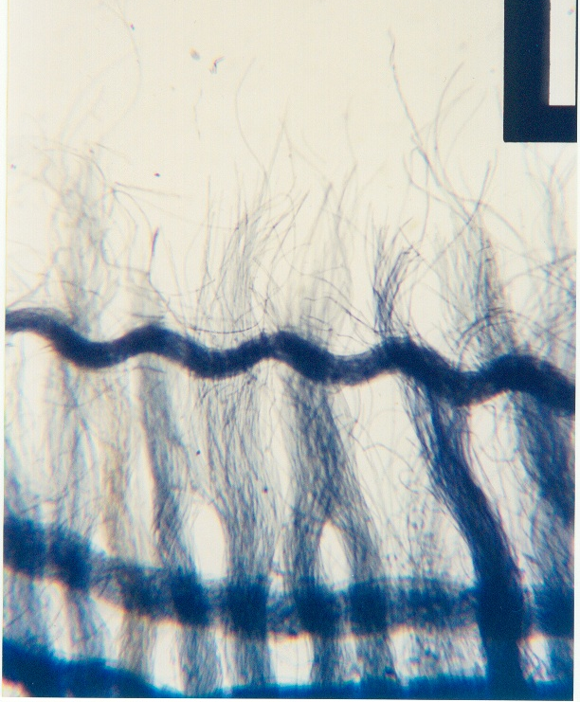
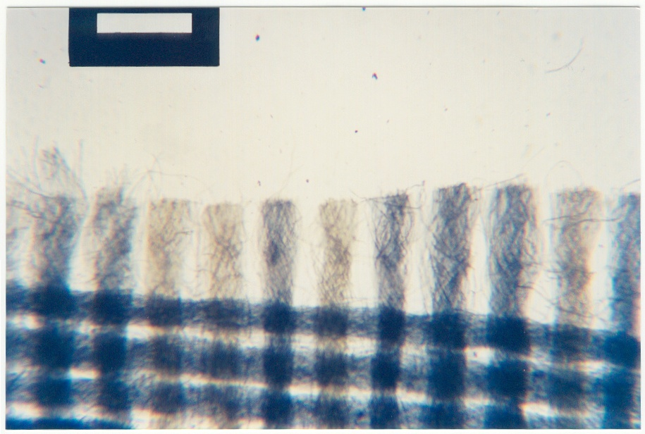
Fibers - Cut vs. Tear
Notes:
We can also do a cut vs. tear determination. Even, unfrayed edges and yarns indicates that the fabric has been cut. The uneven and frayed edges indicate that the fabric has been cut. This can be important in cases to determine if a victim is telling the truth or if possibly evidence has been manufactured.

Slide 14
Case Example: Kidnapping/SA
Young girl was kidnapped, bound, and sexually assaulted in a van
The sexual assault kit was negative for body fluids
Tape lifts of her clothing revealed the presence of:
  six types of carpet fibers
  one type of rope fiber
  several residues consistent with being a type of adhesive (tape)

Slide 15
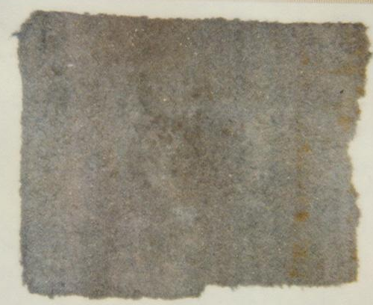
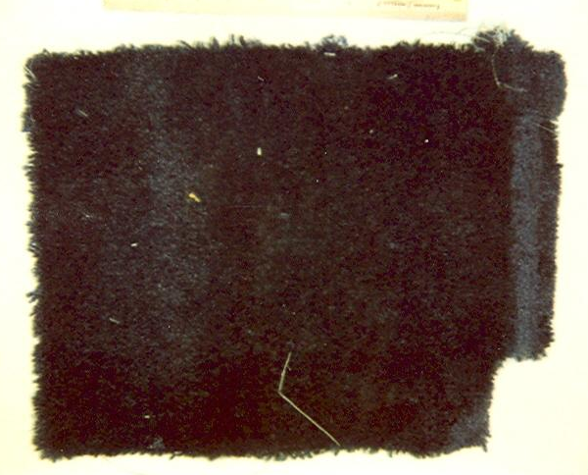
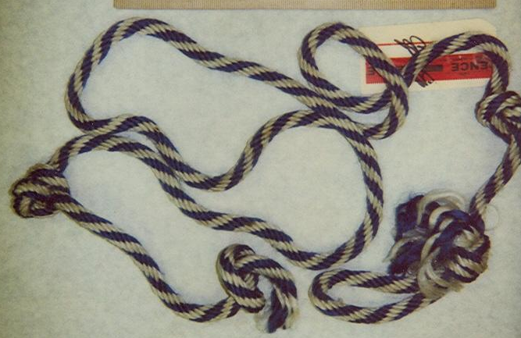
Case Example: Kidnapping/SA
Suspect, a carpet layer, was arrested and his van seized. Despite his attempt to empty his van, several carpet scraps and a piece of blue and white rope were recovered

Slide 16
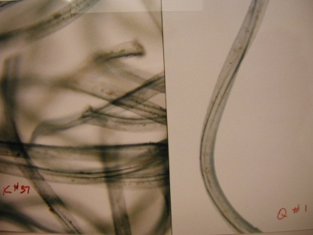
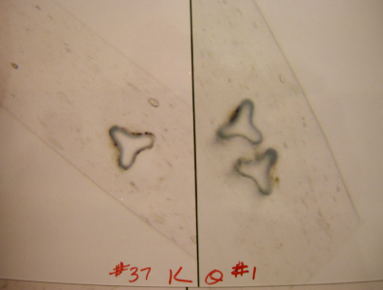
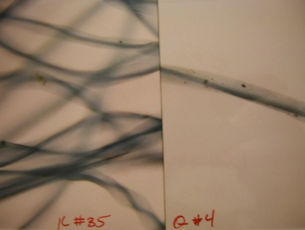
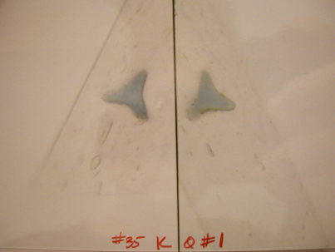
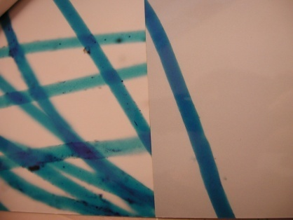
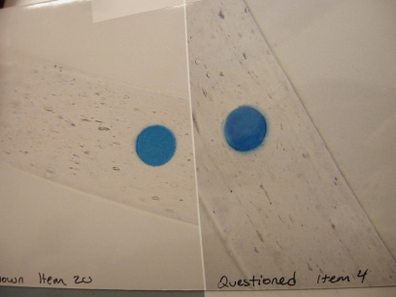
Case Example: Kidnapping/SA
Trace was able to match the two different carpets and the blue rope from the van to fibers recovered from victim’s clothing

Slide 17
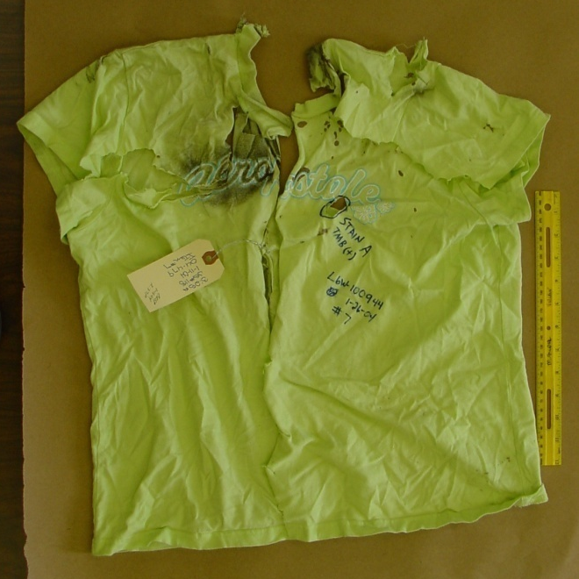
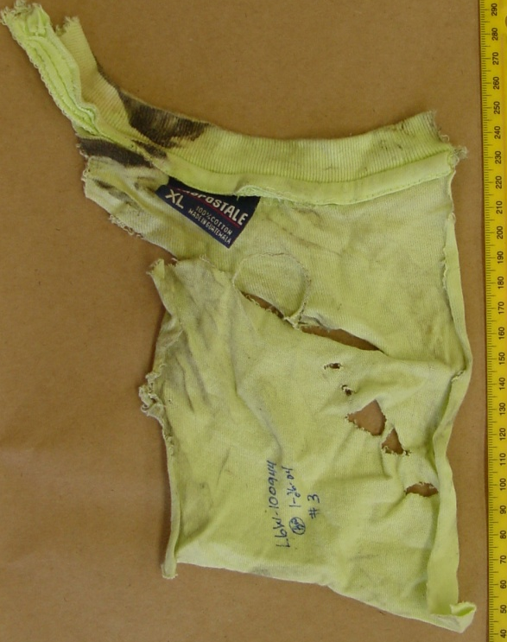
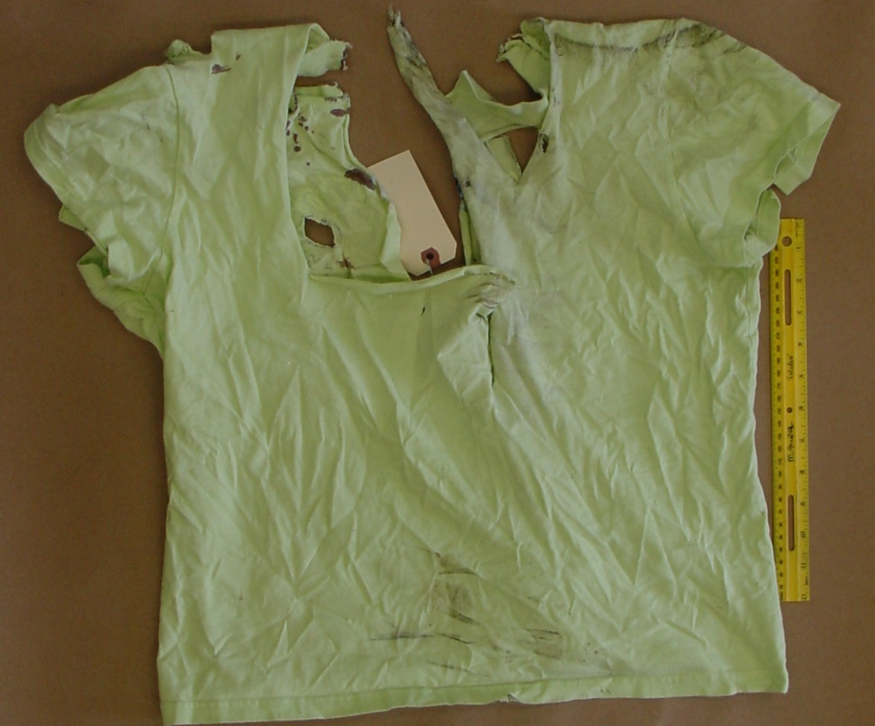
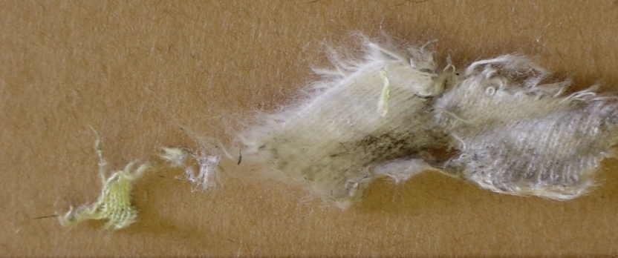
Case Example: Hit and Run
Victim’s shirt
Fabric piece from vehicle
Fabric from under car
Notes:
Teenage girl was walking on side of road when a vehicle hit and killed her and drove off without offering assistance. The victim’s t-shirt was submitted along with fabric that was found in the wheel well of the vehicle. The smaller pieces of fabric were too small for a physical match but color, fibers type and fabric weave could be compared to the victim’s t-shirt

Slide 18
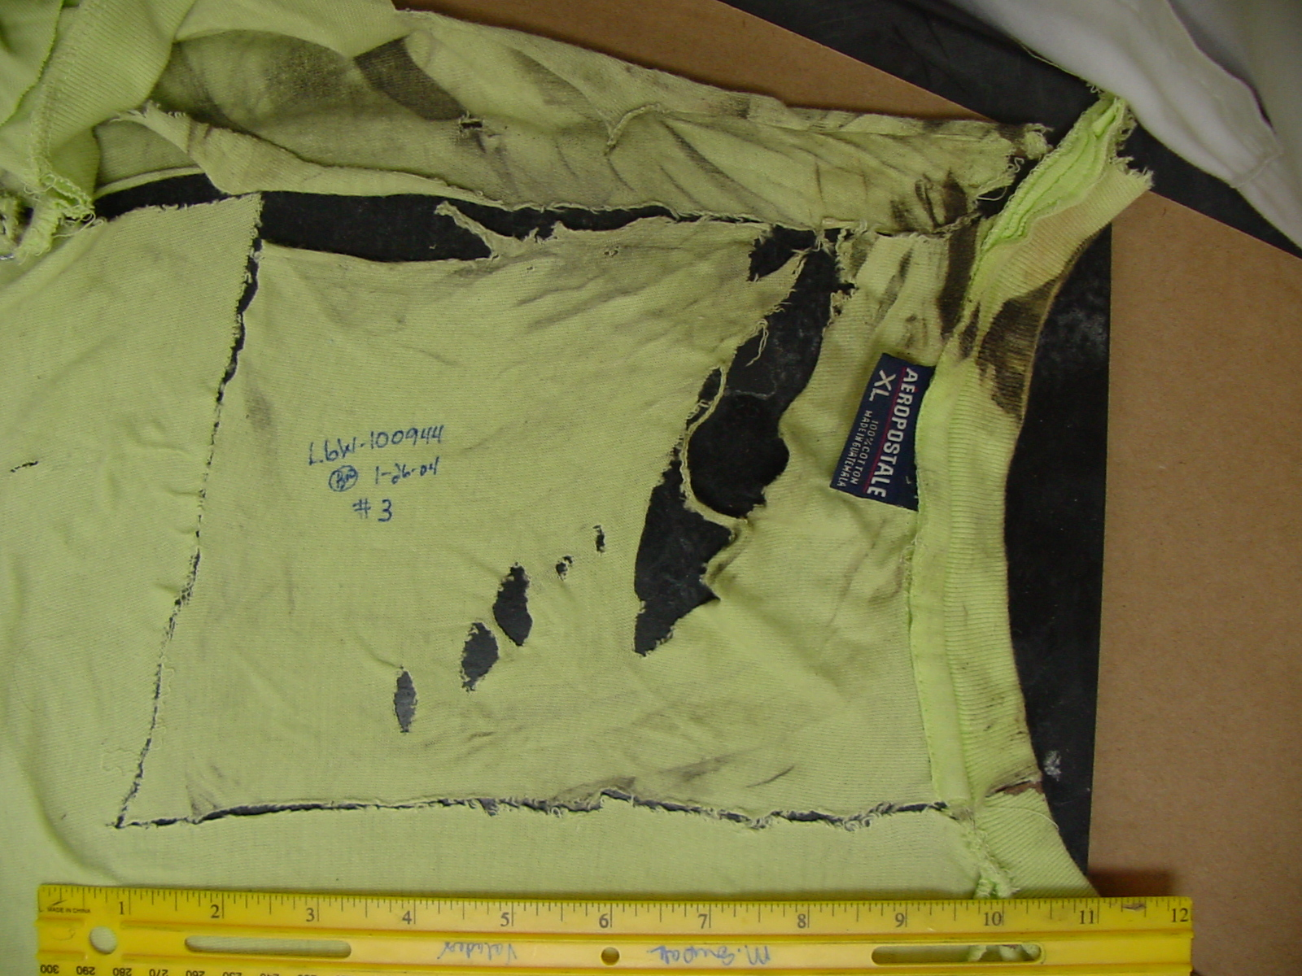
Case Example: Hit and Run
Notes:
A physical match could be made with the larger piece of fabric back to the t-shirt to show that they were once joined.

Slide 19
Paint Evidence
Batch tank for a given paint color can vary from 500 to 10,000 gallons
It takes approximately 2.5 to 3 gallons of color coat to finish one vehicle
There can be 170 to 1,600 vehicle painted with the same batch of paint

Slide 20

Automotive Paint Layer Systems
Standard System
Clear Coat – Base Coat
One Primer
Clear Coat – Base Coat
Two Primer
Tricoat System
Notes:
Most OEM (original manufacturer finish) automotive paint layer systems consist of 3-4 paint layers.
Standard system: color coat and 2 primers
Clear coat-base coat, one primer: clear coat, color coat, primer
Clear coat-base coat, two primer: clear coat, color coat, 2 primers
Tricoat system: clear coat, clear coat and flake (colored), base coat (colored and opaque), primer
Metallic bicycle finishes often have a colored clear coat, dense metallic flake layer, and two primers

Slide 21
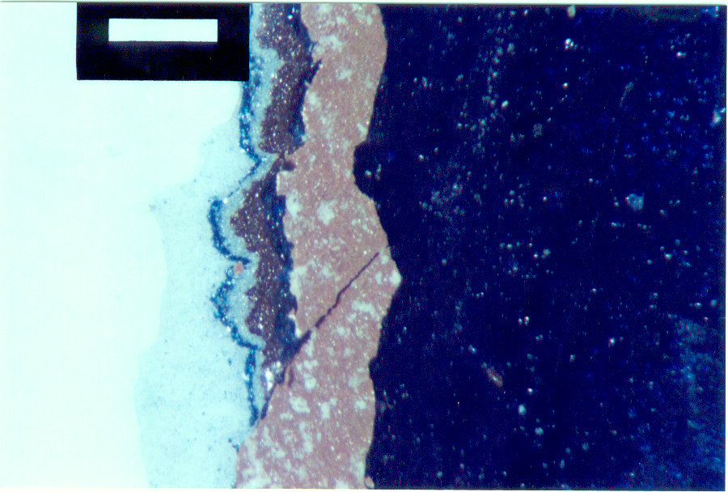
Automotive Paint Chip
6
7
7 Layers
5
4
3
2
1
Notes:
This is a repaint paint chip with 7 layers present, can you see all 7 layers?

Slide 22
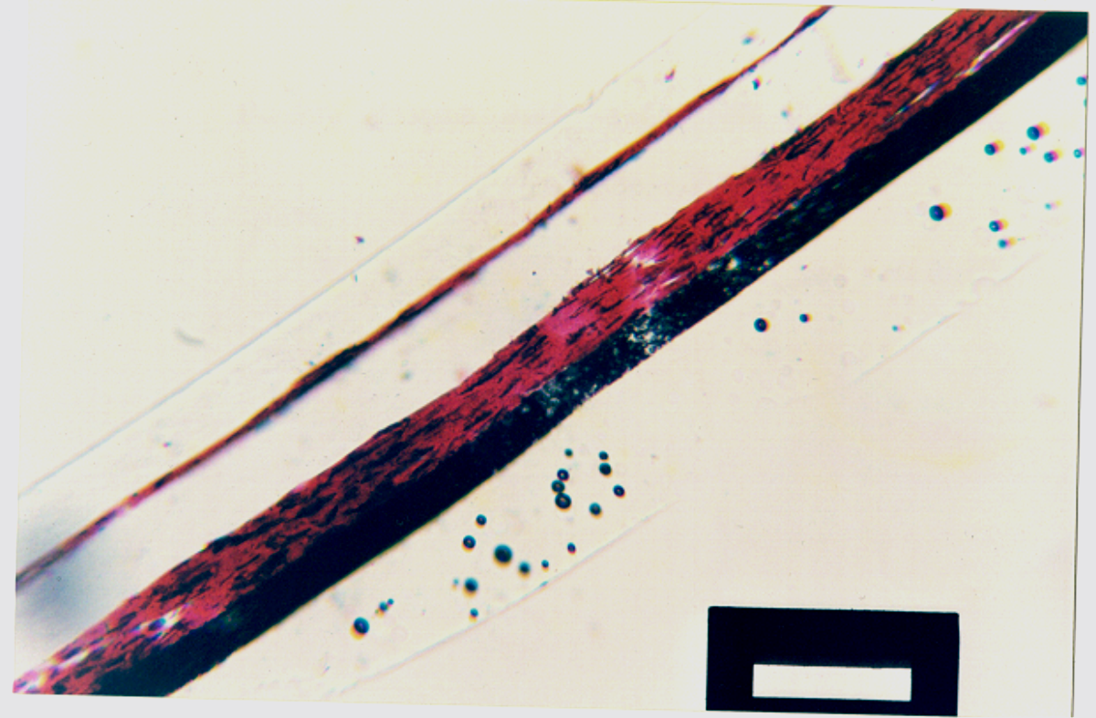
Automotive Paint Chip
5 Layers
5
4
3
2
1
6 Plastic

Slide 23
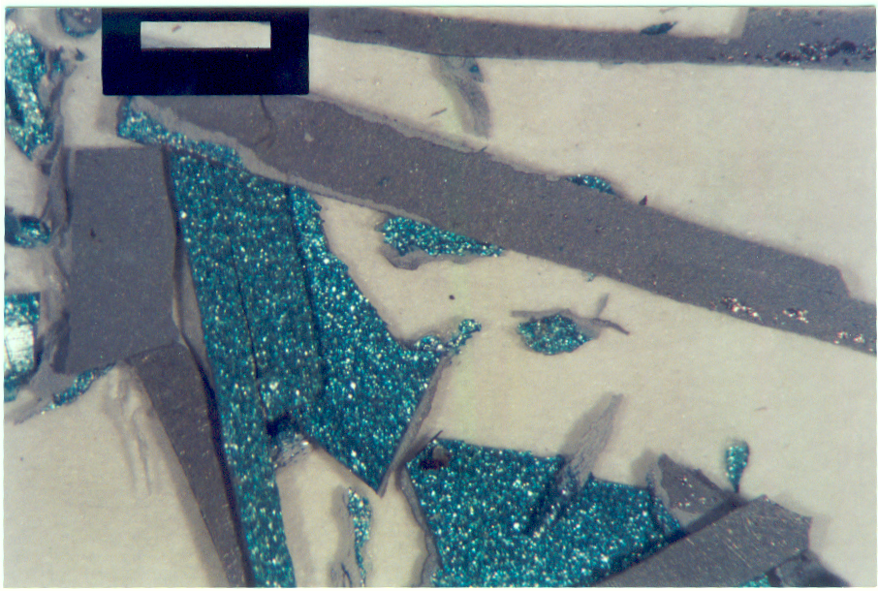
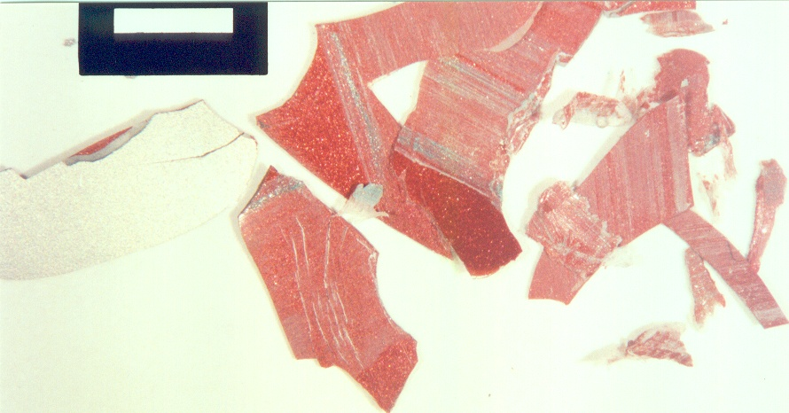
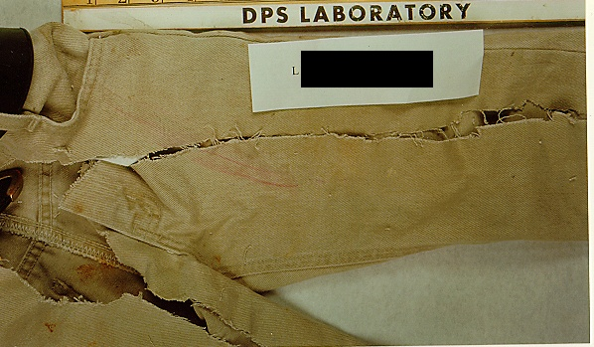
Paint Transfers
Known
Question
Green metallic smears
Impact Sites
Notes:
Case example of a hit and run. The blue paint belongs to the suspect vehicle. The red paint is from a damaged portion of the victim’s vehicle. You can see that the victim’s vehicle has blue smears. These smears are of a sufficient size to analyze and perform a comparison in the lab.

Slide 24
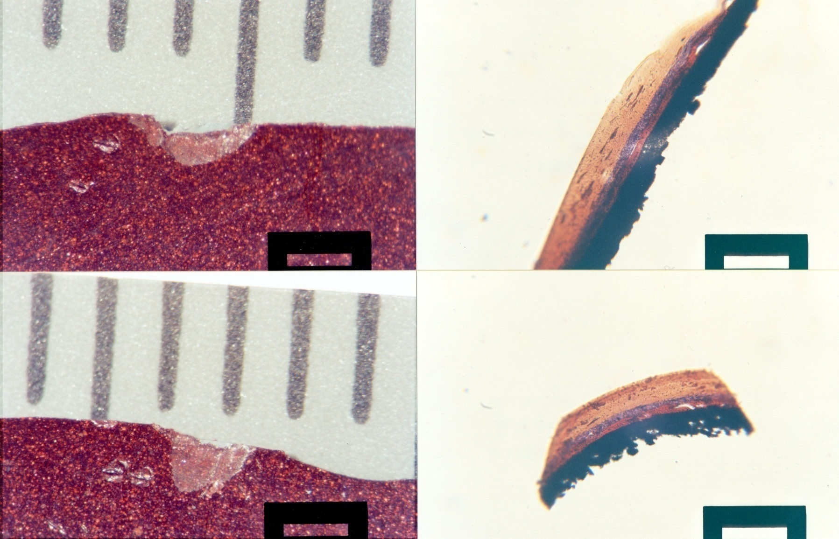
Lab Analysis
Visual and Microscopic Comparisons
Notes:
This shows a side by side comparison of a paint chip and its cross section.
The paint chip allows us to compare overall color and metallic flake distribution.
The cross sections allow us to compare layer sequence, color and thickness as well as flake distribution.

Slide 25
Paint Database - PDQ
PDQ → Paint Data Query
  Possible automotive sources of paint
  Search criteria
    Automotive binders only
    Binder identification
    Color coding
    Layer sequence
    Primer color and identification most important
Notes:
PDQ or Paint Data Query is a database that is housed with the RCMP and allows for a possible make and model determination of the suspect vehicle. Search is based on binder identification of the paint layers and color coding of the layers. Depending on the number of layers present, the list of possibilities may be very short. Only OEM paint can be used to search the database.

Slide 26
Paint Evidence - Conclusions
Exclusion of paint associations
  Differences detected (not from source)
Inclusion of paint associations
  No differences detected between paints
  “Could have come from source”
  Or any other source with same properties
Possible physical match
Notes:
Similar to that of fibers…
Exclusion, major differences exist… it is possible that there is variation on the vehicle itself so the samples may be close but not a match; therefore the lab may request additional samples from other damaged areas of the vehicle for comparison
Inclusion, no significant differences exist and therefore the Q paint could have come from the known paint. There may be other vehicles produces with the same layers sequence but they would have to be made from the same batch of paint in the same plant at the same time and have access to the crime scene at the date/time of the crime so this evidence is significant. Significance is added when none OEM layers exist.

Slide 27
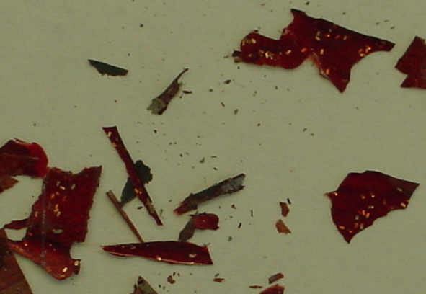
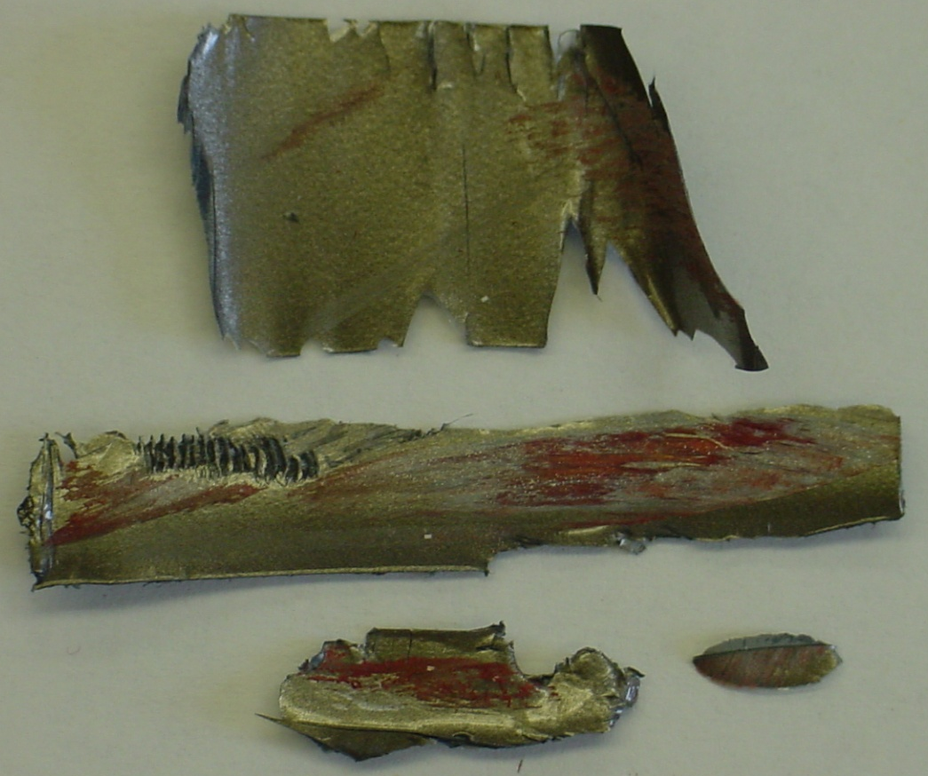
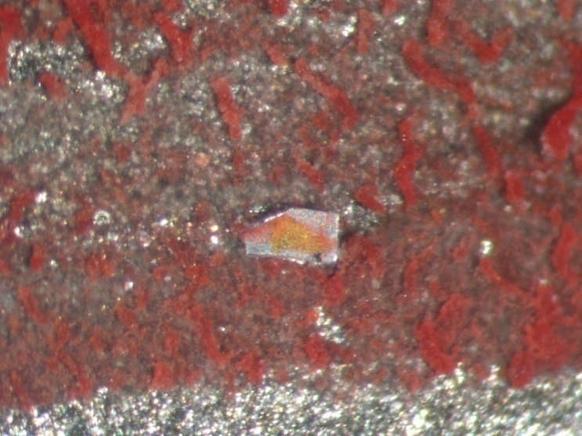
Case Example: Hit and Run
Suspect vehicle
Questioned smear on
victim’s vehicle
Notes:
Hit and run case
Gold vehicle was hit by a red vehicle. Damaged portions of the gold paint were sampled—red smears were present as well as large metal rectangles.
Known suspect paint consisted of red color coat with large rectangular metal flakes imbedded that were silver on one side and gold on the other.

Slide 28
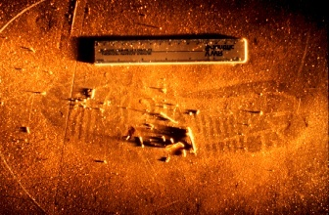
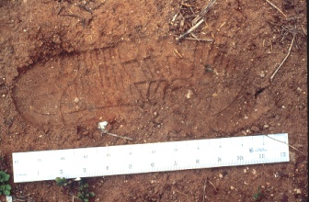
Impression Evidence

Slide 29
Impression Evidence
Class Characteristics
  Size
  Tread pattern
  Wear
  “Could have been this shoe or other shoe with same characteristics”
Accidental Characteristics
  Accidental marks random in nature
  “Print made by shoe”

Slide 30
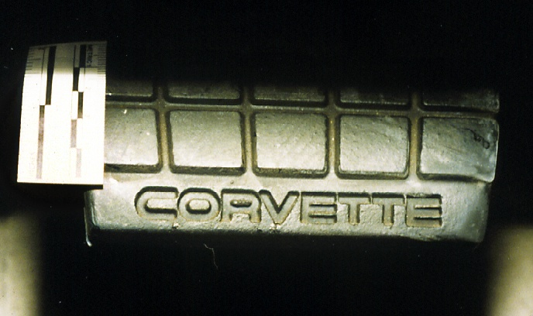
The angle of the light is very important

Slide 31
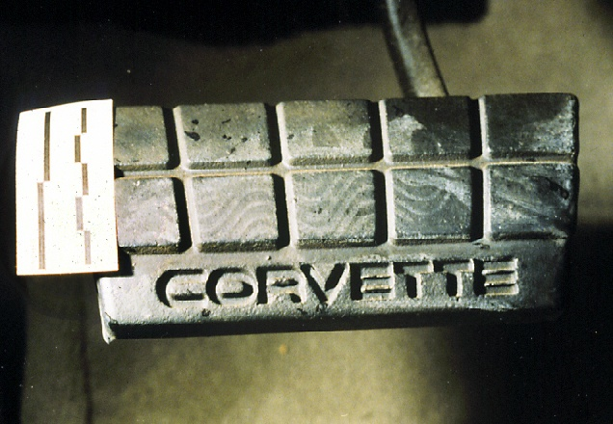
Detail in the print is visible when the lighting angle is correct

Slide 32
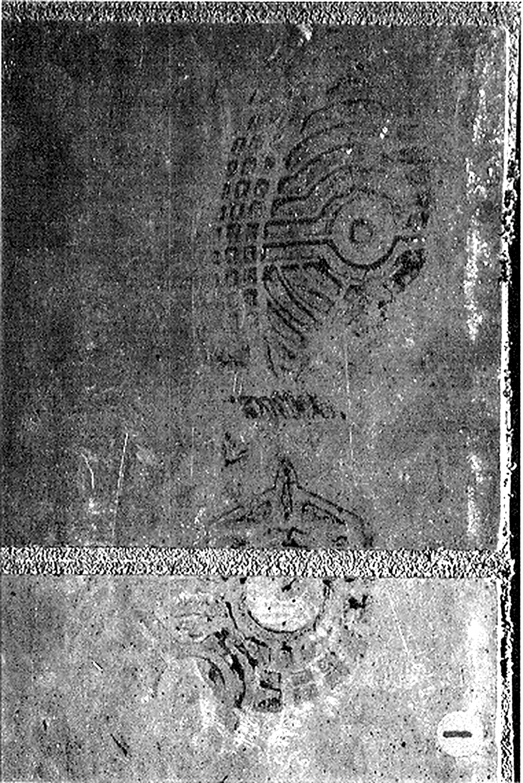
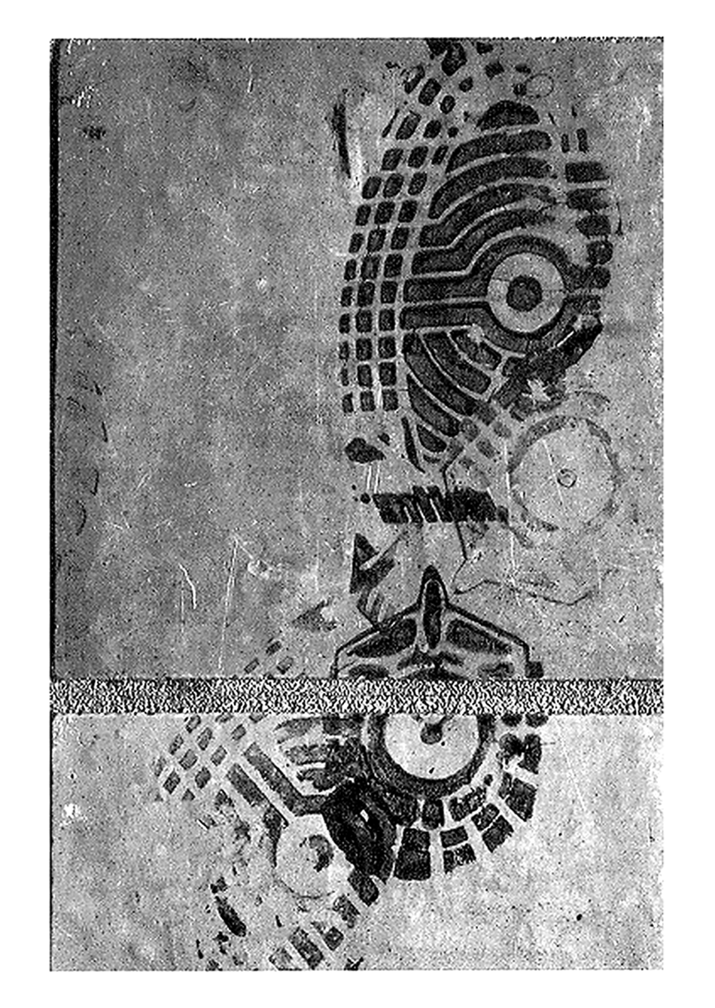

Slide 33
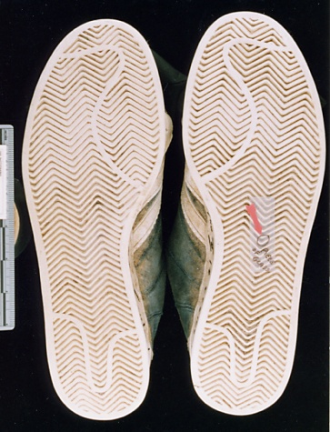
Suspect’s known shoes

Slide 34
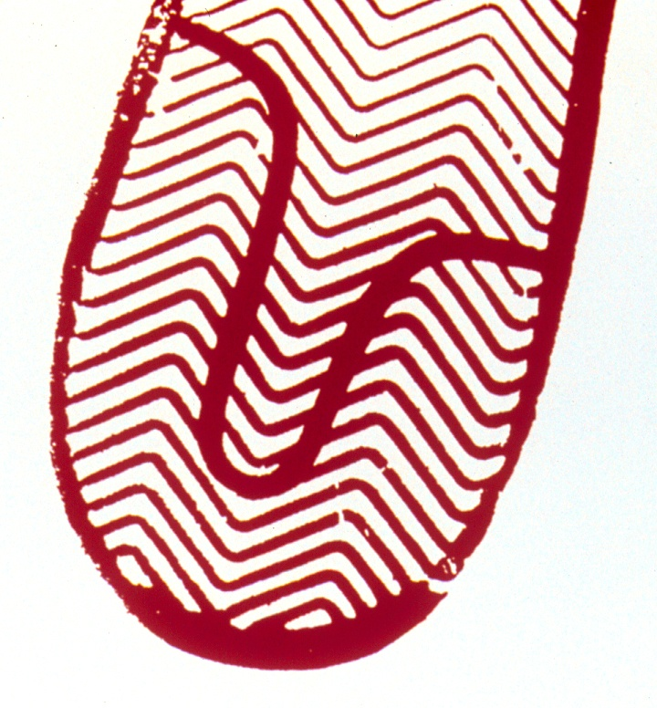
Test print of suspect’s known left shoe

Slide 35
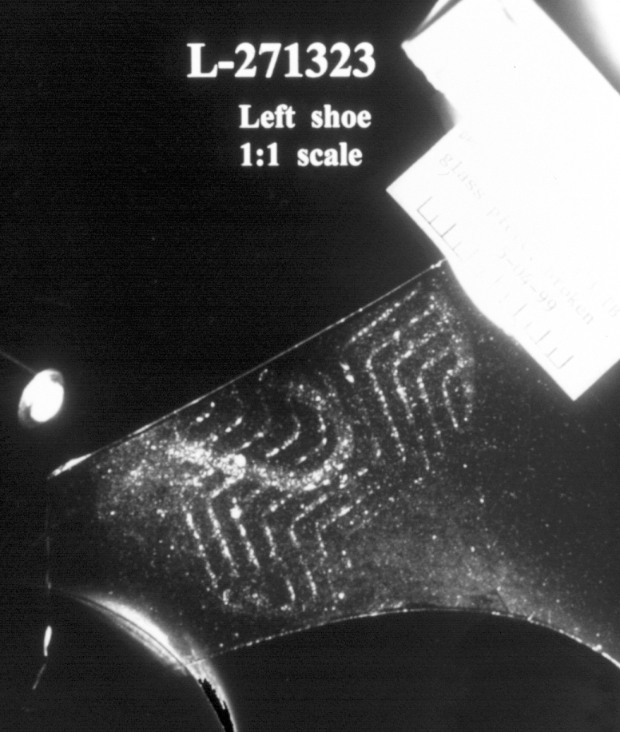
Print on glass from scene

Slide 36
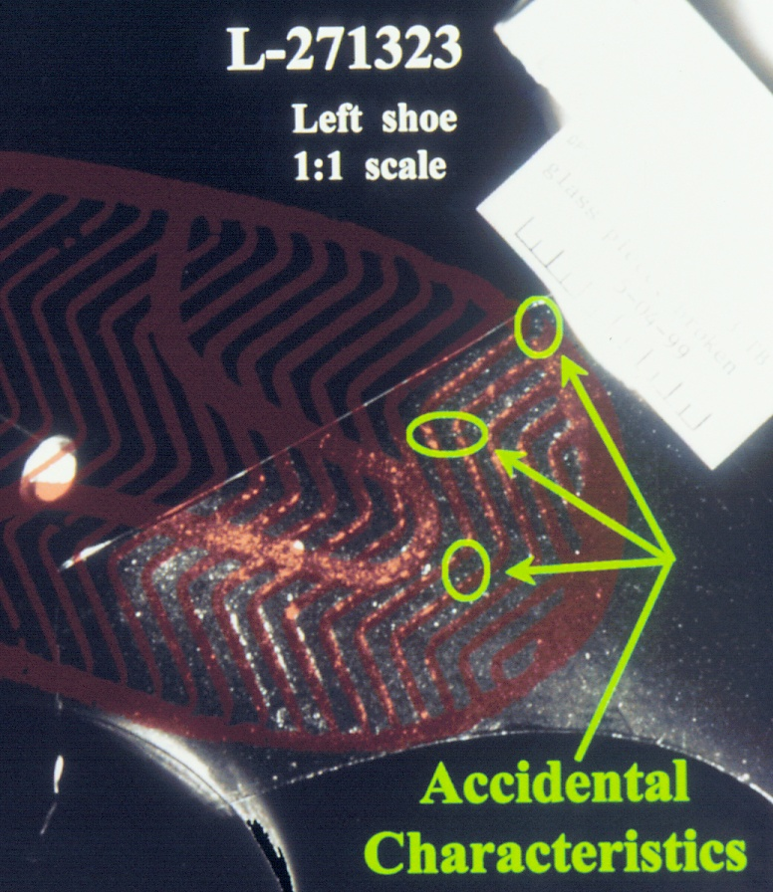
Overlay of test print on print from scene

Slide 37
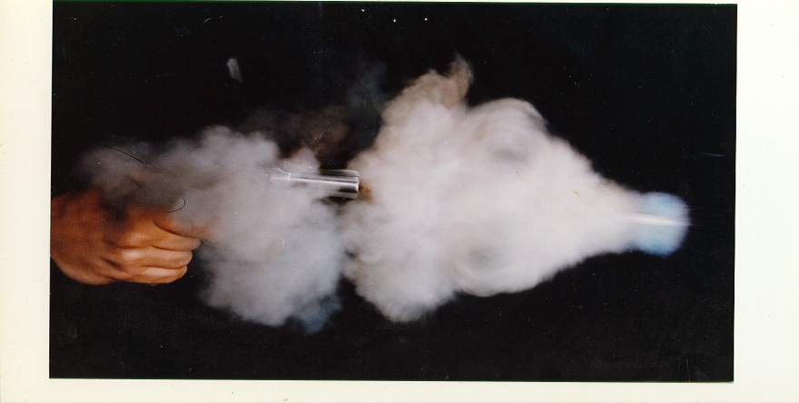
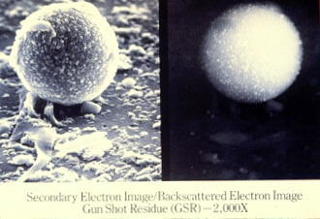
Composition of Gunshot Primer Residue
Lead (Pb)
Barium (Ba)
Antimony (Sb)
SEM-EDS Analysis
Notes:
GSR is composed of three elements: lead, barium and antimony
Not all ammunition contains each of these elements (ex: lead free ammunition)

Slide 38
Limitations to Analysis
Collection must occur within 4 hours of shooting
Victim kits are not analyzed (including suicides)
Only 2-stub kits will be accepted

Slide 39
Conclusions from GSR Analysis
Characteristic particles (shape & 3 elements present)
Indicative particles (shape & 2 elements present)
    Fired a weapon
    Immediate proximity of a weapon being fired
    Handled a fired weapon

Slide 40
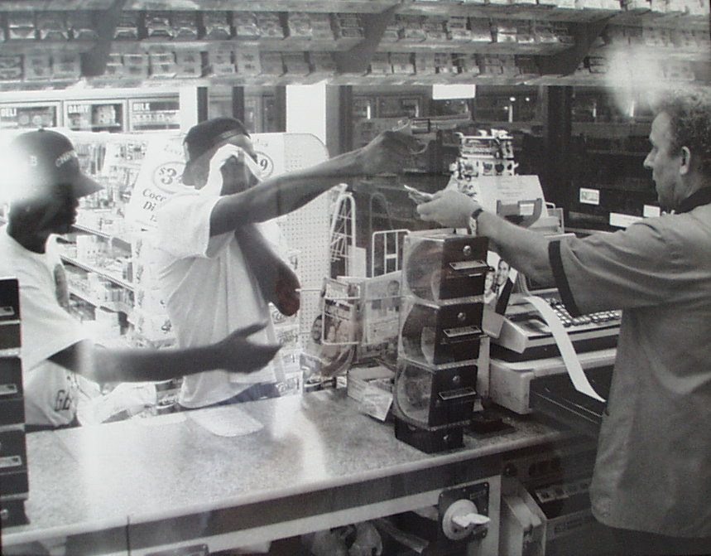

Slide 41
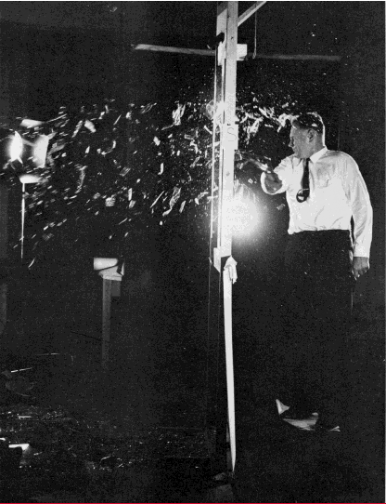
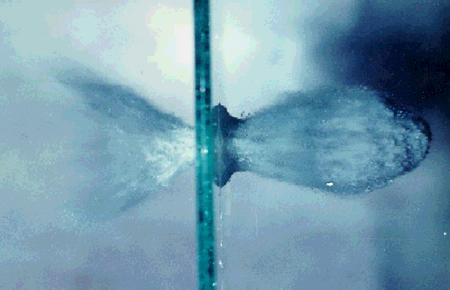
Glass Evidence
Notes:
Note the amount of glass that is being forced back on the striker. Transfer glass can often be found on the strikers clothes, pants cuffs, socks, shoe soles and in their hair.

Slide 42
Analysis of Glass Evidence
Direction of force indicators
Sequence of breaks (bullet holes)
Comparison of question to known
  Possible physical match
  Color
  Thickness
  Microscopy
  Refractive index
  Elemental analysis

Slide 43
Glass Conclusions
Physical Match
  Pieces were once joined
Exclusion of glass associations
  Differences detected (not from source)
Inclusion of glass associations
  No differences detected between glass
  “Could have come from source”
  Or any other source with same properties

Slide 44
Other Types of Trace Evidence
Physical Match
Tape
Ropes/cordage/knots
Filaments (headlight, etc.)
Unknown substances
Pepper spray
Lotions/lubricants

Slide 45

Physical Match - Knife
Notes:
Here is the knife used in a homicide
Tip was left in a wall at the scene and the middle piece was found on the victim

Slide 46

Physical Match - Knife
Notes:
All three pieces fit together uniquely and therefore were once joined indicating this weapon was at the scene and in contact with the victim.

Slide 47

Physical Match - Auto Parts

Slide 48
Physical Match and Tape
Notes:
Tape end matches to show tape came from a particular roll.

Slide 49

Ropes and Cordage

Slide 50

Ropes and Cordage
Notes:
We can also assess the number of yarns and their construction (how they are all twisted together) Some ropes contain a central core with yarns surrounding while other contain many yarns that are twisted and then twisted with other twisted yarns.

Slide 51

Vehicle Lamp Filaments
Notes:
Normal filaments in a halogen bulb

Slide 52

Vehicle Lamp Filaments
Notes:
Two distorted (hot shock filaments with melted ends)

Slide 53
Case Review and Verifications
Disciplines have defined certain examinations that require an examination verification (ex. microscopic hair association, impressions, latent prints, firearms)
All case records involving the forensic examination of evidence will be technically reviewed prior to the release of results and/or issuing the case report.

Slide 54
Case Review and Verifications
Resolution Process
  Immediate supervisor/quality manager is notified
  Additional examination(s) and/or examiner(s) may be used to assist the examiners in their resolution and the observations must be documented.
  Based on the consideration of additional information, the original examiner or verifying examiner may change his/her interpretation/opinion.

Slide 55
Case Review and Verifications
Resolution Process
  If at the end of the resolution process the original examiner and all verifying examiners cannot reach a consensus for the final interpretation/opinion, then the interpretation/opinion must be reported as inconclusive.
  For issues regarding the technical results in the laboratory report, the examiner will not be pressured, forced, or told to change his/her interpretation/opinion to agree with the interpretation/opinion of another individual.

Slide 56
Categories of Association
Category 1: Source Identity/Source Attribution
Category 2A: Associations with distinct characteristics
Category 2B: Association with conventional characteristics
Category 2C: Association with limited characteristics/examinations
Category 3: Inconclusive
Category 4: Dissimilar but not complete exclusion
Category 5: Elimination/Exclusion

Slide 57
Categories of Association
Category 1: Source Identity/Source Attribution
Applies to physical matches, unique accidental associations, or other types of analysis where a source is confirmed or identified.
“The compared samples exhibit characteristics demonstrating that the items were once part of the same object. Alternatively, the sample is positively identified.”

Slide 58
Categories of Association
Category 2A: Associations with distinct characteristics
Applies to after market repaints, custom made products with limited distribution, certain manufacturing defects for tire and shoe molds, and other evidence of that nature.
“These items share distinct characteristic(s) that would not be expected to be encountered in the general population.”

Slide 59
Categories of Association
Category 2B: Association with conventional characteristics
Probably the one most associated with our cases. Applies to OEM paints, most fibers, shoes, and other mass produced items.
“These items share characteristics that have been manufactured or occur in nature and would be indistinguishable from the submitted evidence. Other items which share these properties may be available in the general population.”

Slide 60
Categories of Association
Category 2C: Association with limited characteristics/ examinations
Applies to nearly featureless hairs or fibers, paint samples too small to analyze, partial impressions with little detail or evidence types that are prevalent in society (ex blue denim).
“These items share characteristics that are common amongst these kinds of natural or manufactured materials and would be indistinguishable from the submitted evidence. Alternatively, a limited analysis was performed or minor variations were observed due to characteristics or size of the items.”

Slide 61
Categories of Association
Category 3: Inconclusive
“The observed, measured and/or chemical properties do not provide enough information to associate or eliminate the compared samples.”

Slide 62
Categories of Association
Category 4: Dissimilar but not complete exclusion
Applies to cases where the source for comparison may not be representative.
“Items are dissimilar in observed, measured, and/or chemical properties indicating they did not originate from the same source. However, the compared items share enough general characteristics that, due to reasonable variations in the source, the source itself cannot be associated or eliminated based on the specimen received.”

Slide 63
Categories of Association
Category 5: Elimination/Exclusion
“These items are dissimilar in observed, measured, and/or chemical properties demonstrating they did not originate from the same source.”

Slide 64
Trace Evidence
Melissa Valadez
Trace Evidence Section Manager
DPS Austin Crime Laboratory
melissa.valadez@dps.texas.gov

