Slide 1
Forensic Anthropology:
Advancements and Limitations
TX Criminal Justice Integrity Unit & Forensic Science Commission
Jennifer C. Love, PhD, D-ABFA
Forensic Anthropology Director

Slide 2
Forensic Anthropology
Where we were.
Where we are.
Where we need to be.

Slide 3
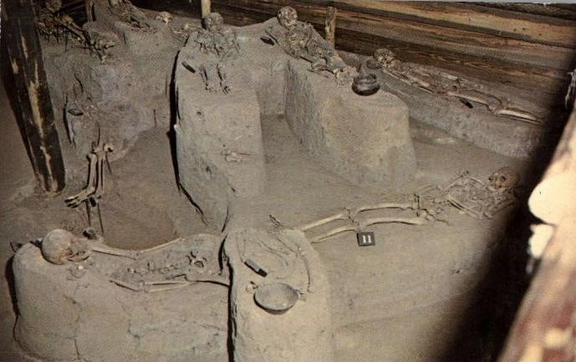
Where We Were
Memphis, TN - Chucalissa Museum Burial Exhibit

Slide 4
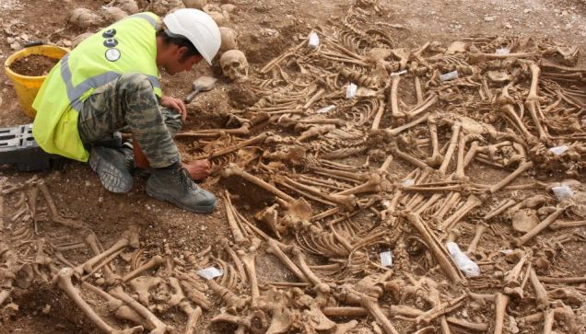
Where We Were
Dorset, England – 51 headless Viking skeletons

Slide 5
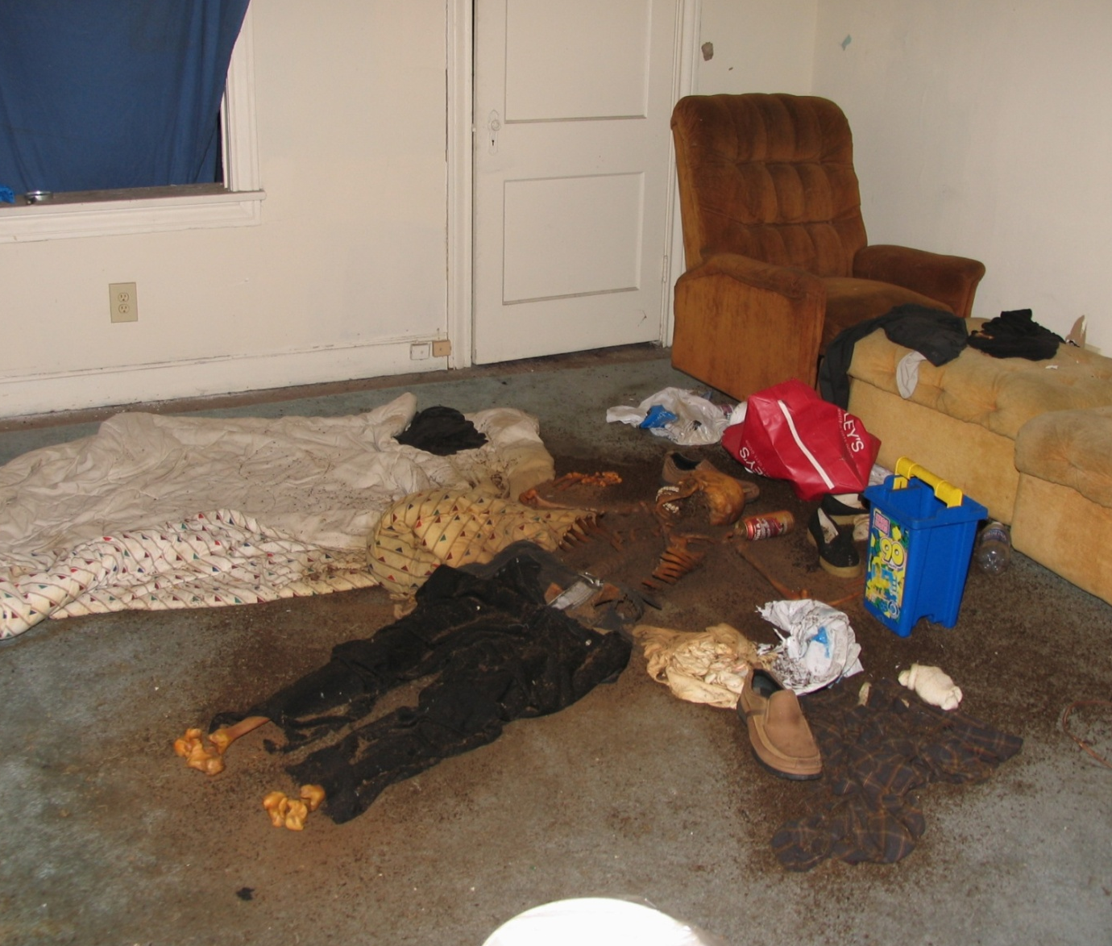
Forensic Anthropology
Houston, TN – Vacant House

Slide 6
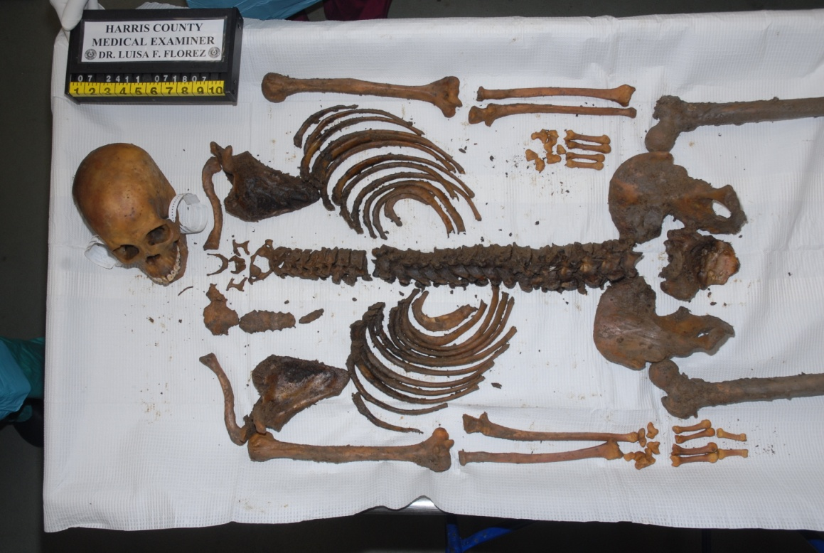
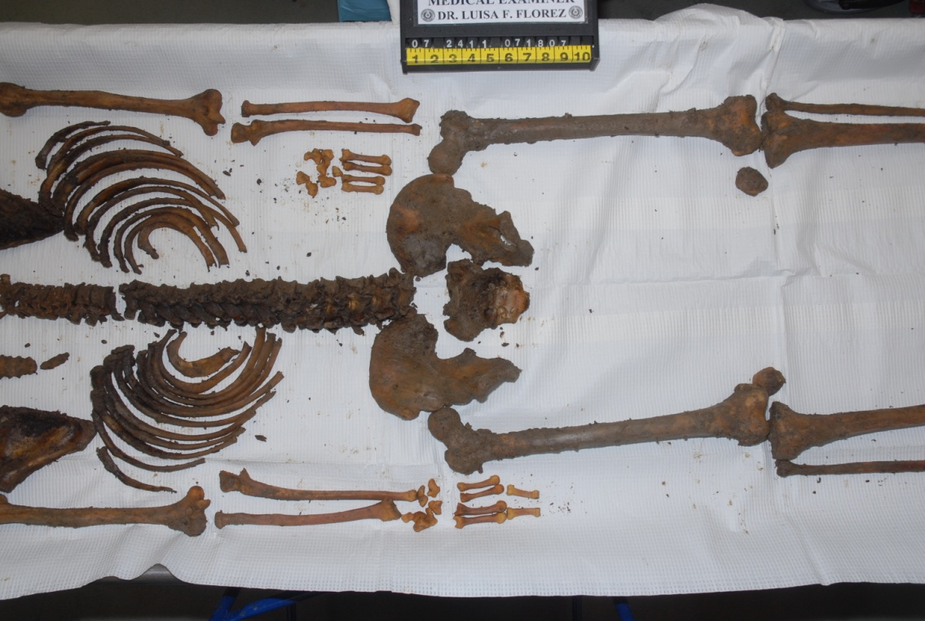
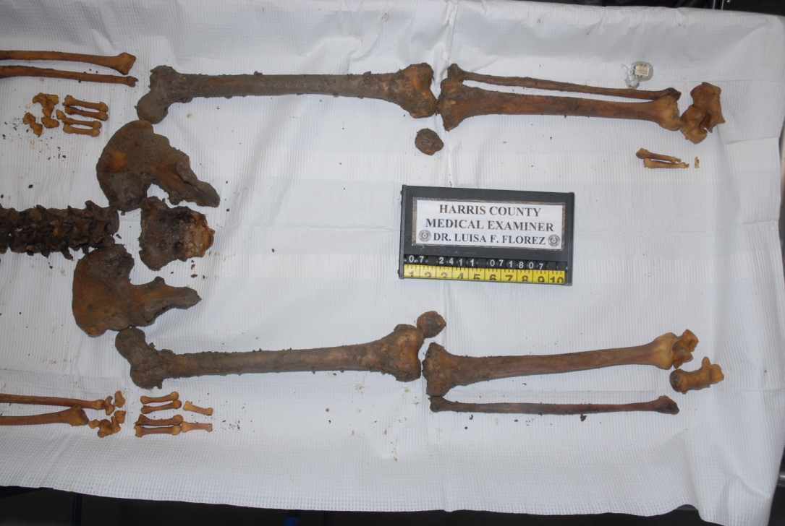
Forensic Anthropology

Slide 7
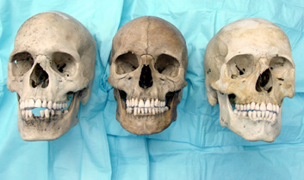
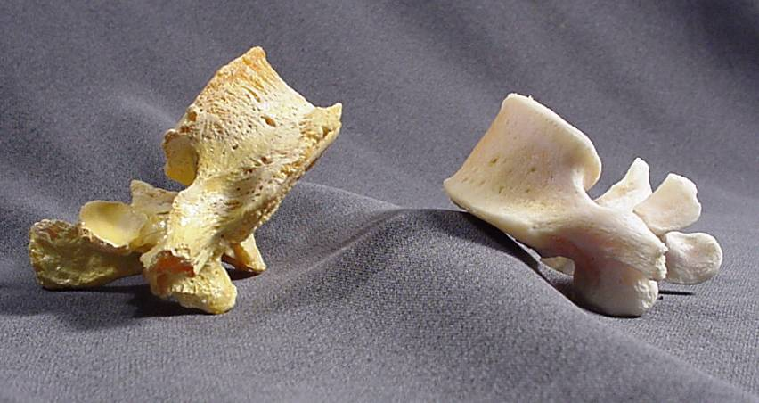
Estimating Skeletal Profile
Estimate Sex
Estimate Ancestry
Male
Female
Black White Hispanic
Estimate Age
Estimate Stature

Slide 8
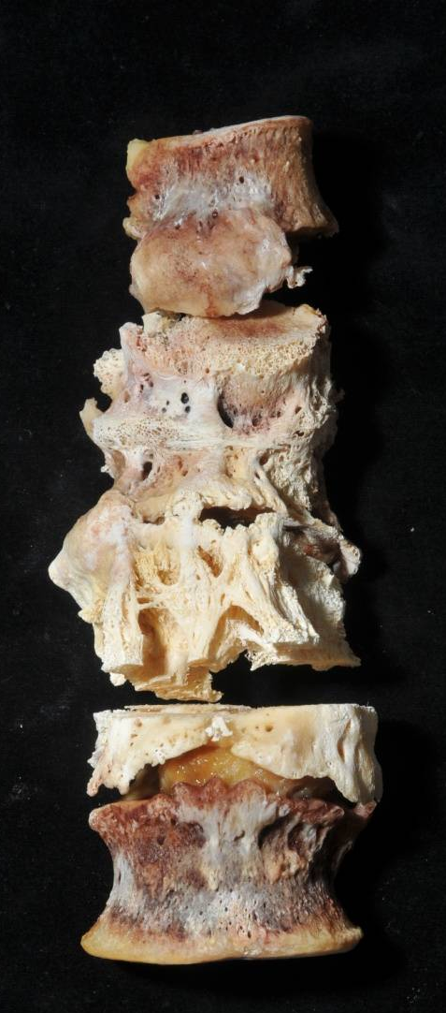
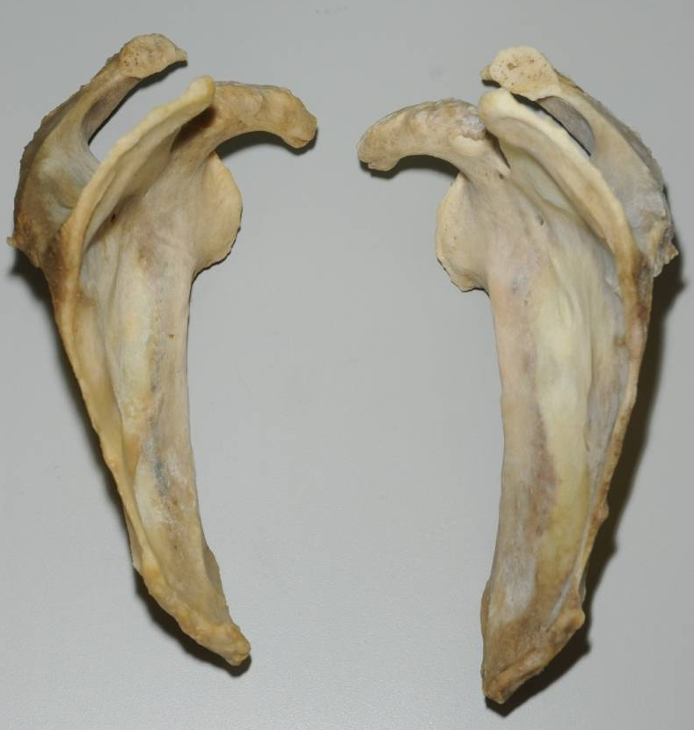
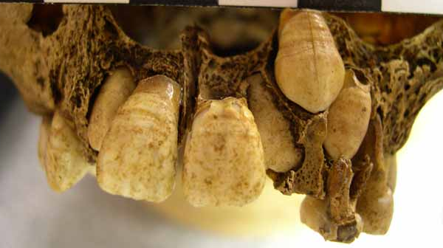
Life History
Hypoplasia
Pulmonary Deficiencies
Potts Disease –
Tuberculosis of the Spine

Slide 9
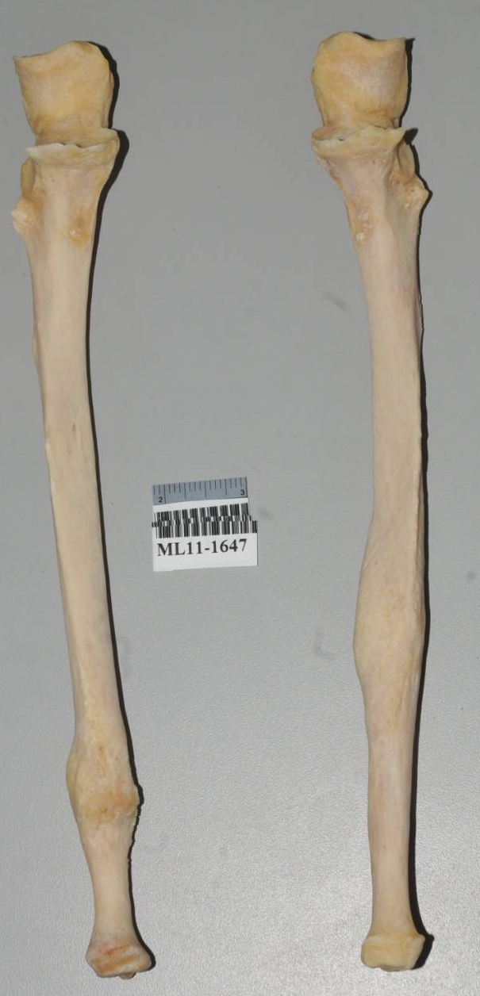
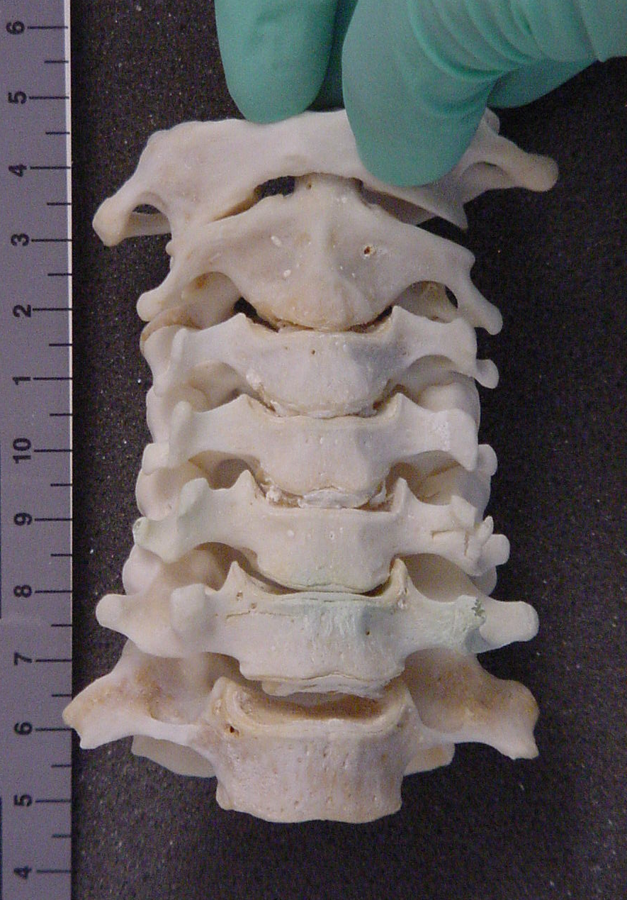
Trauma Analysis
Antemortem Trauma
Perimortem Trauma

Slide 10
Where We Were
Analysis of skeletal remains
  Creating a skeletal profile
    Ancestry
    Sex
    Age
    Stature
  Recognizing signatures of life history
  Identifying perimortem trauma
  Positive identification - skeletal radiograph

Slide 11
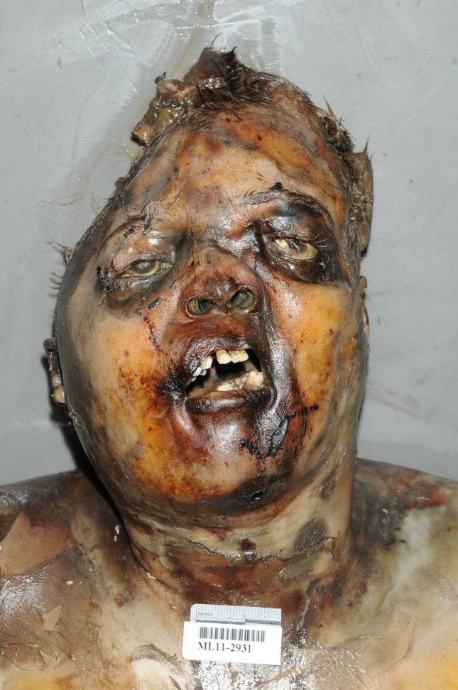
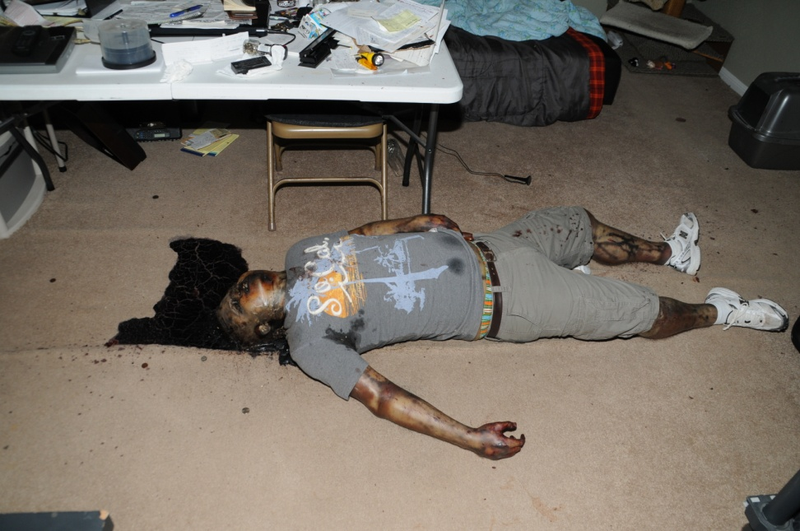
Where We Are

Slide 12
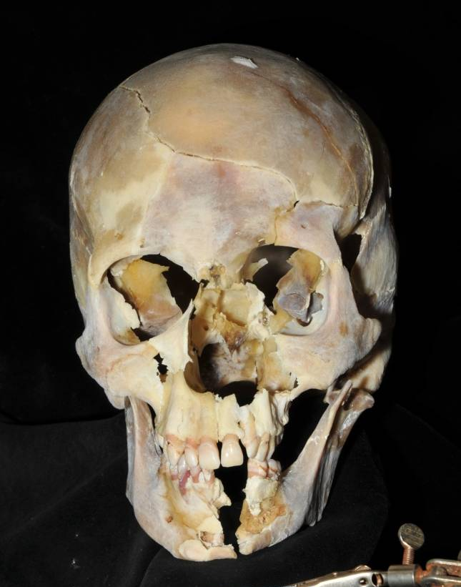
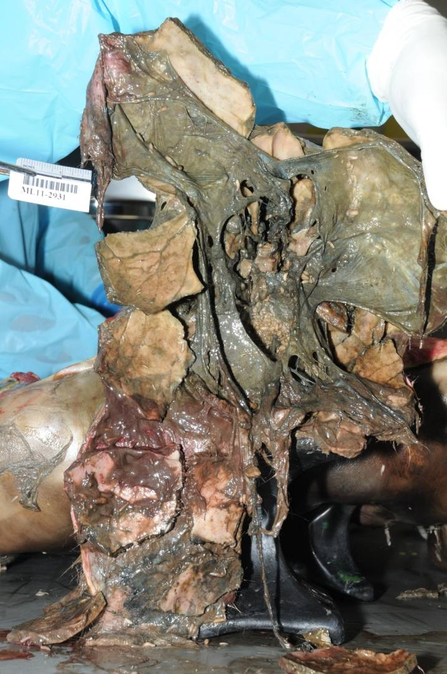
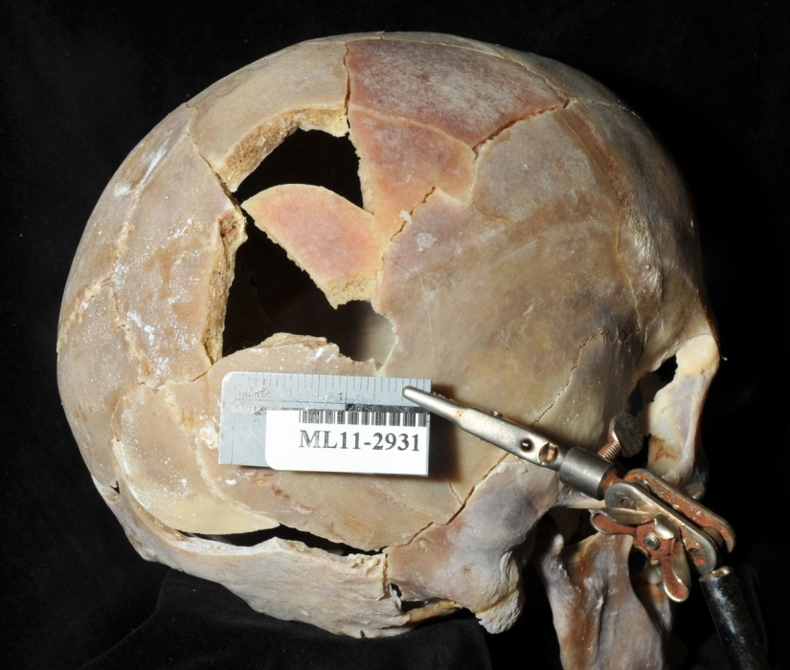

Slide 13
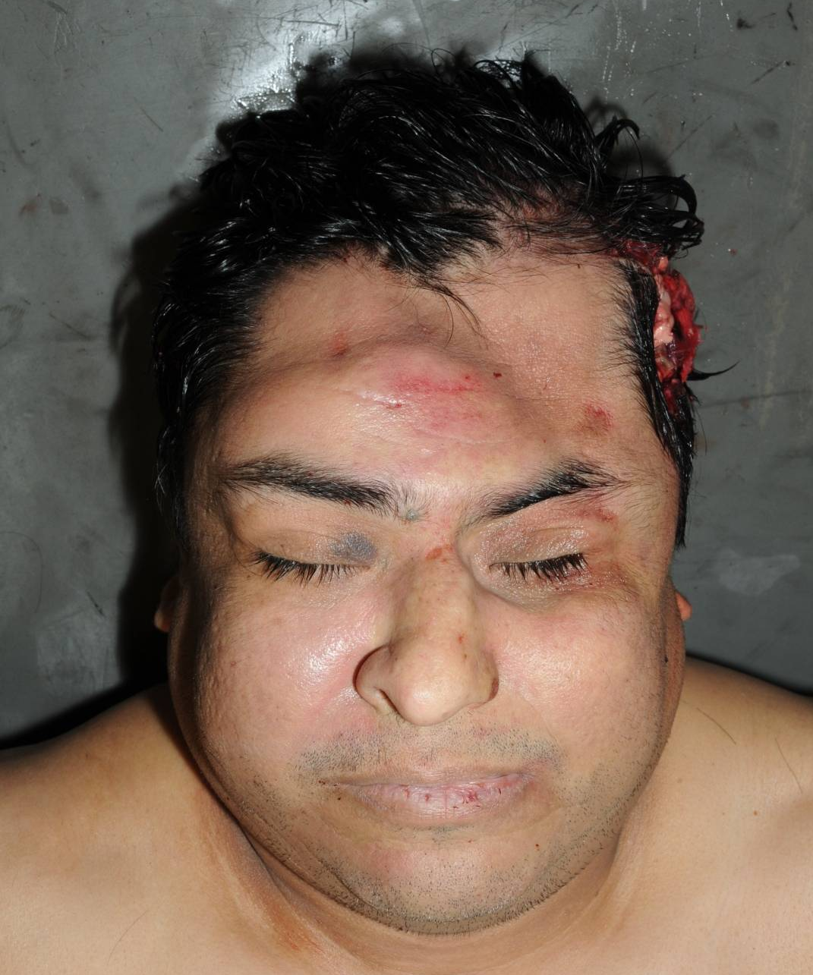
Where We Are

Slide 14
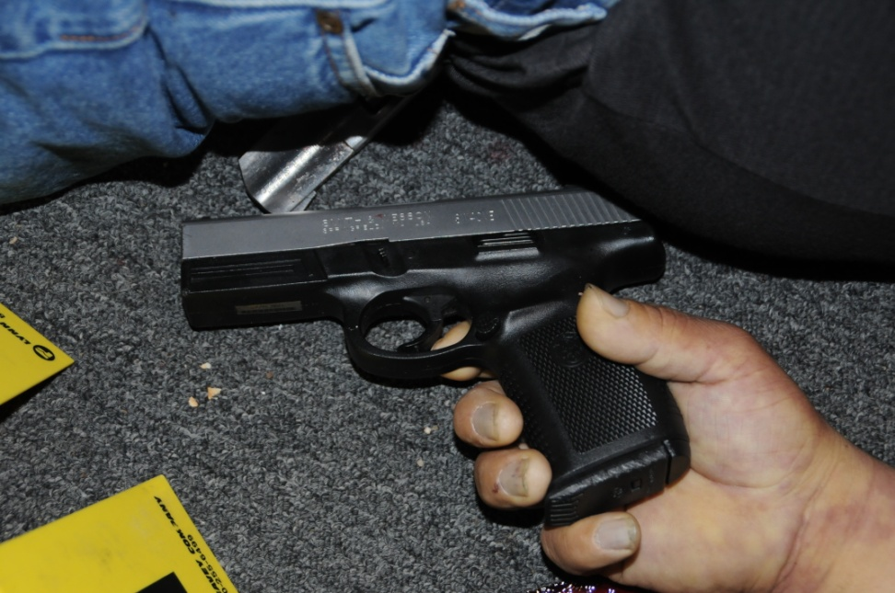
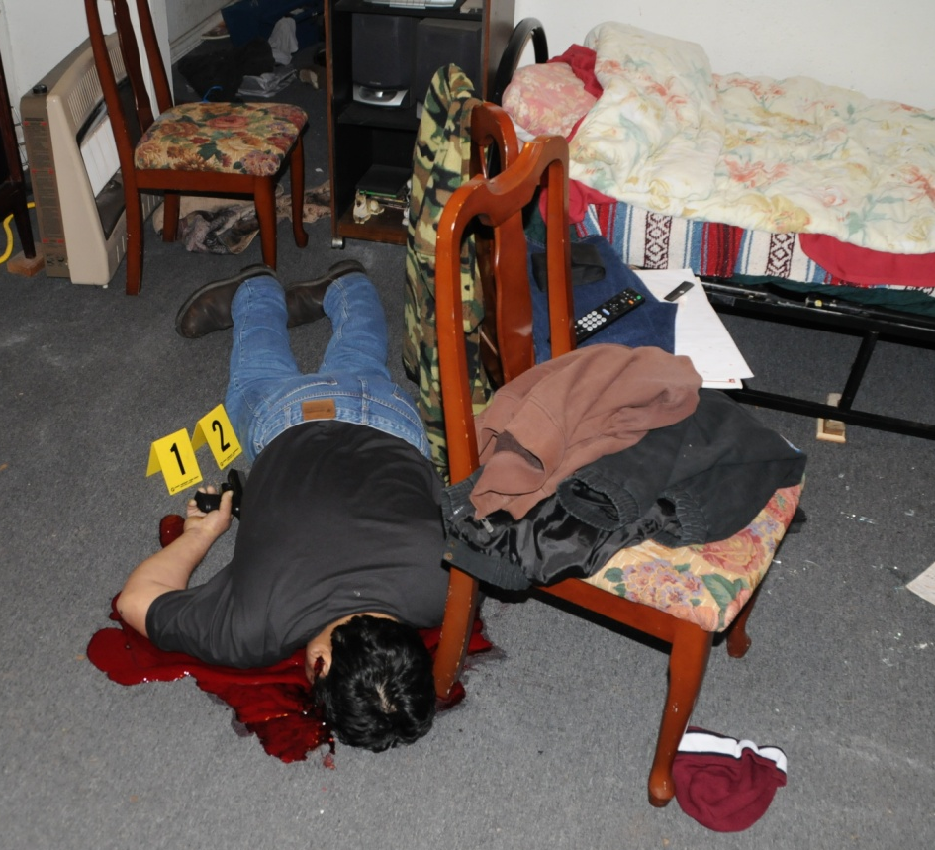
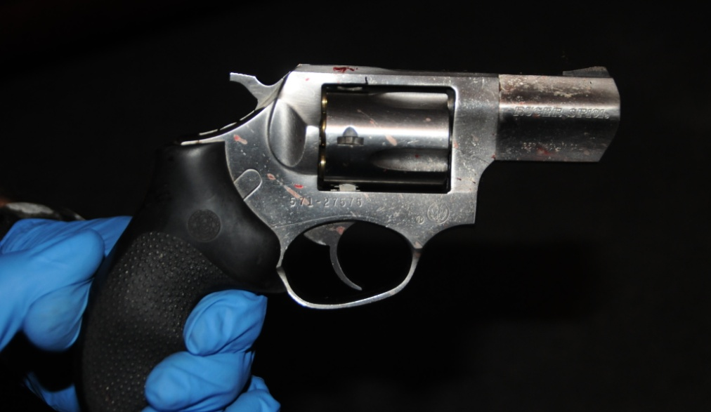

Slide 15
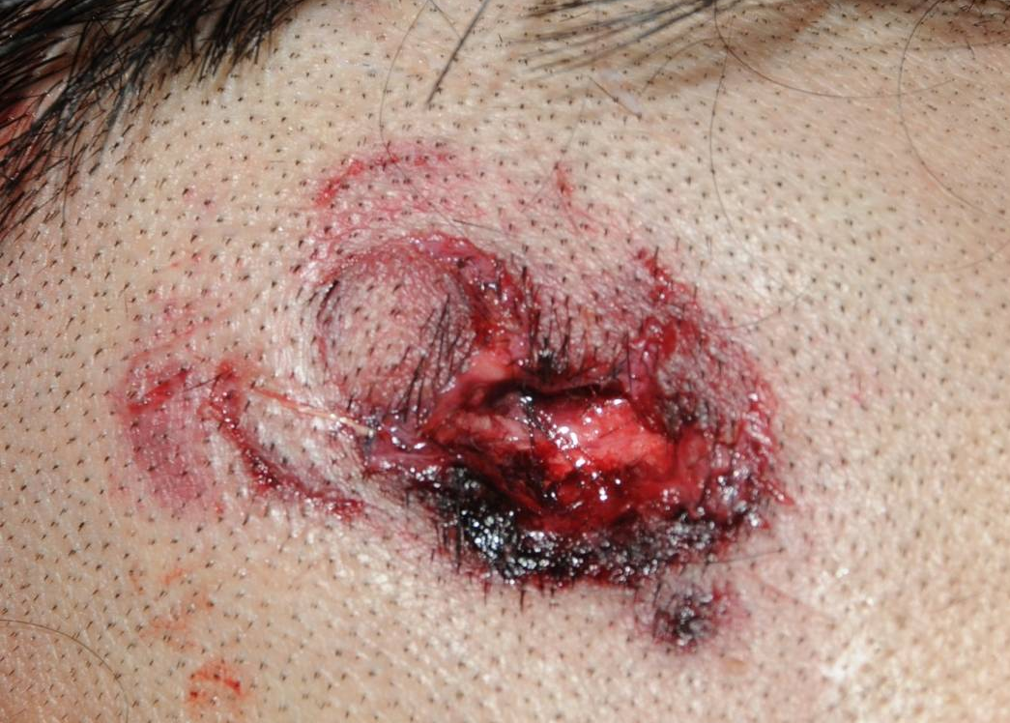
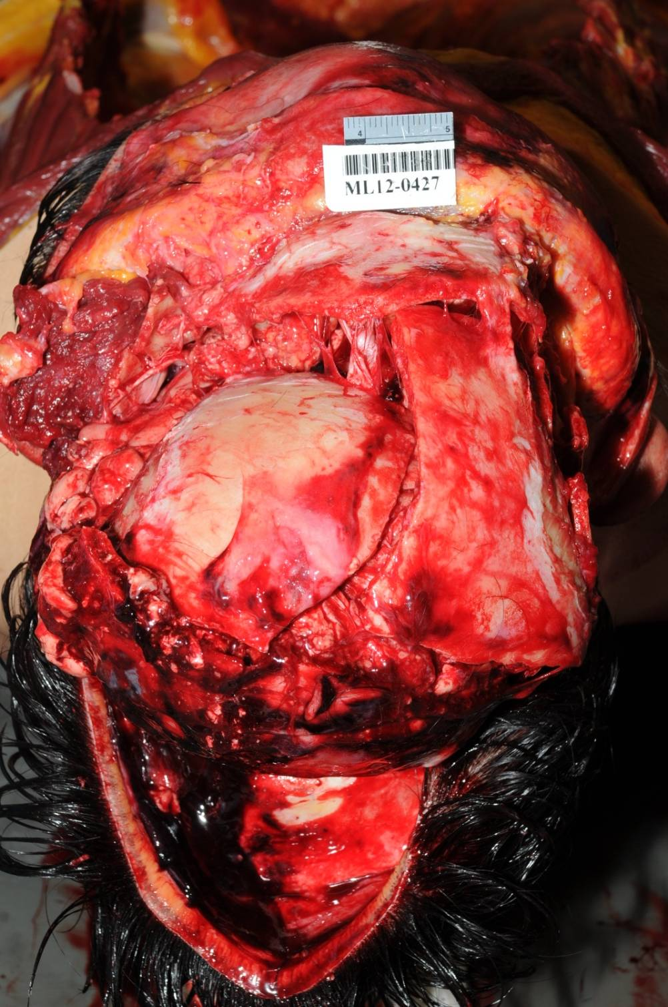
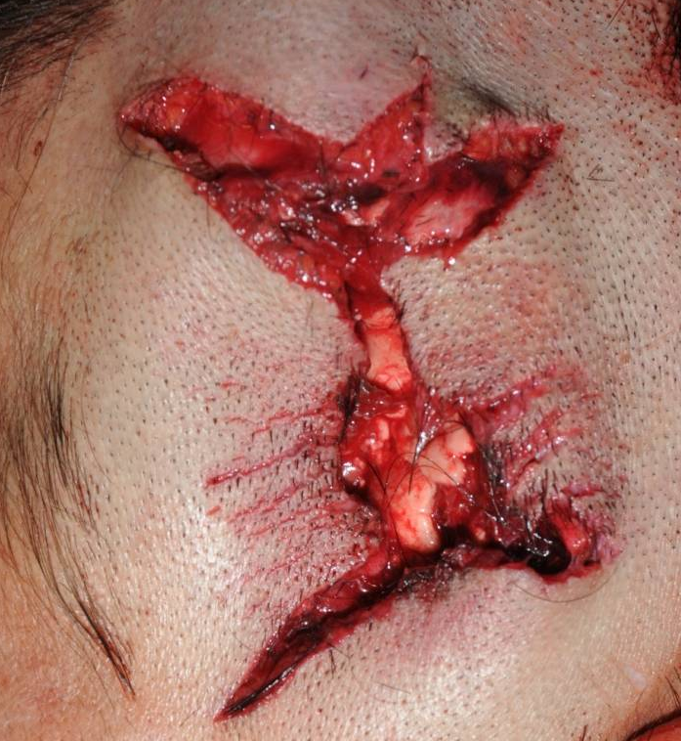

Slide 16
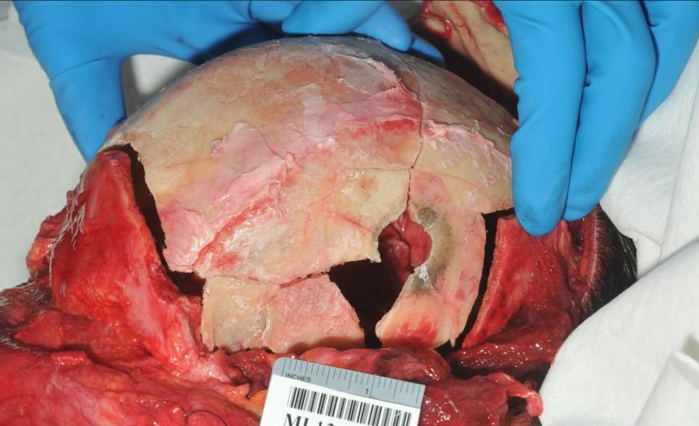
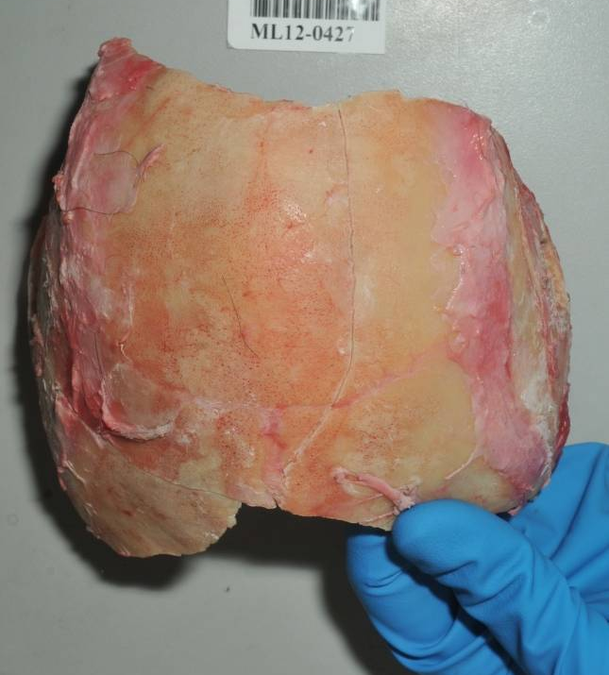
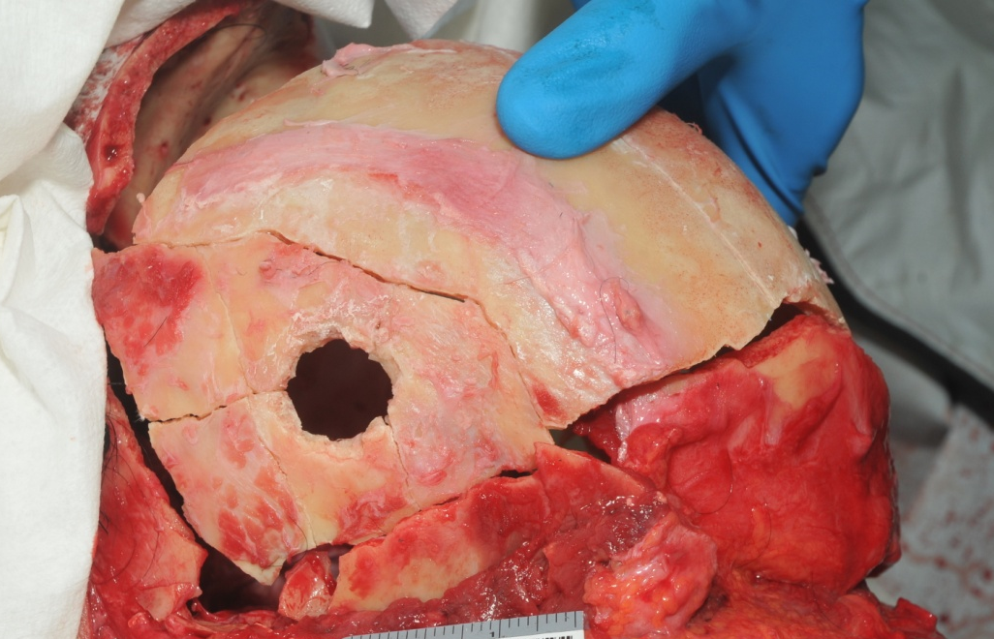

Slide 17
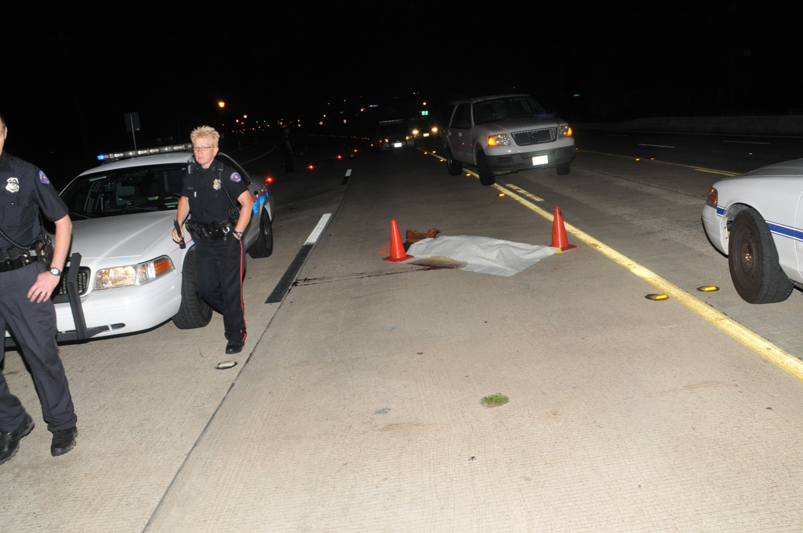
Where We Are

Slide 18
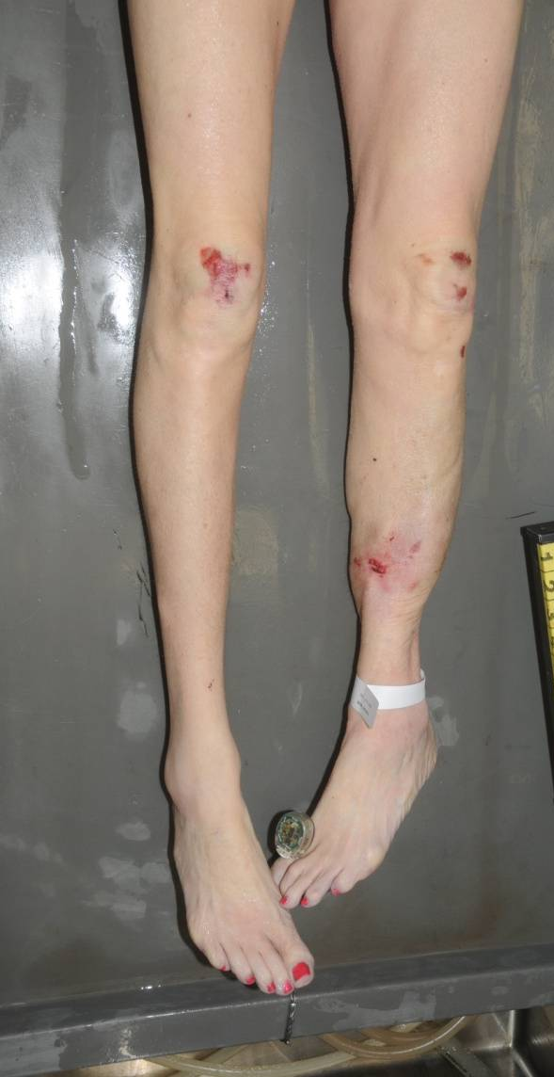
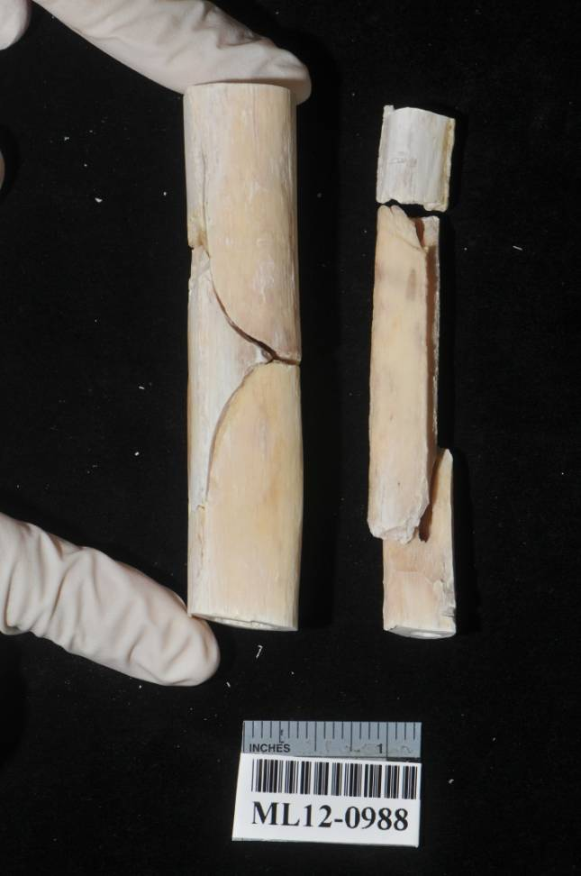

Slide 19
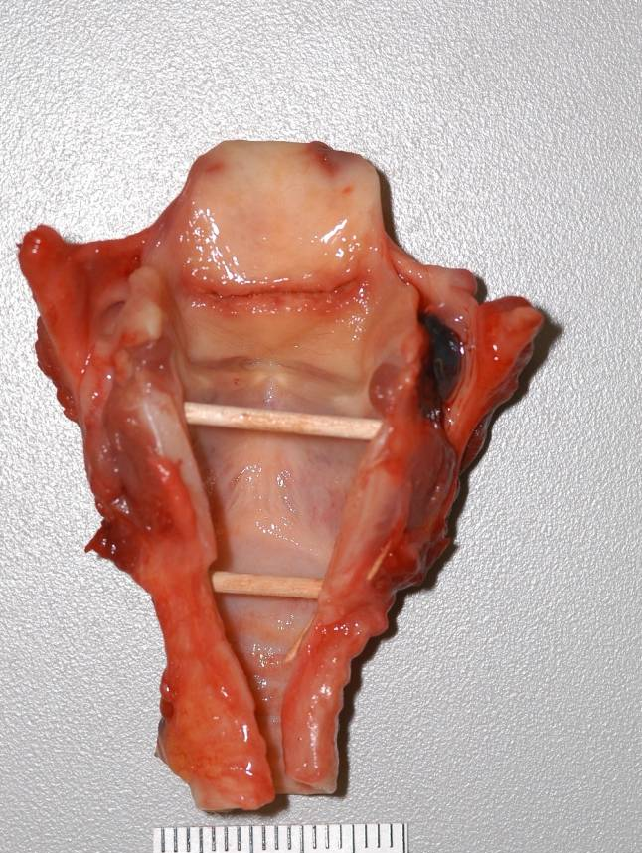
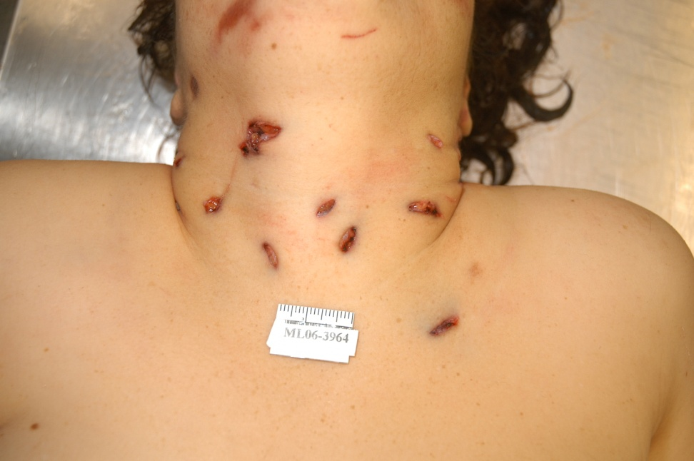
Where We Are

Slide 20
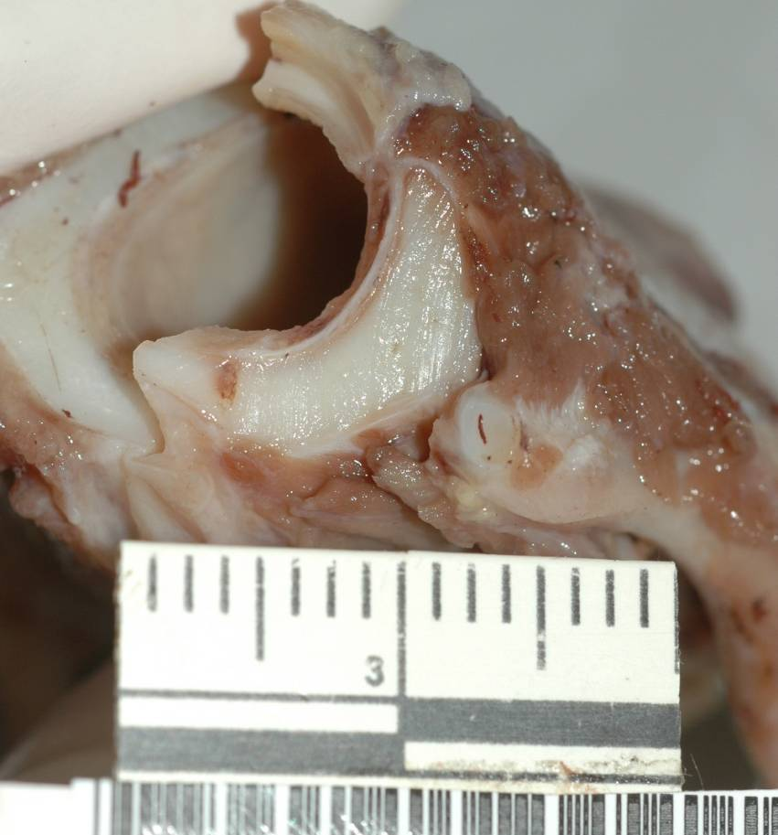
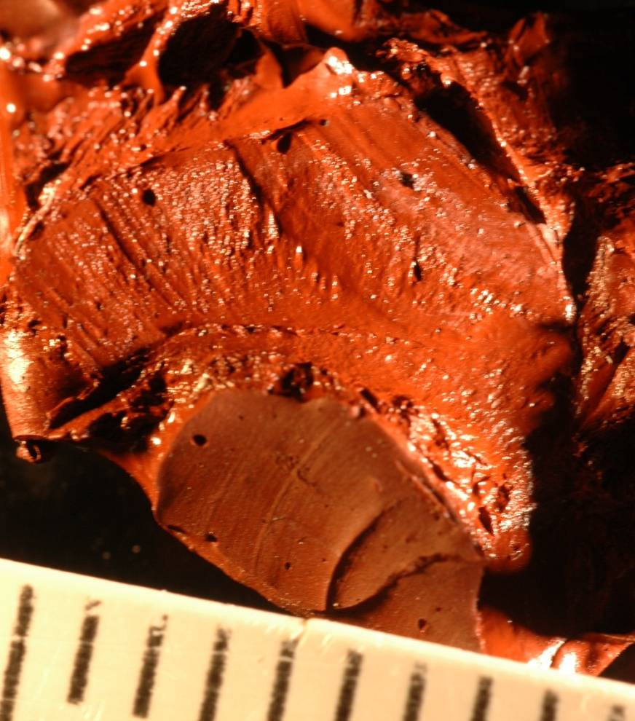

Slide 21
Where We Are – Child Abuse
Responsibilities
  Identify skeletal injuries
  Interpret skeletal injuries

Slide 22
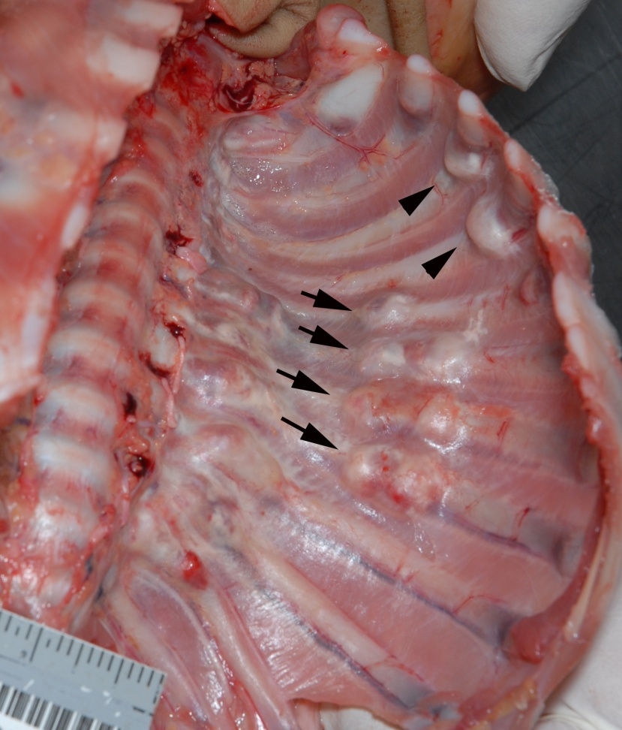
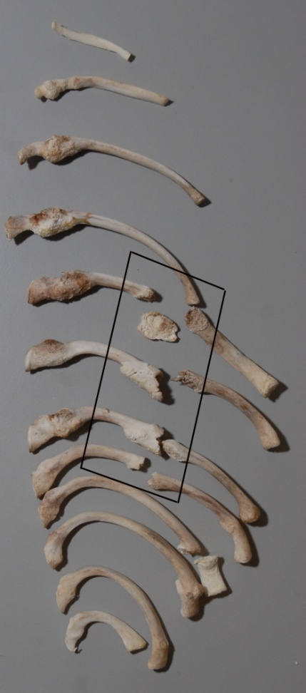
Identifying Skeletal injury

Slide 23
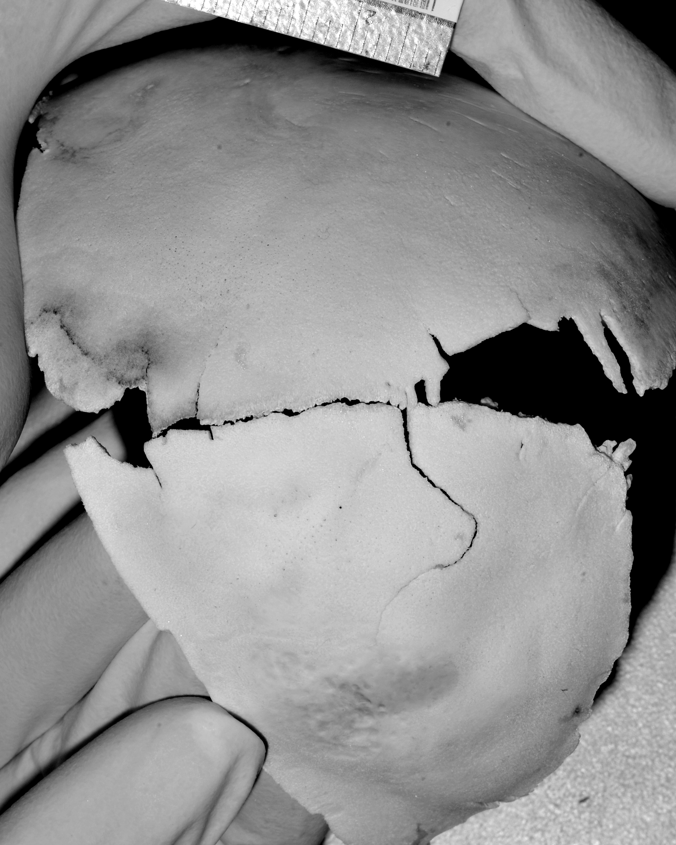
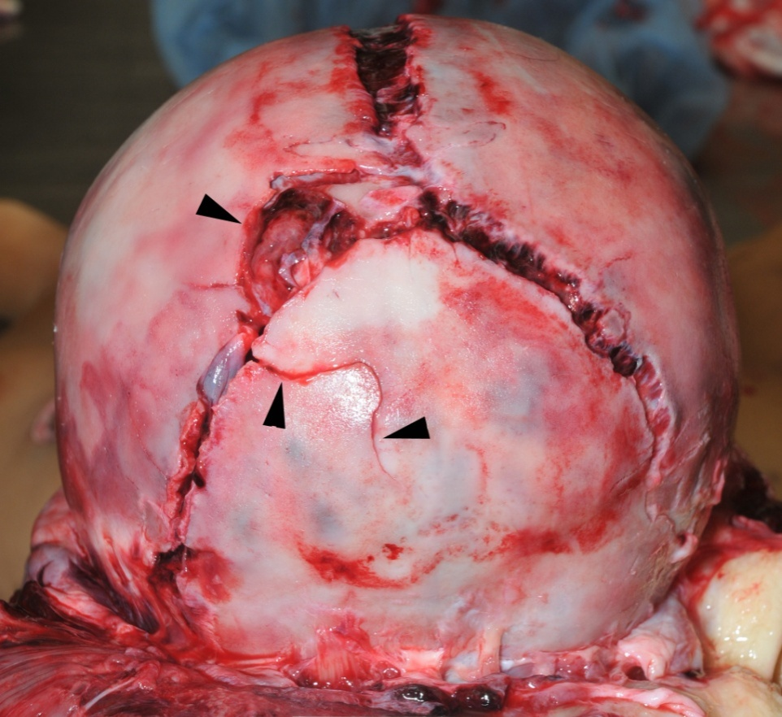
Identifying Skeletal Injury

Slide 24
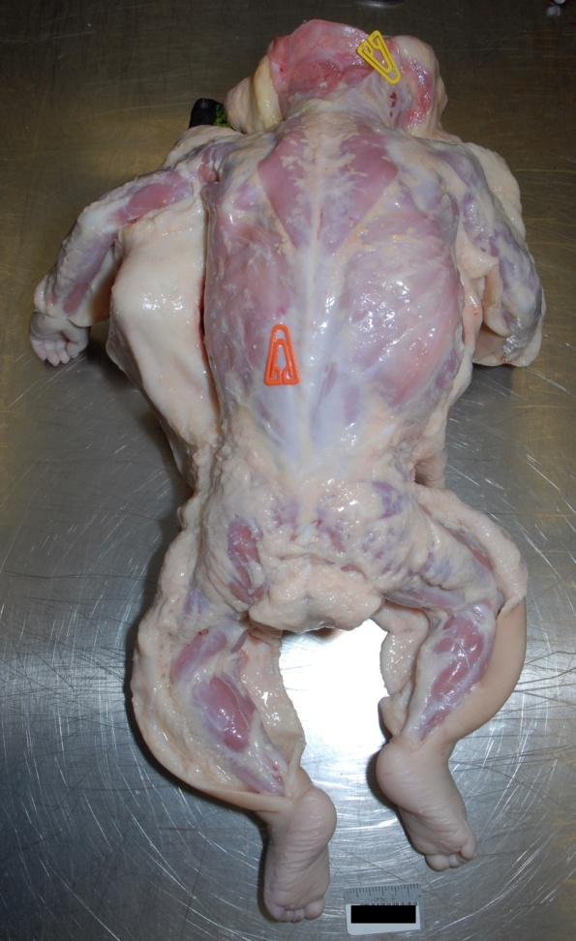
Identifying Skeletal Injury

Slide 25
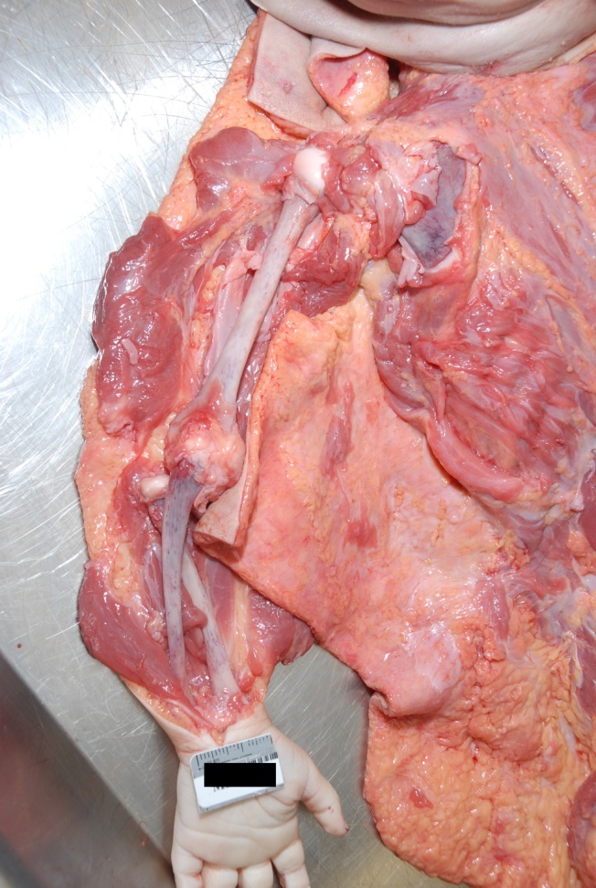
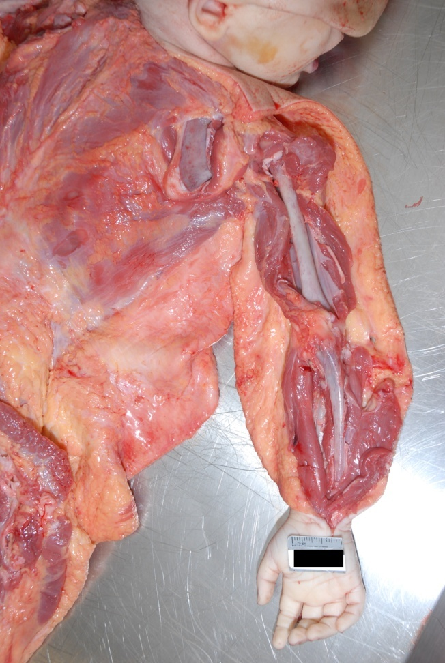
Identifying Skeletal Injury

Slide 26
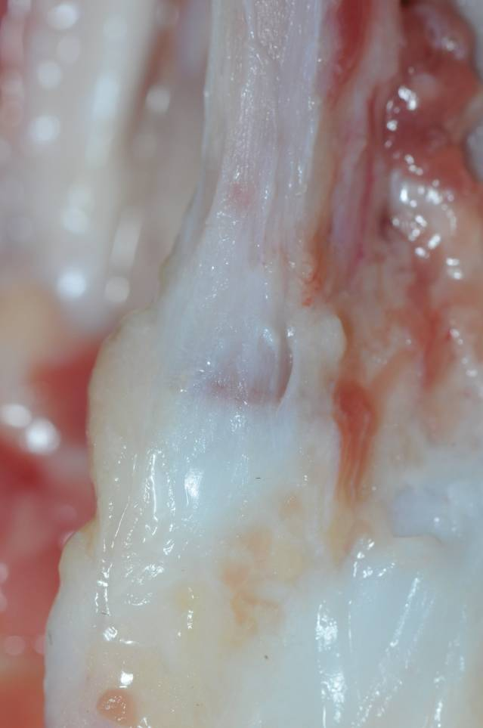
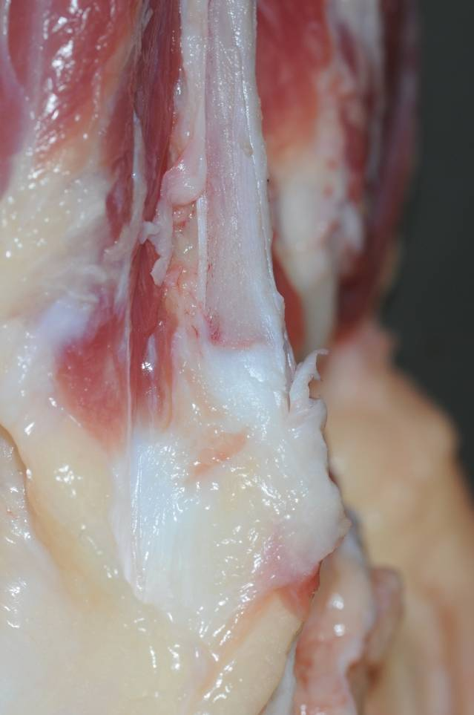
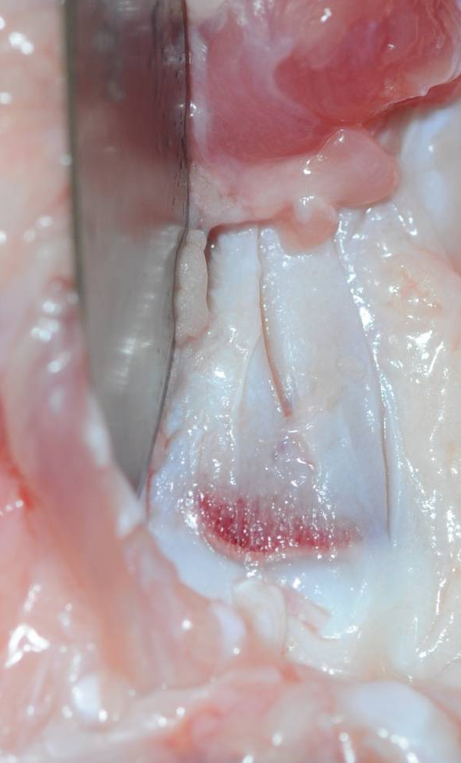
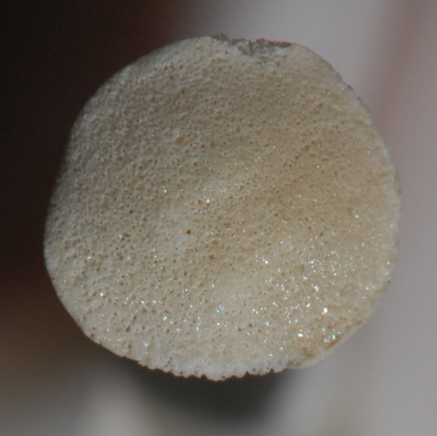
Identifying Skeletal Injury

Slide 27
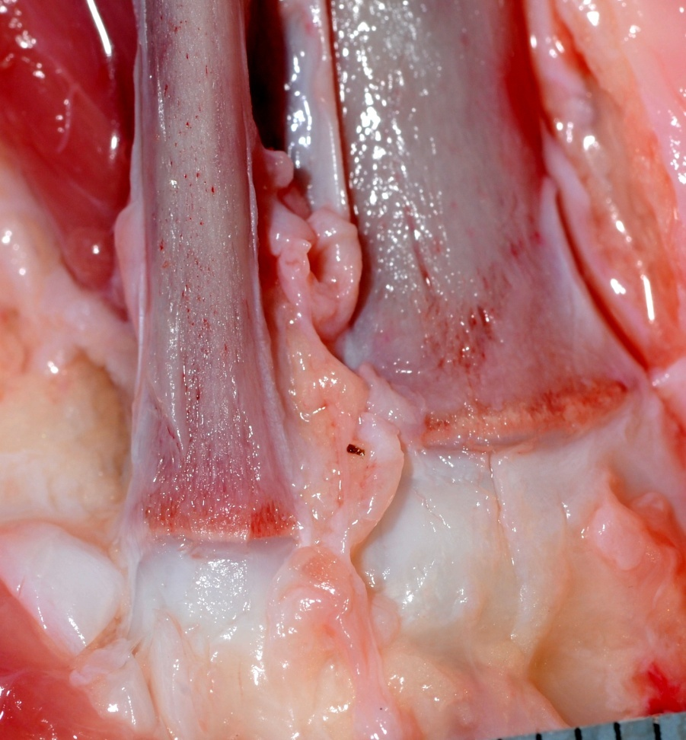
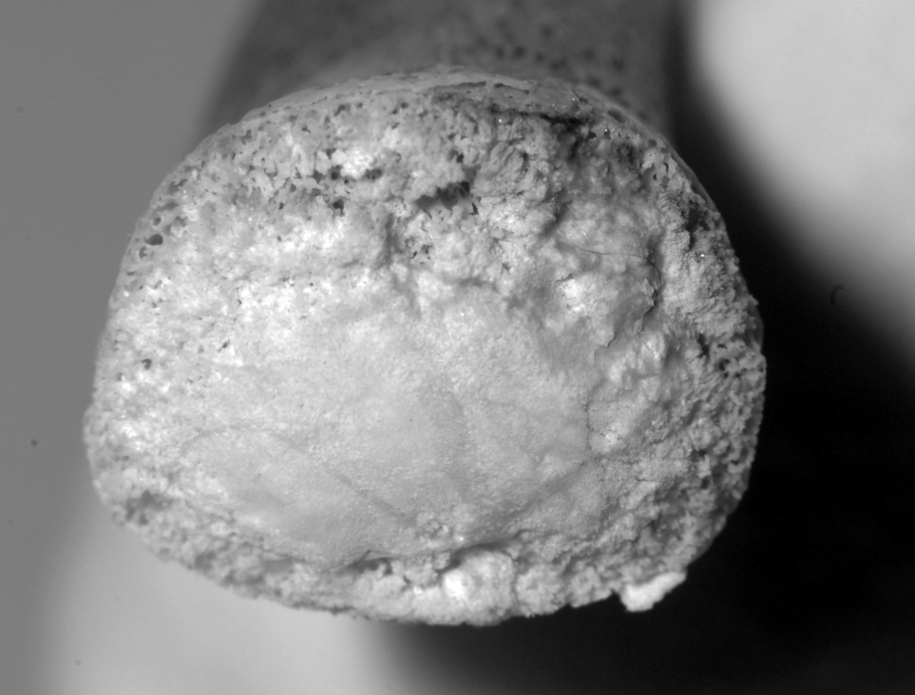
Identifying Skeletal Injury

Slide 28
Interpreting Skeletal Injury
Although the medical evidence in child abuse cases may be complex, these cases almost always involve a binary decision – were the injuries caused by abuse or accident?
  Einstein on the Bench? Moreno 2003

Slide 29
Non-Accidental Injury
Classic Metaphyseal Lesions (Bucket Handle or Corner Fractures)
Rib Fractures – Especially Posterior
Scapular Fractures
Spinous Process Fractures

Slide 30
Non-Accidental Injury
Fracture pattern inconsistent with traumatic event

Slide 31
Interpreting Skeletal Injury

Slide 32
Non-Accidental Injury
Fracture pattern inconsistent with traumatic event
Numerous fractures on various bones

Slide 33
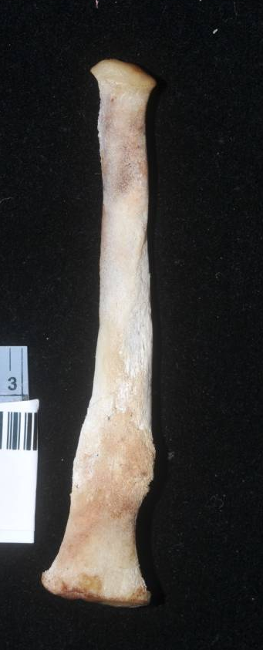
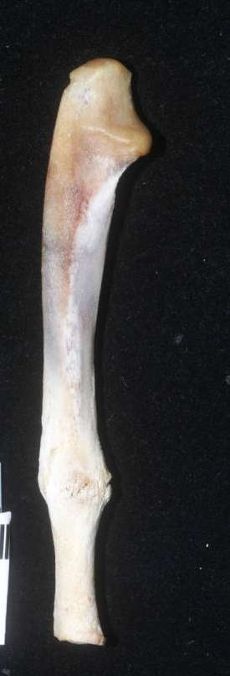


Multiple Bones Fractured

Slide 34
Non-Accidental Injury
Fracture pattern inconsistent with traumatic event
Numerous fractures on various bones
Fractures of different ages

Slide 35




Stages of Healing

Slide 36
Non-Accidental Injury
Fracture pattern inconsistent with traumatic event
Numerous fractures on various bones
Fractures of different ages
Fractures in non-ambulatory children

Slide 37

Non-Ambulatory Children

Slide 38
Anthropologic Contribution
What does anthropology bring to a child abuse case?
  Recognition of occult fractures
  Reconstruction of biomechanical forces
  Estimation of minimal number of traumatic episodes (support of battered child syndrome)
  Estimation of age of injury

Slide 39

2 Month Old Female

Slide 40

History
2 mo child found unresponsive in bed
EMS arrived at scene, bystander CPR in progress
Cluttered, unkempt residence
Bassinet filled with blankets and stuff animals

Slide 41

Autopsy Findings
Right chest ulceration
  Right chest wall abscess with extension into neck and back
  Methicillin resistant staphylococcus aureus (MSRA)
Bilateral bronchopneumonia
Sepsis
  Liver, kidney, brain, skeletal muscle

Slide 42

Anthropology Findings
Long bone fractures
  7 healing
  5 acute
Rib fractures
  4 healing
  4 acute

Slide 43


Long Bone Fractures

Slide 44


Rib Fractures - Healing

Slide 45


Rib Fractures - Acute

Slide 46

Distribution of Fractures

Slide 47
Interpretation
Minimum of two traumatic events
  First event- > 1 month prior to death
  Second event – at or near the time of death
Mechanism of injury
  Compression of chest with posterior levering
  Flailing of arms and legs
COD
  MSRA chest wall abscess with disseminated infection
Contributory COD
  Chronic stress associated with multiple blunt trauma injuries
MOD
  Homicide

Slide 48

Where We Need to Be

Slide 49
Where Do We Need to Be.
Motor vehicle accident
Fall from 4th floor window
Vs
Fall from Dinning Room Chair

Slide 50


Slide 51
Where We Need to Be.
Cross sectional studies
Experimental studies with animal models
Experimental studies with computer models

Slide 52
Cross Sectional Studies
Child trauma databases
  Injury frequencies
  Causes of injury
  Therapeutic outcome

Slide 53

Pediatric Head Injury from Falls –
Makoroff (Cincinnati Children’s Hospital)

Slide 54
Cross Sectional Study - Prospective
N=85 infants; 28% rib fractures

Slide 55

Cross Sectional Study - Prospective
Bone density study
  Bone compromised by an undetected syndrome
Measure bone density in all decedents under the age of two years.
  Radiological parameters
  Quantitative Ultrasound
  Bone histomorphology

Slide 56


Experimental Studies – Animal Models
Fracture Patterns on the Infant Porcine Skull Following Severe Blunt Impact
  Fracture patterns resulting from ridge and compliant interfaces
  Predictable pattern

Slide 57


Slide 58

Experimental Studies – Computer Models
Shaken Baby Syndrome
  Rangarajan et al 2009
    Created a model of the eye
    Dimensions of the eye obtained from CT of infants
    Measured the forces generated by biofidelic infant dummy subjected to shaking by an adult
    Created finite elemental model to identify and measure the distribution of forces
Aprica 2.5kg Dummy
Notes:
CT of infants taken for non-retinol hemorrhage concerns that were not present

Slide 59

Experimental Studies – Computer Models
CRABI Dummy – 6 mo
  Van Ee 2008
    Anterior /posterior human shaking in the sagittal plane
    Head acceleration and force levels are much lower than those which are associated with traumatic head injury
  Rangarajan and Shams 2010
    CRABI does not move like human child when dropped
    Thorax, shoulder, pelvis etc. are not designed to provide biofidelic responses
    Several design features prevent it from displaying human-like kinematics

Slide 60
Conclusion
Progress
  Expended from skeletal remains
    Significant role in diverse medicolegal cases
Future
  Research, research, research

