Slide 1





Texas Department of Public Safety
Crime Laboratory Services MSC 0460
Forensic Document Section
PO Box 4143
5805 N. Lamar Blvd.
Austin, TX 78765-4143
(512) 424-2105 Phone
(512) 424-5642 Fax
Dale Stobaugh,
Supervisor
E-MAIL:
Dale.Stobaugh@dps.texas.gov
Jennifer Land
Forensic Scientist
E-MAIL: Jennifer.Land@dps.texas.gov
Erin Gruene
Forensic Scientist
E-MAIL:
Erin.Gruene@dps.texas.gov
Nathan Calderon
Forensic Scientist
E-MAIL:
Nathan.Calderon@dps.texas.gov
Notes:
Computer Forensics VS Audio/Video portions of DME

Slide 2
DIGITAL MULTIMEDIA EVIDENCE EXAMINATION
(Computer Forensics)

Slide 3
The Division of DME
According to The American Society of Crime Lab Directors-Lab Accreditation Board (ASCLD-LAB), digital multimedia evidence is subsequently divided into three concentrations:
Digital Multimedia Evidence
Digital Media Analysis/Computer Forensics
(QD Section)
Imaging
(Photography Section)
Audio/Video
(Photography Section)
This division also represents how computer and audio/visual evidence is distributed within the crime laboratory

Slide 4
Our role in Digital Multimedia Evidence Analysis
Computer Forensics
Preserve data on the media submitted
Make an exact “image” of the data (bit for bit copy), whenever possible
Examine and search the “image” copy of the evidence
Notes:
Hardware write-blocker
Examination of deleted areas not accessible to user (deleted but not yet overwritten)
We are presented with some limitations in making a pristine image of some devices, most commonly cellular telephones.

Slide 5
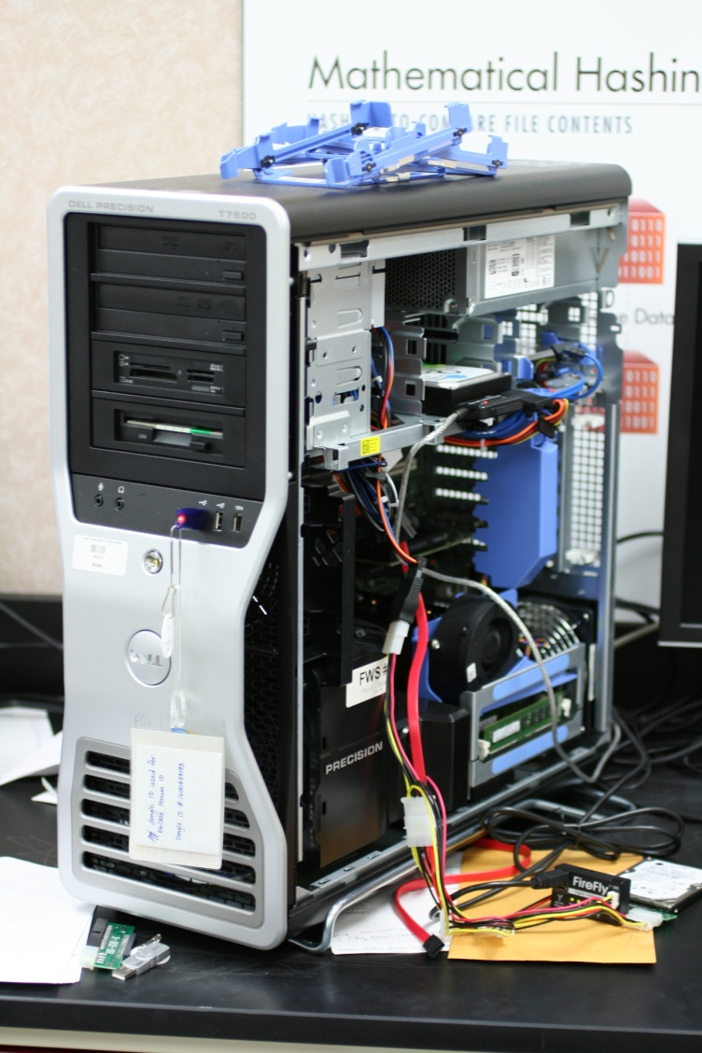
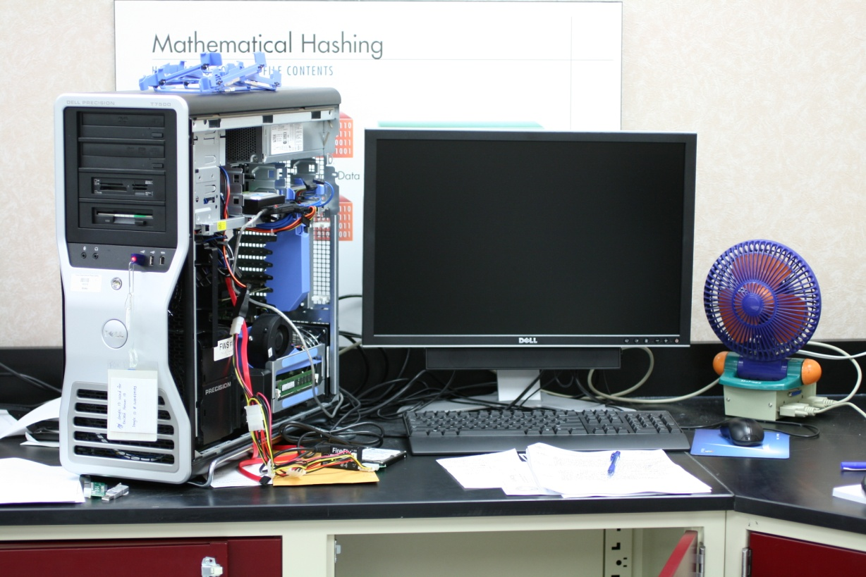
Forensic Workstations
Forensic Analysis Machines or Forensic Workstations

Slide 6
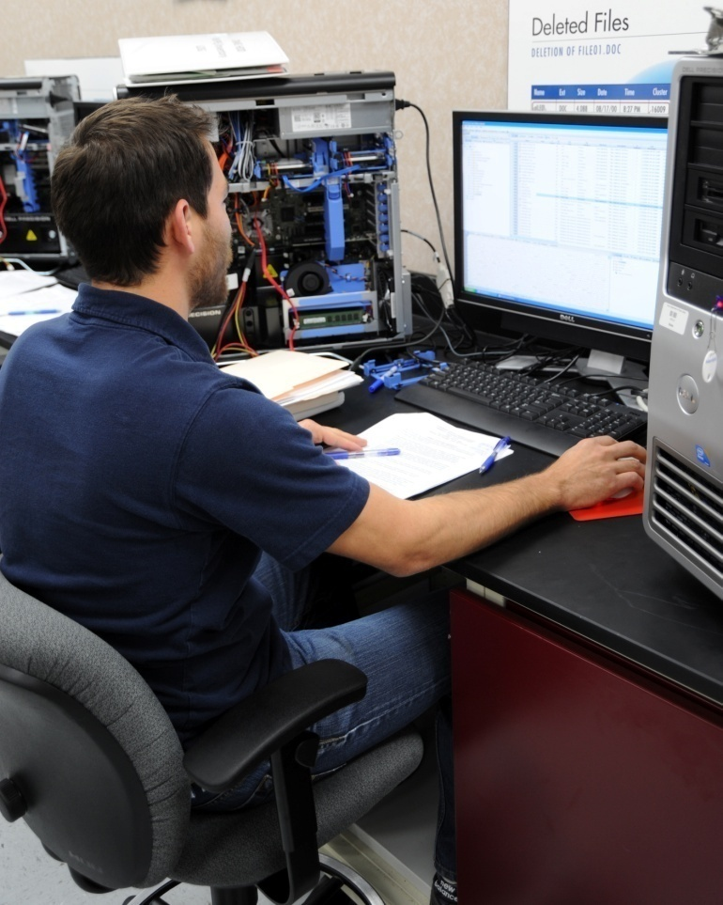

Specialized, Forensically-tested software is used
Use of Guidance Software’s EnCase on Windows analysis machine
Use of BlackBag Technologies Forensic Suite on Mac analysis machine

Slide 7
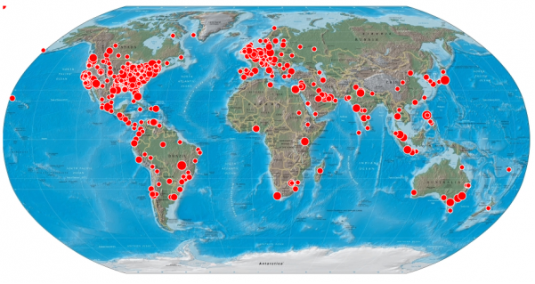
What is Digital Evidence and How is it Different?
Information and data of investigative value that is stored on or transmitted by an electronic device
Can transcend borders quickly via Internet
Data in computer systems is highly susceptible to alteration or destruction
Caution must be exercised when collecting, transporting, examining and storing this type of evidence to avoid data loss
Special training, skills, equipment, and software are needed to retrieve evidence stored within computers and computer media to avoid alteration or destruction
Notes:
Data in computer systems is usually stored in electromagnetic or electronic form. These types of storage are highly susceptible to alteration or destruction.
Caution must be exercised when collecting, transporting, examining and storing this type of evidence to avoid the loss of evidence and intellectual property.

Slide 8
Digital Evidence at the Crime Scene - Considerations
Search Warrant / Consent to Search
Identifying Evidence to be Collected
Documentation, Collection, Preservation of Evidence
Transporting Evidence to the Laboratory

Slide 9
Search Warrant / Consent to Search
DPS Crime Lab Policy is to have copy of the search warrant or consent to search form before examination can begin
Specific wording not only to seize the media but also to access data stored within the media…there is a difference
  This requirement provides protection at the time of trial preventing the examiner of the evidence from unlawful search of the data contained on the items submitted. This is an example of how digital evidence differs from other types of evidence that can be seen “in plain sight”. A search warrant to collect possible evidence of a crime at the scene typically covers the evidence you can walk into a room and see or touch. It is a more intrusive search to get into a laptop, remove the hard drive and examine (search) for evidence of a crime.
Go-bys are available from the DPS Lab
A common misconception about the search warrant “return” to the issuing Judge: officers often ask if we can begin examination within that return time. When in fact, the evidence merely needs to be submitted to the lab within that return deadline to the Judge.
Notes:
The policy to require a search warrant before examination begins serves as protection from conducting an illegal search and helps to prevent the evidence ascertained from the examination from being kept out of court.

Slide 10
Types of electronic devices or MEDIA that may contain digital evidence
Personal computer, laptop
External hard drives (USB connection)
DVD, CD, floppy disks
Flash drives (thumb, USB)
Memory sticks
Digital cameras
SD Cards
Personal Data Assistants (PDAs, iPods, Palm)
Cellular phones
MP3 Players
Smart Phones (Blackberry/iPhone/Android)
iPads, tablets
Many unusual pieces of media

Slide 11
Other Items of Evidence at Scene
Computer media relevant to crime
Documents surrounding computer
Documents in the printer, scanner, trash
Web camera (usually on top of monitor)
PDA, cell phones with charger/data cable
Related software
Related cables / power cords / chargers

Slide 12
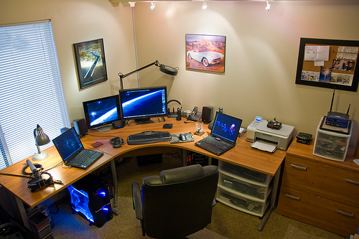
Home or Business Office
http://atlantasmall.biz/

Slide 13
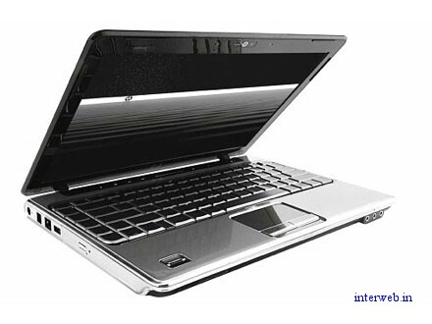
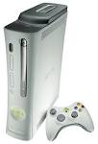

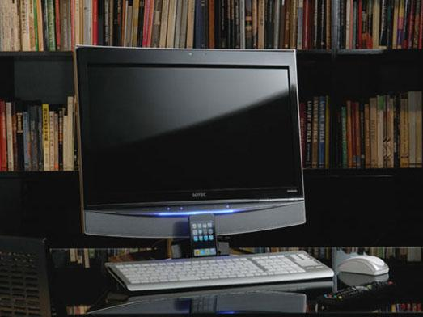


Digital Media Examples
External drives / disks
External drives/devices

Slide 14
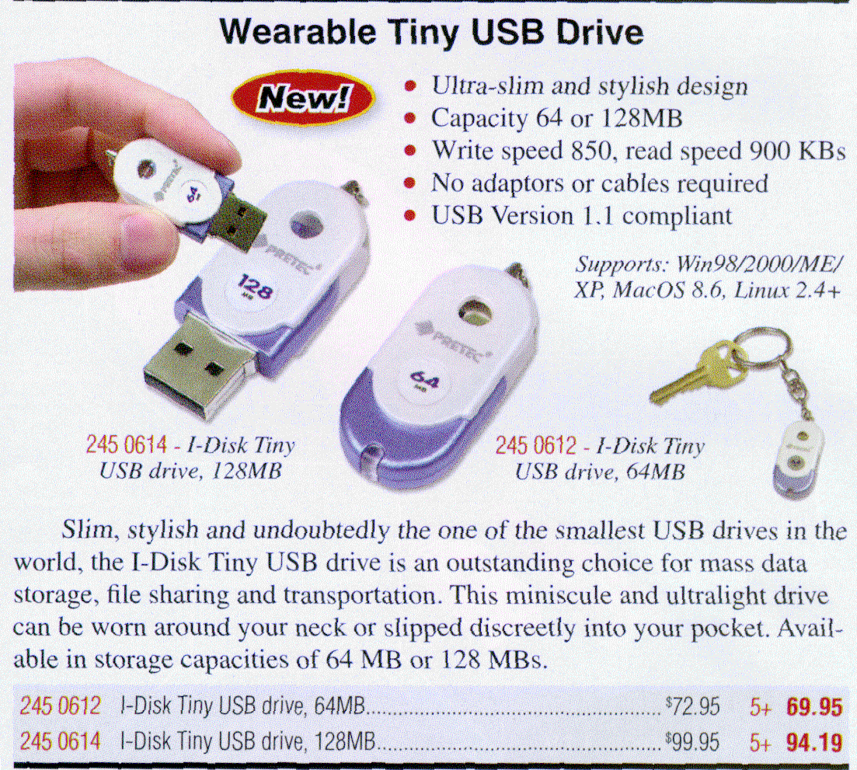
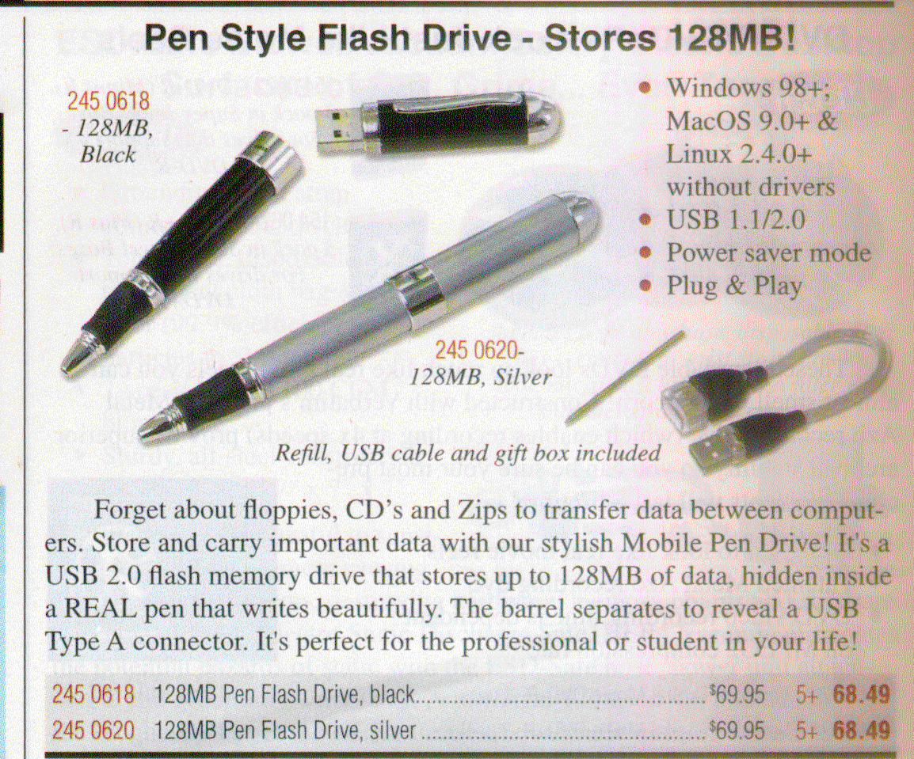

Unusual Digital Media Examples
USB devices can be disguised or hidden in any number of everyday items.
Micro/Solid State Drive

Slide 15
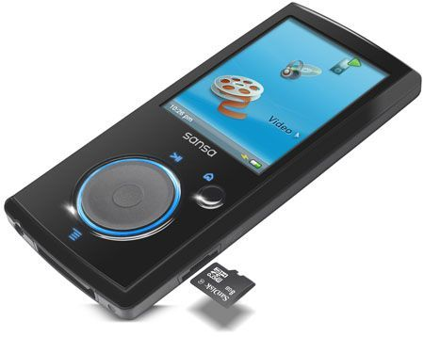
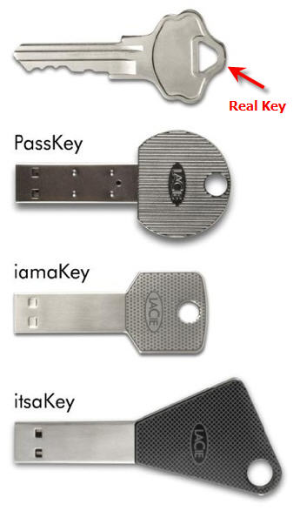
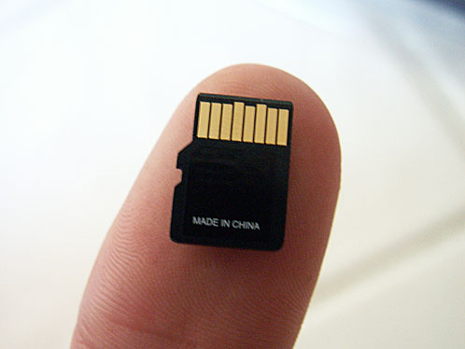
Extremely concealable media, can be found & stored anywhere…
USB Devices
Sansa Video Player
Micro SD Card
http://china.getusb.info/?s=%E4%BD%A0

Slide 16
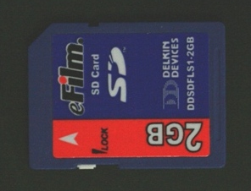
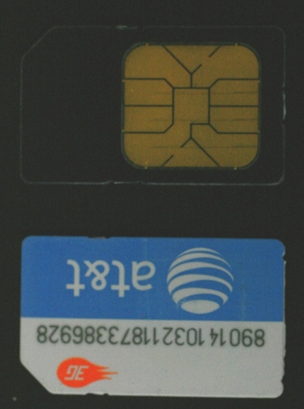
DATA STORAGE DEVICES
SIM Card from Cellular Phone
SD Card from Digital Camera

Slide 17
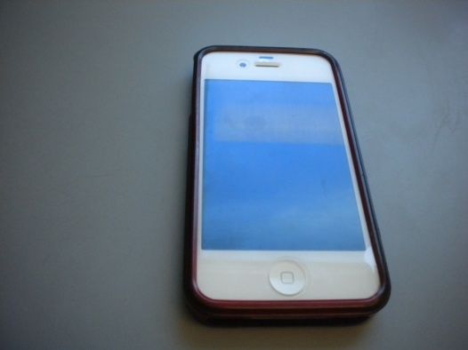
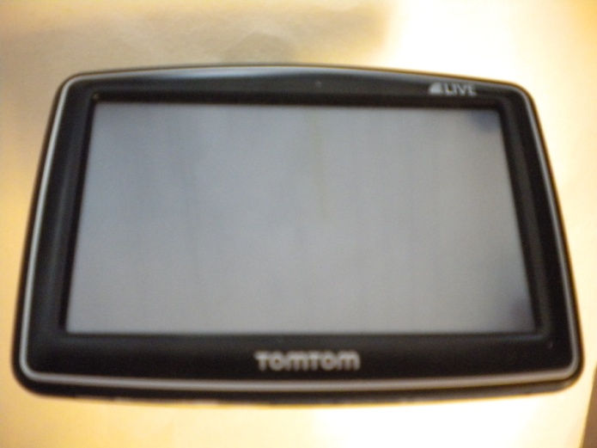
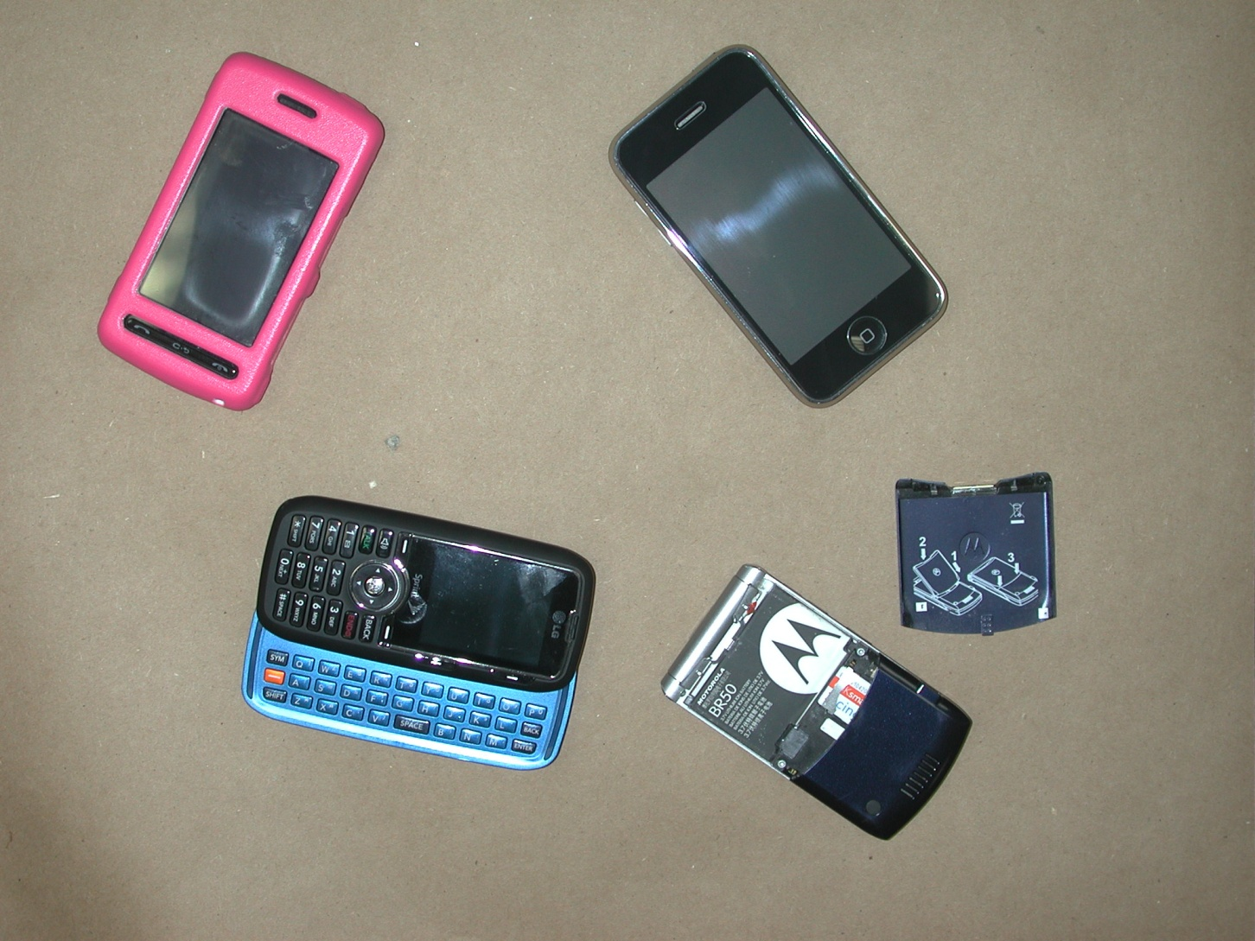
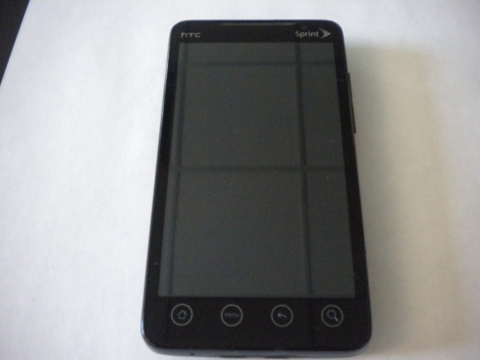
SMART PHONES and
GPS DEVICES

Slide 18
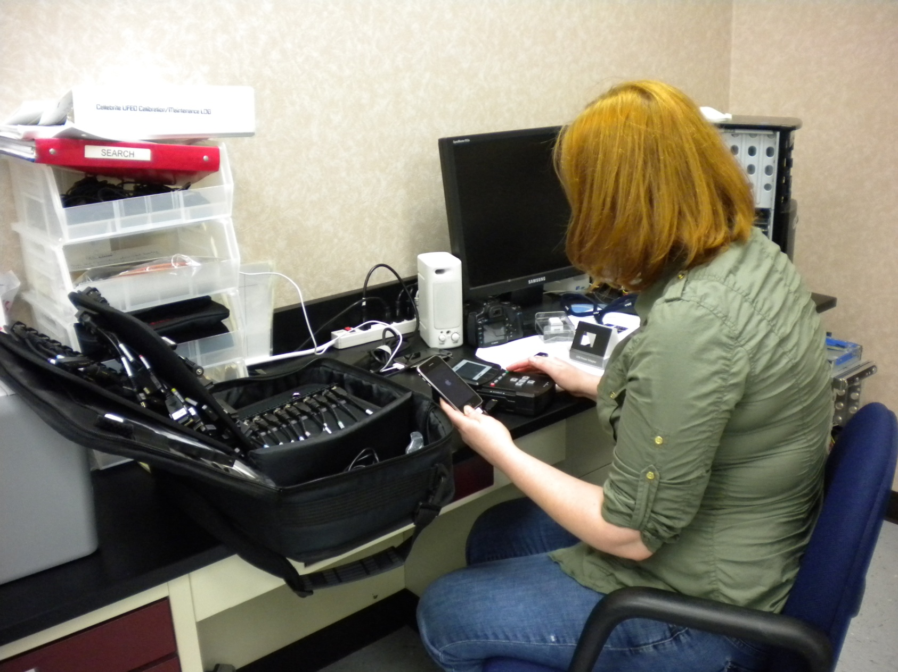
Use of CelleBrite UFED to extract evidence from a cell phone
Notes:
Cell phone examination is not necessarily always a “forensic” process.
Careful documentation is necessary, communication with officer/prosecutor is key.

Slide 19
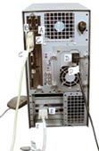
Collection of Evidence
Generally, if the device is OFF, leave it OFF.
Computer collection versus Mobile device collection
Possibility of mobile device connecting to the service provider’s network
  Erase data
  New messages overwrite deleted files
  Save battery power
Wire Tap Considerations (date of search warrant or consent to search)
Preventing data loss is key

Slide 20
Recoverable Data
(Homicide / Suicide)
Cell phones / Smart phones (will more likely be close in proximity to victim / suspect)
Computers (will likely have more information pertaining to motive or premeditation, possible cell phone information if mobile device was synced)
  Address books / contacts
  Emails
  Location of tower access
  Social networking
  Text messaging (SMS/MMS)
  Web-based messaging
  Apps
  Related documents on computer
  Time and date of events
  Last activity on the computer/mobile device
  Last use of the computer/mobile device
  Internet history
  In these types of cases, the examiner will likely view millions of files in order to recover that one piece of evidence needed

Slide 21
Recoverable Data
Sexual Assault (adult or child, child pornography)
  Image / Movie files contained on media
    Cell phones, cameras, web cam, computer
  Text files, emails/chats concerning event
  Emails / Peer-to-peer sharing of images or contraband
  Social networking
  Internet history and searches

Slide 22
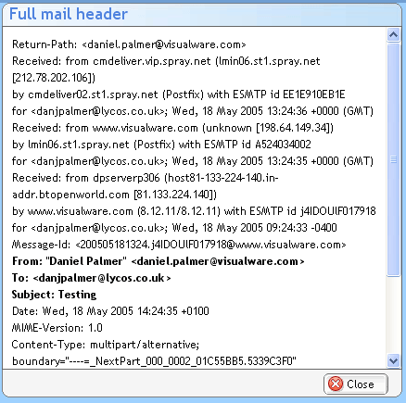
Detailed Time and Date Information
If time and date are in question, even if the suspect computer’s time and date have been manipulated, it is still possible determine when certain processes occurred. This is an example of email information telling us what time and date an email hit outside servers.

Slide 23
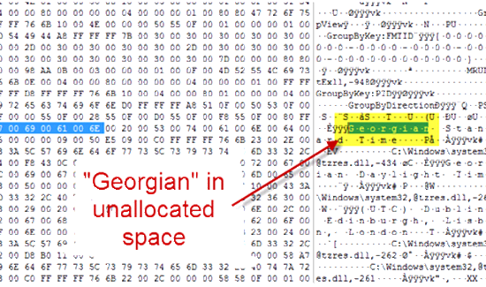
Detailed Information is Very Important
Examiners need specific information related to the case in order to search key words that might be in hidden or deleted files. If the highlighted portion below were the name or address of a victim, for example, then it might be material to the case.

Slide 24
The Forensic Examiner
It is extremely important that the examiner is well trained in the software and equipment being utilized.
DME is a relatively new field of forensics compared to other areas of the lab.
  New technology introduced daily
  Ever-evolving field
  Updated and regular training to stay informed is critical
  Association with professional organizations in the field

Slide 25
Anyone involved in digital evidence cases containing extremely graphic images and/or video, such as child pornography, should have or seek coping strategies in order to deal with the emotional trauma caused by the repeated exposure to such content.
Supporting Heroes In mental health Foundational Training (SHIFT)
Judicial Guide
A Judge’s Guide to Exposure to Child Pornography for Court Personnel and Jurors
http://shiftwellness.org/

Slide 26
Presenting Digital Evidence in Court
Given that the discipline is relatively new and technical, it is important that attorneys presenting the examiner as a witness in court prepares with a pretrial conference.
  Where was the data was located on the media?
  What are the limitations of what was recovered?
  What are all the possibilities for how the data came to be on the piece of media?
  Is the file user-created or does the media store it automatically?
There may be limitations as to what the witness can offer in the examination of digital evidence.
For Example…

Slide 27
RESOURCES
United States Secret Service, Best Practices for Seizing Electronic Evidence
File System Forensic Analysis, by Brian Carrier
How Computers Work, by Ron White
National Center for Missing and Exploited Children (NCMEC) www.missingkids.com
S.H.I.F.T.: Supporting Heros In mental health Foundational Training http://shiftwellness.org/

Slide 28

National Center for Missing and Exploited Children (NCMEC)
We continue to work with NCMEC on several cases in order to further identify child victims involved in our casework.
We offer the service of forwarding images of identified victims so they can be included in the NCMEC database.

Slide 29
Questions/Comments
Jennifer L. Land
Forensic Scientist IV
Texas Department of Public Safety
Crime Laboratory
Jennifer.Land@dps.texas.gov

