Slide 1

Government Code
Subchapter A
§ 411.0205. CRIME LABORATORY ACCREDITATION PROCESS.
(a) In this section, “crime laboratory,” “forensic analysis,” and “physical evidence” have the meanings assigned by Article 38.35, Code of Criminal Procedure.
(b) The director by rule:
    shall establish an accreditation process for crime laboratories and other entities conducting forensic analyses of physical evidence for use in criminal proceedings; and
    may modify or remove a crime laboratory exemption under this section if the director determines that the underlying reason for exemption no longer applies.

Slide 2
Government Code
Subchapter A
§ 411.0205. CRIME LABORATORY ACCREDITATION PROCESS.
( c) The director by rule may exempt from the accreditation process established under Subsection (b) a crime laboratory conducting a forensic analysis or a type of analysis, examination, or test if the director determines that:
  (1) Independent accreditation is unavailable or inappropriate for the laboratory or the type
  of analysis, examination, or test performed by the laboratory;
  (2) The type of analysis, examination, or test performed by the laboratory is admissible
  under a well established rule of evidence or a statute other than Article 38.35, Code of
  Criminal Procedure;
  (3) The type of analysis, examination, or test performed by the laboratory is routinely
  conducted outside of a crime laboratory by a person other than an employee of the
  crime laboratory; or
  (4) The laboratory:
  (A) is located outside this state or, if located in this state, is operated by a
  governmental entity other than the state or a political subdivision of the state; and
(B) was accredited at the time of the analysis under an accreditation process with
standards that meet or exceed the relevant standards of the process established by the
director under Subsection (b).

Slide 3
Art. 38.35. Forensic Analysis of Evidence; Admissibility.
(d) (1) Except as provided by Subsection (e), a forensic analysis of physical evidence under this article and expert testimony relating to the evidence are not admissible in a criminal action if, at the time of the analysis, the crime laboratory conducting the analysis was not accredited by the director under Section 411.0205, Government Code.
(e) A forensic analysis of physical evidence under this article and expert testimony relating to the evidence are not inadmissible in a criminal action based solely on the accreditation status of the crime laboratory conducting the analysis if the laboratory:
(A) except for making proper application, was eligible for accreditation by the director at the time of the examination or test; and
(B) obtains accreditation from the director before the time of testimony about the examination or test.

Slide 4
Art. 38.35. Forensic Analysis of Evidence; Admissibility.
(a) In this article:
(4) “Forensic analysis” means a medical, chemical, toxicologic, ballistic, or other expert examination or test performed on physical evidence, including DNA evidence, for the purpose of determining the connection of the evidence to a criminal action. The term includes an examination or test requested by a law enforcement agency, prosecutor, criminal suspect or defendant, or court. The term does not include:
(A) latent print examination;
(B) a test of a specimen of breath under Chapter 724, Transportation Code;
(C) digital evidence;
(D) an examination or test excluded by rule under Section 411.0205(c), Government Code;
(E) a presumptive test performed for the purpose of determining compliance with a term or condition of community supervision or parole and conducted by or under contract with a community supervision and corrections department, the parole division of the Texas Department of Criminal Justice, or the Board of Pardons and Paroles; or
(F) an expert examination or test conducted principally for the purpose of scientific research, medical practice, civil or administrative litigation, or other purpose unrelated to determining the connection of physical evidence to a criminal action.

Slide 5
Texas Administrative
Code
TITLE 37 PUBLIC SAFETY AND CORRECTIONS
PART 1 TEXAS DEPARTMENT OF PUBLIC SAFETY
CHAPTER 28 DNA, CODIS, FORENSIC ANALYSIS, AND
CRIME LABORATORIES
SUBCHAPTER I ACCREDITATION
Rules
§28.141 Purpose
§28.142 Definitions
§28.143 Recognition Process
§28.144 List of Recognized Accrediting Bodies
§28.145 Disciplines and Subdisciplines Subject to DPS Accreditation
§28.146 Disciplines, Subdisciplines, and Procedures to Which Statutory DPS
Accreditation Does Not Apply
§28.147 Disciplines, Subdisciplines, and Procedures Exempt from Statutory
DPS Accreditation
§28.148 Full DPS Accreditation
§28.149 Provisional DPS Accreditation
§28.150 Accreditation Term
§28.151 Automatic Withdrawal of DPS Accreditation

Slide 6
Texas Administrative
Code
TITLE 37 PUBLIC SAFETY AND CORRECTIONS
PART 1 TEXAS DEPARTMENT OF PUBLIC SAFETY
CHAPTER 28 DNA, CODIS, FORENSIC ANALYSIS, AND
CRIME LABORATORIES
SUBCHAPTER I ACCREDITATION
RULE §28.141 Purpose
(a) Generally. This subchapter contains the director's rules adopted under Government Code, §411.0205, that govern:
(1) the recognition of an accrediting body by the director; and
(2) the accreditation of an individual laboratory or other entity by the director.
(b) Accreditation sequence. To be accredited by the director under this subchapter, a laboratory must first be accredited by a recognized accrediting body.
(c) Source of evidence predicate. The Code of Criminal Procedure, Article 38.35, requires DPS accreditation of an individual laboratory or other entity for admission of evidence or testimony if the laboratory or entity conducts a forensic analysis of physical evidence for use in a criminal proceeding.
(d) Statutory DPS accreditation. A laboratory may apply to the director for statutory DPS accreditation if accreditation is required for evidence admissibility under Code of Criminal Procedure, Article 38.35.

Slide 7
Texas Administrative
Code
TITLE 37 PUBLIC SAFETY AND CORRECTIONS
PART 1 TEXAS DEPARTMENT OF PUBLIC SAFETY
CHAPTER 28 DNA, CODIS, FORENSIC ANALYSIS, AND
CRIME LABORATORIES
SUBCHAPTER I ACCREDITATION
RULE §28.142 Definitions
(2) Forensic analysis--has the meaning assigned by Code of Criminal Procedure, Article 38.35. The term does not include:
(A) an expert examination or test excluded under Code of Criminal Procedure, Article 38.35, subsection (a)(1);
(B) an expert examination or test conducted principally for the purpose of scientific research, medical practice, civil or administrative litigation, or other purpose unrelated to determining the connection of physical evidence to a criminal action;
(C) the location, identification, collection, or preservation of physical evidence by laboratory or investigative personnel unless the activity is integral to an expert examination or test; or
(D) field, spot, screening, or other presumptive testing unless the activity is integral to an expert examination or test for which an expert opinion is rendered.

Slide 8
Rule §28.147 Disciplines, Procedures exempt from Statutory DPS Accreditation
sexual assault examination of the person;
forensic anthropology, entomology, or botany;
environmental testing;
facial or traffic accident reconstruction;
serial number restoration;
polygraph examination;
voice stress, voiceprint, or similar voice analysis;
forensic hypnosis;
statement analysis;
profiling; or
other discipline or subdiscipline so determined by the director.

Slide 9
Rule §28.145
Disciplines Subject to DPS Accreditation
Controlled Substances;
Toxicology;
Biology;
Firearms/Toolmark;
Questioned Documents;
Trace Evidence; or
Other discipline if approved by a recognized accrediting body and the director.

Slide 10
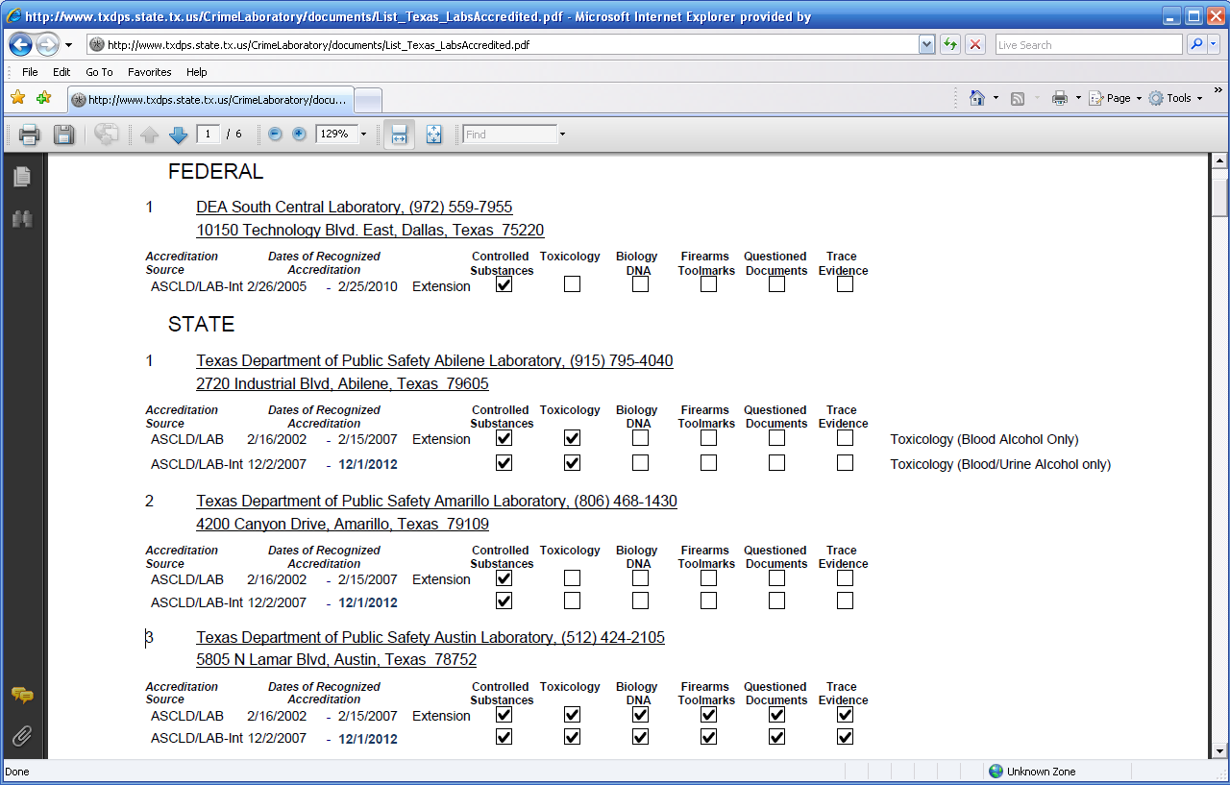
List of DPS Accredited Labs from Texas
(Date Printed 9/14/2010)

Slide 11
Department of Public Safety web site
(for list of accredited labs): www.txdps.state.tx.us
Secretary of State web site (for Administrative Rules): www.sos.state.tx.us
Pat Johnson, Deputy Assistant Director
Texas Department of Public Safety
Crime Laboratory Service
Pat.Johnson@txdps.state.tx.us
(512) 424-2143

