Slide 1

Firearm and Toolmark Identification
Tim Counce
Forensic Scientist IV
Purpose: To provide members of the legal community the scientific underpinnings of forensic firearm and toolmark analysis, its compliance with applicable scientific criteria for admission under Daubert and Frye standards, and associated published research substantiating the discipline

Slide 2
Agenda
What makes an examiner
Firearms 101
Conducting the exam
Firearm and Toolmark Theory
Class, Individual, and Subclass characteristics
Testability of Scientific Principle
Known Error Rate
Peer Review/Publication
Acceptance in Relevant Field
Use of Standards and Controls

Slide 3
What makes an Examiner?
~ Two years of specific training in FA/TM examinations with minimum education standards
Thousands of microscopic comparisons
Multiple competency and proficiency tests
May be qualified in other sub-disciplines
  Serial Number restoration
  Toolmarks
  Muzzle to garment distance determinations
Continuing Education

Slide 4
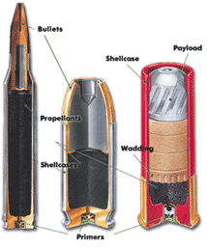
Ammunition
Cartridges consist of Four major components:
-Case
-Primer
-Powder
-Projectile(s) (Bullets, slugs, or shot)

Slide 5
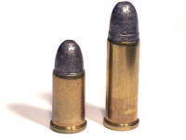
Caliber
The term caliber generally refers to the diameter of the bullet being fired, but there are NO hard and fast rules when it comes to naming ammunition or weapon calibers.
If the number is the same, but the caliber name has different words it usually means that the bullet diameters are the same, but the cartridge length or type of cartridge case are different.
22 Caliber Long
22 Caliber Short
Both of these cartridges have the same size bullet which is .22 inches in diameter, but the case lengths are different

Slide 6
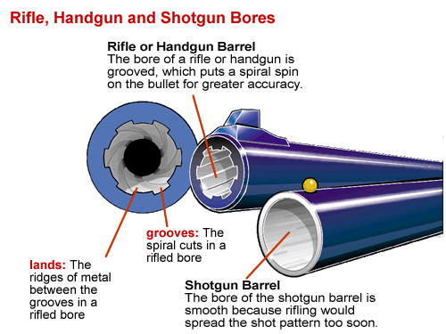
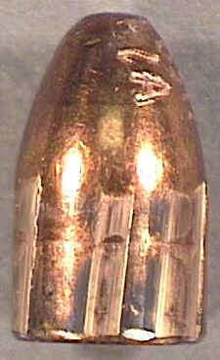
Rifling Marks
Rifling is a series of helical grooves in the interior of the barrel which causes the bullet to spin and make it more stable (like a spiral on a football)
Shallow marks made by grooves in barrel
Deep marks made by lands in barrel

Slide 7
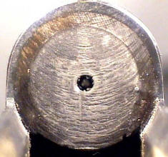
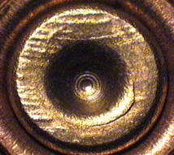
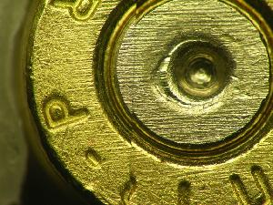
Marks on Cartridge Cases
Firing Pin Hole
Breech Face
Two Breech Face Marks
Case on Left was a test fire in the lab, Case on right was recovered at a crime scene.

Slide 8
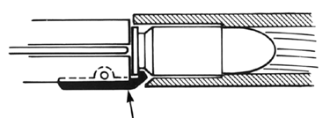
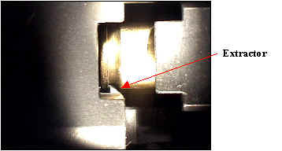
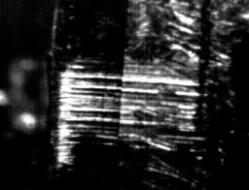
Extractor
The extractor is a device found on most firearms except revolvers which helps pull the empty case out of the gun after it is fired. Extractors work by pulling on the edge of the cartridge rim and leave striated marks as shown below.
Extractor Marks under the comparison microscope
Extractor

Slide 9
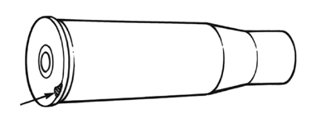
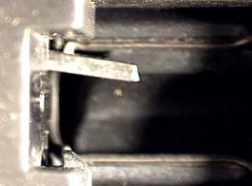
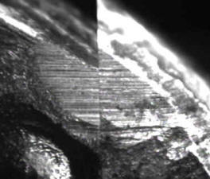
Ejector
As the extractor pulls the case back, it strikes a hard protrusion or bump, called the ejector, which caused the case to fling out of the weapon. While the extractor pulls, the ejector pushes and usually leaves marks on the very edge of the cartridge case rim.
Ejector marks
Ejector Marks under the comparison microscope
Ejector

Slide 10
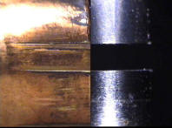
Conducting the Exam Step #1
First, a thorough exam of the firearm is made to determine if it functions, trigger pull, markings, features, etc.
Exams can include
  # of lands and grooves
  Direction of Twist
  Caliber
  Types of safeties
  Make
  Model
  Trigger pull
  Location of extractor and ejector
  Defects or safety hazards
  Width of Lands and Grooves
Measuring width of lands and grooves

Slide 11
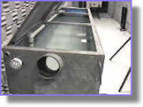
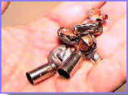
Conducting the Exam Step #2
Then the weapon is test fired into a water tank and both the cases and bullets are recovered.

Slide 12
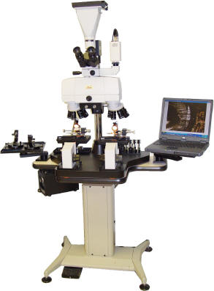
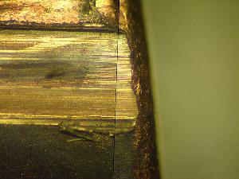
Conducting the Exam Step #3
Then the cases and bullets are compared with a special comparison microscope. The tests and the submitted evidence are analyzed side by side. These exams depend on certain marks.

Slide 13
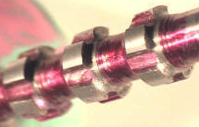
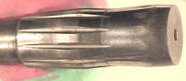
Firearm and Toolmark Theory
Proposition #1 – Most manufacturing processes involve the transfer of rapidly changing or random marks onto work pieces such as gun barrels, breech faces, knife blades, and screwdriver tips. This is caused principally by the phenomena of tool wear and chip formation or by electrical/chemical erosion. Microscopic marks on tools will then continue to change from further wear, corrosion, and abuse.
Tools for creating rifling in firearm barrels; gang broach (top) and button (bottom).

Slide 14
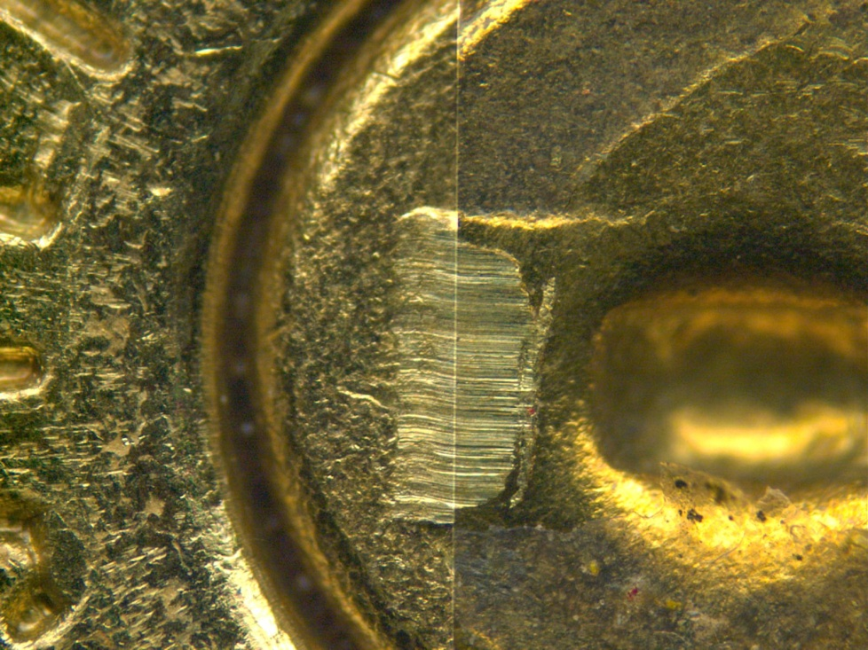
Firearm and Toolmark Theory
Proposition #2 – Toolmarks imparted to objects by different tools will rarely, if ever, display agreement sufficient to lead a qualified examiner to conclude the objects were marked by the same tool. Likewise, those objects with sufficient agreement can be said to have a common origin, or to have come from the same tool.

Slide 15
Theory of Identification
The theory of identification as it pertains to the comparison of toolmarks enables opinions of common origin to be made when the unique surface contours of two toolmarks are in “sufficient agreement.”
This “sufficient agreement” is related to the significant duplication of random toolmarks as evidenced by the correspondence of a pattern or combination of patterns of surface contours.
Significance is determined by the comparative examination of two or more sets of surface contour patterns comprised of individual peaks, ridges and furrows. Specifically, the relative height or depth, width, curvature and spatial relationship of the individual peaks, ridges and furrows within one set of surface contours are defined and compared to the corresponding features in the second set of surface contours.
Agreement is significant when it exceeds the best agreement demonstrated between toolmarks known to have been produced by different tools and is consistent with agreement demonstrated by toolmarks known to have been produced by the same tool.
The statement that “sufficient agreement” exists between two toolmarks means that the agreement is of a quantity and quality that the likelihood another tool could have made the mark is so remote as to be considered a practical impossibility.

Slide 16
Subjectivity
Currently the interpretation of individualization/identification is subjective in nature, founded on scientific principles and based on the examiner’s training and experience.
Subjective does not mean unscientific and does not imply a need to be quantifiable. Many people recognize the shapes and patterns of facial features for identity every day and “trained/experienced” individuals can tell the difference between identical twins.
All science involves some subjectivity whether it is reading an analog instrument or a doctor diagnosing an illness.
The subjective criteria of identification of firearm and toolmark examiners is based on personally observing thousands of known matches and known non-matches. This is an objective conclusion (meaning based on observation; without bias or opinion) based on a subjective interpretation.

Slide 17
Match vs. Non-Match
Almost all fired components with similar class characteristics have some matching striated lines
Fired components known to be fired from the same gun will always have some matching striated lines that differ
Firearm and toolmark identification is based on matching patterns of lines, not individual, scattered lines and these have been shown to be unique both statistically* and empirically†
Identifications based on both quantity and quality of individual characteristics
* Biasotti-1959, Bracket-1970, Blackwell & Framan-1980, Deinet-1981, and Uchiyama-1988 and 1992
† Tulleners, Giusto, & Hamiel-1998, Tulleners, Stoney & Hamiel-1998, Miller-1998, and Miller 2000

Slide 18
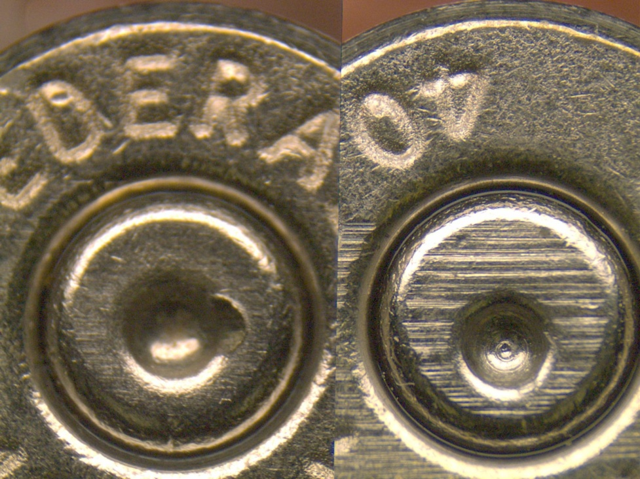
Class Characteristics
Measurable features of a specimen which indicate a restricted group source. They result from design factors, and are therefore determined prior to manufacture.
Class characteristics Illustrated on cartridge cases (above) and fired bullet (left)
Source: Association of Firearm and Toolmark Examiner (AFTE) Glossary 5th Edition

Slide 19
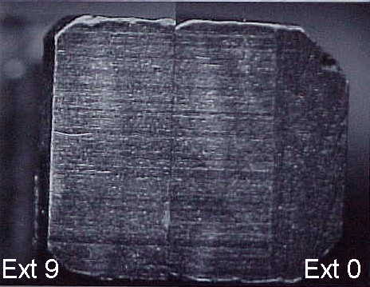
Subclass Characteristics
Discernible surface features of an object which are more restrictive than CLASS CHARACTERISTICS in that they are:
- Produced incidental to manufacture.
- Are significant in that they relate to a smaller group source (a subset of the class to which they belong).
- Can arise from a source which changes over time.
- Examples would include: bunter marks, extrusion marks on pipe, etc.
(Caution should be exercised in distinguishing subclass characteristics from INDIVIDUAL CHARACTERISTICS.)
Sublclass marks present on consecutively manufactured extractors. Of note, this study concluded that the subclass marks were NOT transferred to the tool surfaces and did not hinder identification
Source: Association of Firearm and Toolmark Examiner (AFTE) Glossary 5th Edition

Slide 20
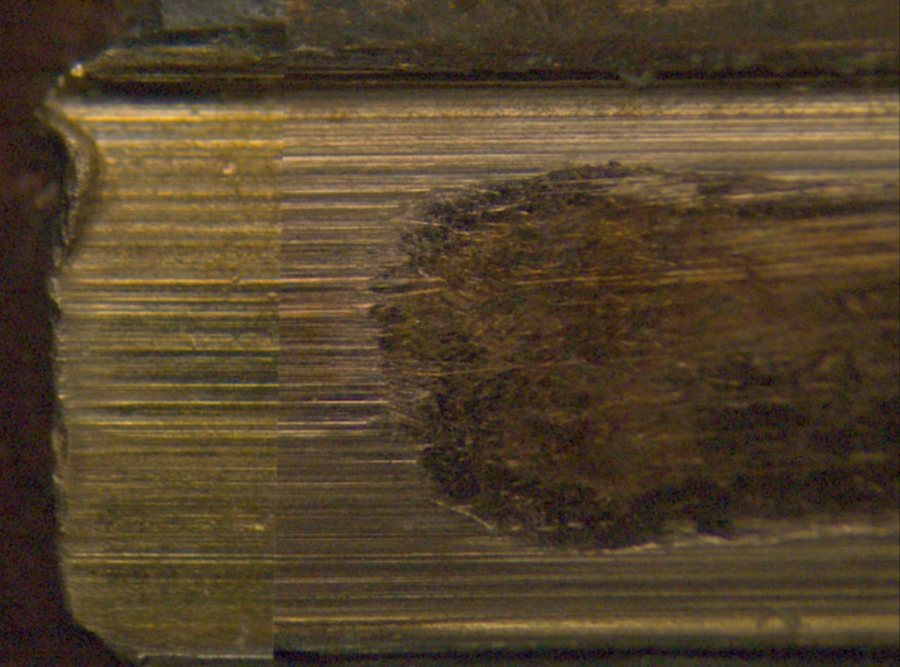
Individual Characteristics
Marks produced by the random imperfections or irregularities of tool surfaces. These random imperfections or irregularities are produced incidental to manufacture and/or caused by use, corrosion, or damage. They are unique to that tool and distinguish it from all other tools.
Identification based on individual characteristics from the land of a firearm barrel imparted onto the surface of a bullet
Source: Association of Firearm and Toolmark Examiner (AFTE) Glossary 5th Edition

Slide 21
Identity
There is no way to be ABSOLUTELY certain of any identification without comparison to marks from every particular tool, which is impossible.
All firearm and toolmark examinations can conclude is that a conclusion is one of “practical certainty” or has made an identification “to a reasonable degree of scientific certainty”

Slide 22
Why Firearms is not DNA
Forensic DNA analysis significantly differs from Firearms Examination as DNA
  16 regions of the DNA molecule are compared but the possible combinations of results of those regions are limited based on parentage and population
  The overall DNA profile result is assessed and unique characteristics are rarely seen...(you may share the same profile at four locations but the overall profile helps to distinguish you from your neighbor)
  DNA does not change over time
  Statistics can be generated based on known population parameters
Firearm and Toolmark exams have
  Infinite number of ways in which tools can be manufactured and used
  Characteristics unique to one tool and one tool only
  Can change over time
  Population data for firearms cannot be calculated

Slide 23
Testability of Scientific Principle
Consecutive Manufacture Studies
  Worst case scenarios with potential for most agreement and most subclass carryover
    Matty-1984 Smith & Wesson firing pins
    Matty-1984 Raven .25 Auto breech faces
    Watson-1978 Knives
    Tuira-1982 Knives
    Brundage-1994 Ruger Pistol Barrels
Other “Black Box” Validation Studies
  Bunch & Murphy-2003 0% error rate
  De France-2003 0% error rate
  Thompson & Wyant-2005 .78% error rate
  Smith-2005 0% error rate
  Orench-2005 0% error rate

Slide 24
Known Error Rate
Error Rate can be calculated by use of annual proficiency tests
  Designed to test competence of lab system, not validity of technique
  Used primarily as a quality assurance device
  Not all participants are trained examiners
  Not anonymous
  May be subject to less review
Based on data from Collaborative Testing Services Proficiency tests:
  1.4% of those taking the firearms tests made a false identification or elimination
  4% of those taking the toolmark tests made a false identification or elimination
  Of the five major consecutive manufacturing studies taken by qualified examiners, four had a 0% error rate and one had a .78% error rate
Source: Peterson and Markham-1995

Slide 25
Peer Review/Publication
Association of Firearm and Toolmark Examiners (AFTE) Journal
  Primary professional, peer reviewed journal for firearm and toolmark community
  Extensive pre-publication and post-publication review process
  Published since 1969
Articles also published in Forensic Science International and Journal of Forensic Science

Slide 26
Acceptance in Field
Scientific Working Group on Firearm and Toolmark Examination (SWGGUN)
AFTE growing body dedicated to research on the scientific underpinnings of firearm and toolmark examination
Recognized forensic discipline in the US since the 1930s with Firearms examiners at TX DPS since 1935
Forensic firearm and toolmark analysis admitted in courts since Commonwealth of Massachusetts v. Best in 1902

Slide 27
Use of Standards and Controls
Adherence to Standard Operating Procedures
  Laboratory Accreditation
  Verification
  Internal/External Audits
  100% Technical Reviews
  100% Administrative Reviews
Proficiency Testing
Continuing Education

Slide 28
Firearms and the Scientific Method
Identify Problem
Do Background Research
Construct Hypothesis
Was this bullet fired from this gun?
Test Firearm for functionality
Do class characteristics match?
Test With an Experiment
Report Results
Class characteristics agree; bullet was fired from gun
Class characteristics do not agree, bullet was not fired from gun
Microscopically compare with test fires made from submitted weapon
Draw Conclusion
Microscopic marks agree that exceeds best known non-match; bullet was fired from gun
Issue Report
Testify in court

Slide 29
Additional Information References
http://www.swggun.org/index.htm
www.afte.org/

Slide 30
Questions
"I have a love interest in every one of my films - a gun."
- Arnold Schwarzenegger
"I have a very strict gun control policy: if there's a gun around, I want to be in control of it."
- Clint Eastwood

