Slide 1









Texas Department of Public Safety
Crime Laboratory Services MSC 0460
Forensic Document Section
PO Box 4143
5805 N. Lamar Blvd.
Austin, TX 78765-4143
(512) 424-2105 Phone
(512) 424-5642 Fax
Dale Stobaugh,
Supervisor
E-MAIL: Dale.Stobaugh@
txdps.state.tx.us
Ken Crawford
Jennifer Land
Veronica Bradshaw
Erin Gruene
Sarah Pryor
Meg O’Brien
Nathan Calderon
Notes:
Computer Forensics VS Audio/Video portions of DME

Slide 2
DIGITAL MULTIMEDIA EVIDENCE EXAMINATION
(Computer Forensics)

Slide 3
The Division of DME
According to The American Society of Crime Lab Directors-Lab Accreditation Board (ASCLD-LAB), digital media evidence is subsequently divided into three concentrations:
Digital Multimedia Evidence
Digital Media Analysis/Computer Forensics
(QD Section)
Imaging
(Photography Section)
Audio/Video
(Photography Section)
This division also represents how computer and audio/visual evidence is distributed within the crime laboratory

Slide 4
Our role in Digital Multimedia Evidence Analysis
Computer Forensics
Preserve data on the media submitted
Make an exact “image” of the data (bit for bit copy)
Examine and search the “image” copy of the evidence
Notes:
Hardware write-blocker
Examination of deleted areas not accessible to user (deleted but not yet overwritten)

Slide 5
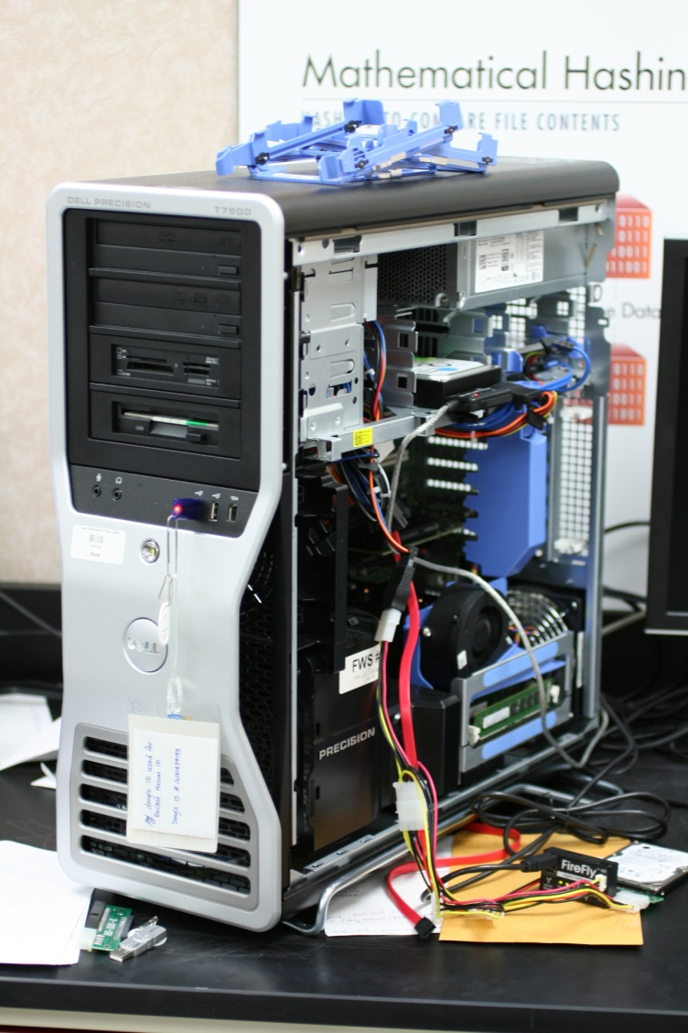
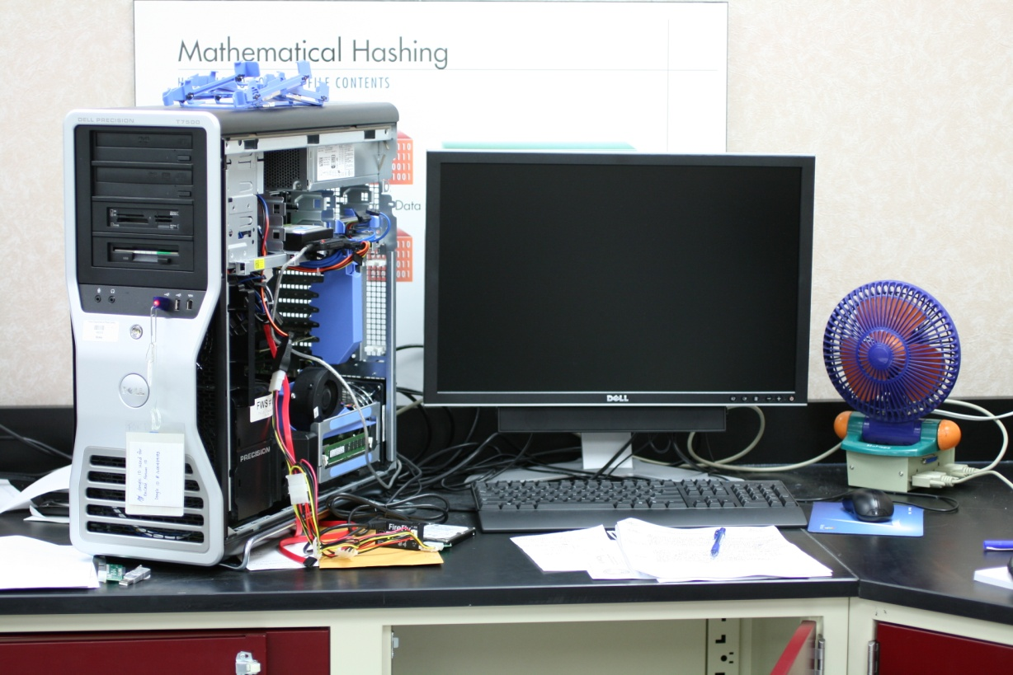
Forensic Workstations
Forensic Analysis Machines or Forensic Workstations

Slide 6
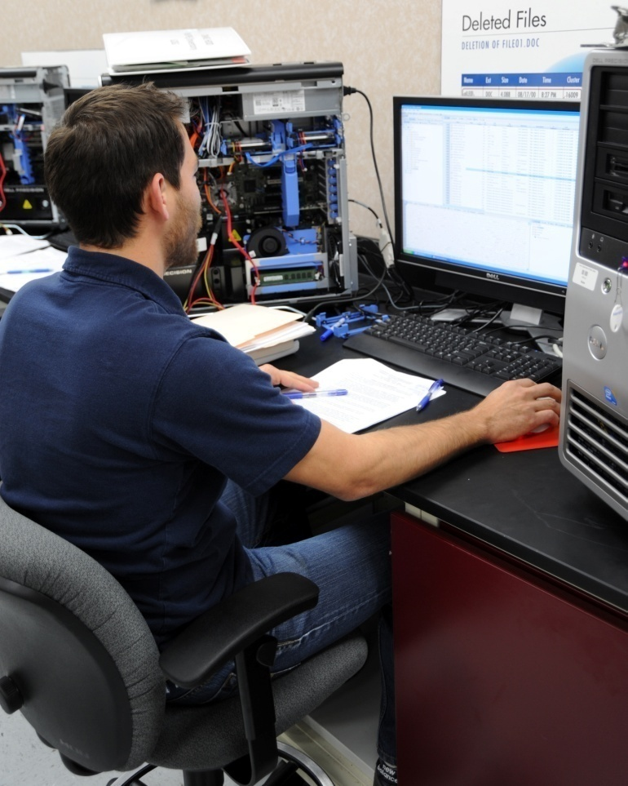

Specialized, Forensically-tested software is used
Use of Guidance Software’s EnCase on Windows analysis machine
Use of BlackBag Technologies Forensic Suite on Mac analysis machine

Slide 7
What is Digital Evidence and How is it Different?
Information and data of investigative value that is stored on or transmitted by an electronic device
Can transcend borders quickly via Internet
Data in computer systems is highly susceptible to alteration or destruction
Caution must be exercised when collecting, transporting, examining and storing this type of evidence to avoid data loss
Special training, skills, equipment, and software are needed to retrieve evidence stored within computers and computer media to avoid alteration or destruction
Notes:
Data in computer systems is usually stored in electromagnetic or electronic form. These types of storage are highly susceptible to alteration or destruction.
Caution must be exercised when collecting, transporting, examining and storing this type of evidence to avoid the loss of evidence and intellectual property.

Slide 8
Digital Evidence at the Crime Scene
Search Warrant / Consent to Search Issues
Identifying Evidence to be Collected
Documentation, Collection, Preservation of Evidence
Transporting Evidence to the Laboratory

Slide 9
Considerations
What type of computer system is anticipated?
  Stand alone home computer (home PC not connected to a network or other computer, may have internet connectivity)
  Networked computers (computers which are interconnected to share data and other resources, storage area)
Contact a forensic examiner if needed

Slide 10
Search Warrant / Consent to Search
DPS Crime Lab Policy is to have copy of the search warrant or consent to search form before examination can begin
Specific wording not only to seize the media but also to access data stored within the media…there is a difference
Go-bys are available from the DPS Lab
A common misconception about the search warrant “return” to the issuing Judge: officers sometimes ask if we can begin examination within that return time. When in fact, the evidence merely needs to be submitted to the lab within that return deadline to the Judge.

Slide 11
Types of electronic devices or MEDIA that may contain digital evidence
Personal computer, laptop
External hard drives (USB connection)
DVD, CD, floppy disks
Flash drives (thumb, USB)
Memory sticks
Digital cameras
SD Cards
Personal Data Assistants (PDAs, iPods, Palm)
Cellular phones
MP3 Players
Smart Phones (Blackberry/iPhone)
Many unusual pieces of media

Slide 12
Types of Evidence at Scene
Computer media relevant to crime
Documents surrounding computer
Documents in the printer, scanner, trash
Web camera (usually on top of monitor)
PDA, cell phones with charger/data cable
Related software
Related cables / power cords / chargers

Slide 13
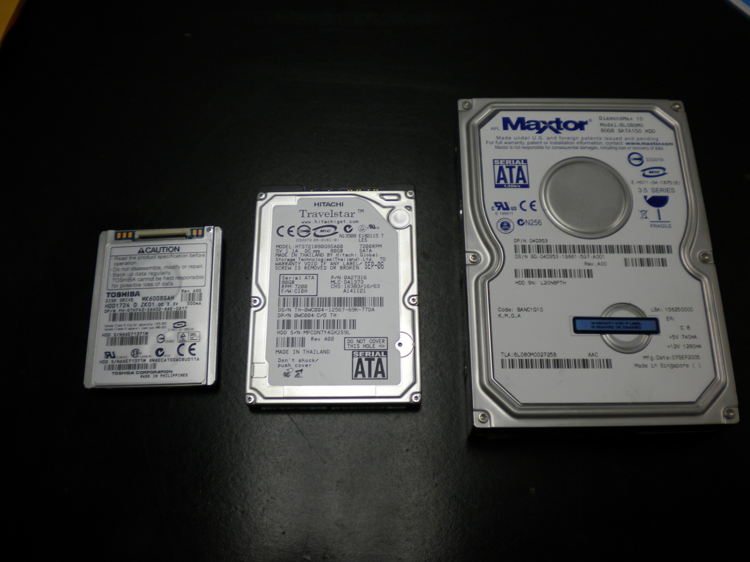
Hard Drives can come in various sizes

Slide 14
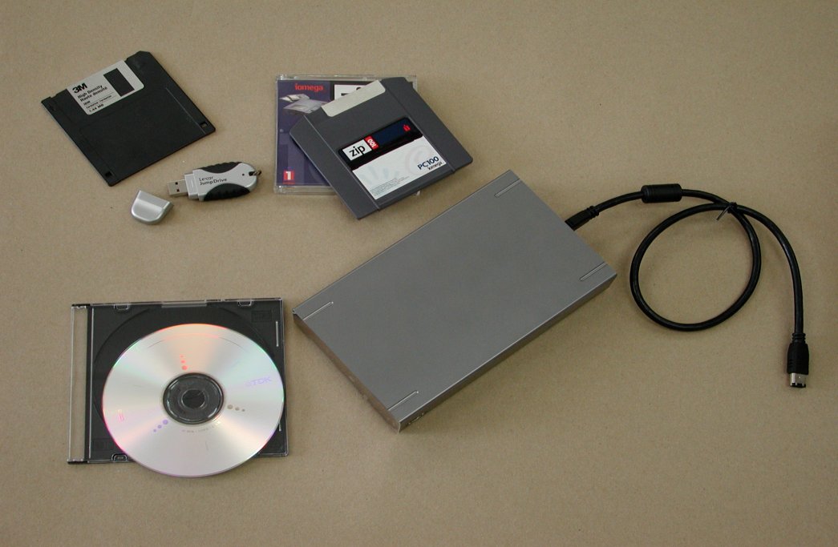
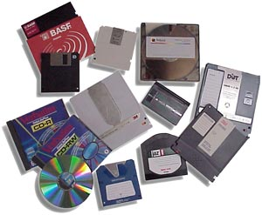
Digital Media Examples

Slide 15
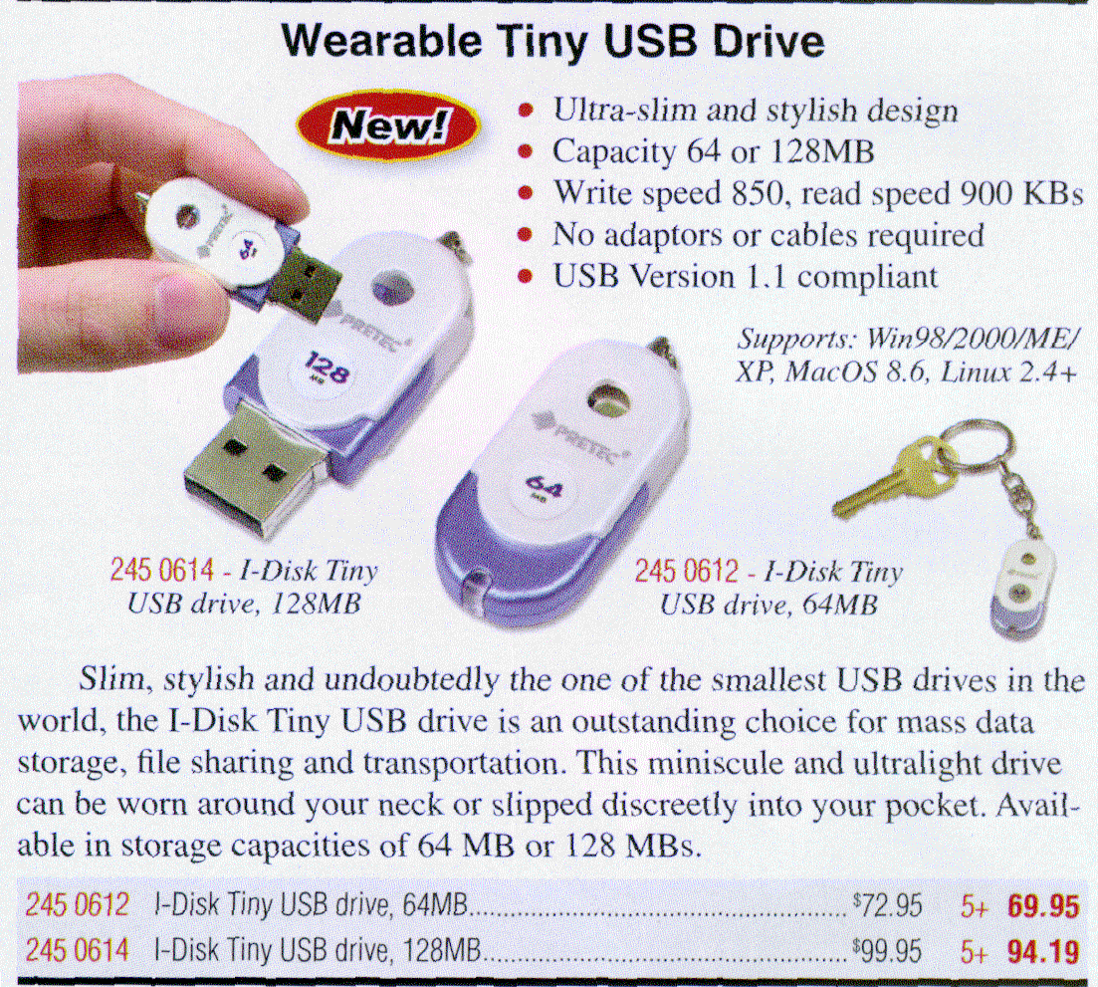
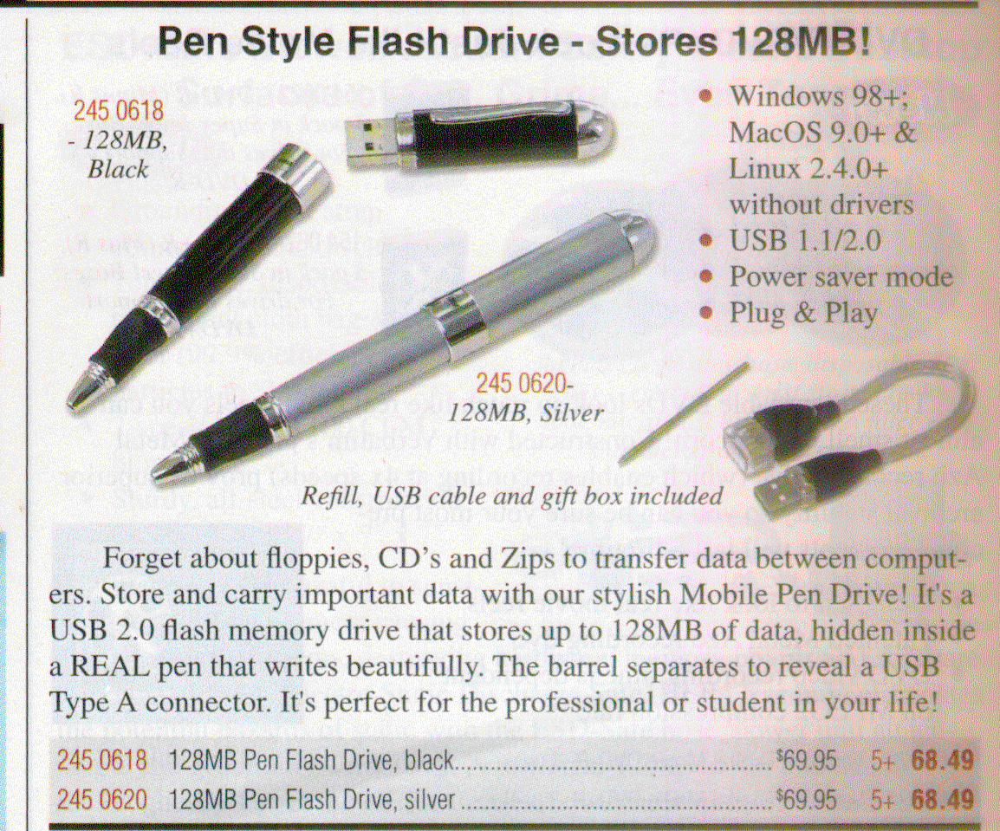

Digital Media Examples
USB devices can be disguised or hidden in any number of everyday items
Micro/Solid State Drive

Slide 16
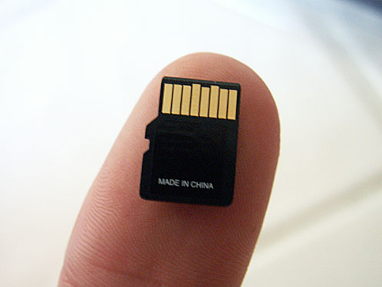
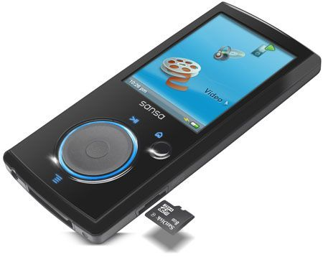
Extremely concealable media, can be found & stored anywhere…
Sansa Video Player
Micro SD Card

Slide 17
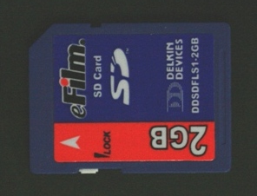
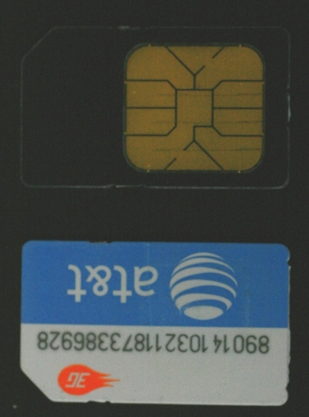
DATA STORAGE DEVICES
SIM Card from Cellular Phone
SD Card from Digital Camera

Slide 18
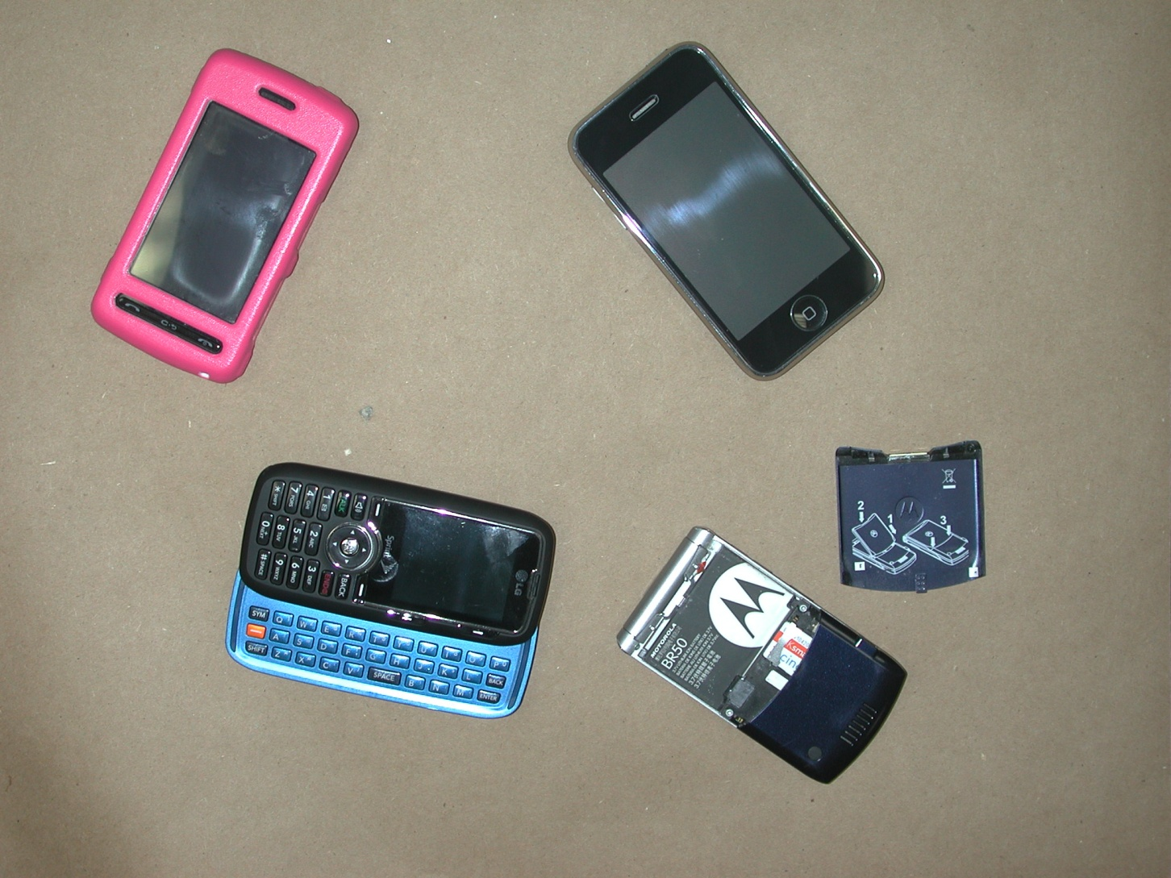
CELLULAR TELEPHONES

Slide 19
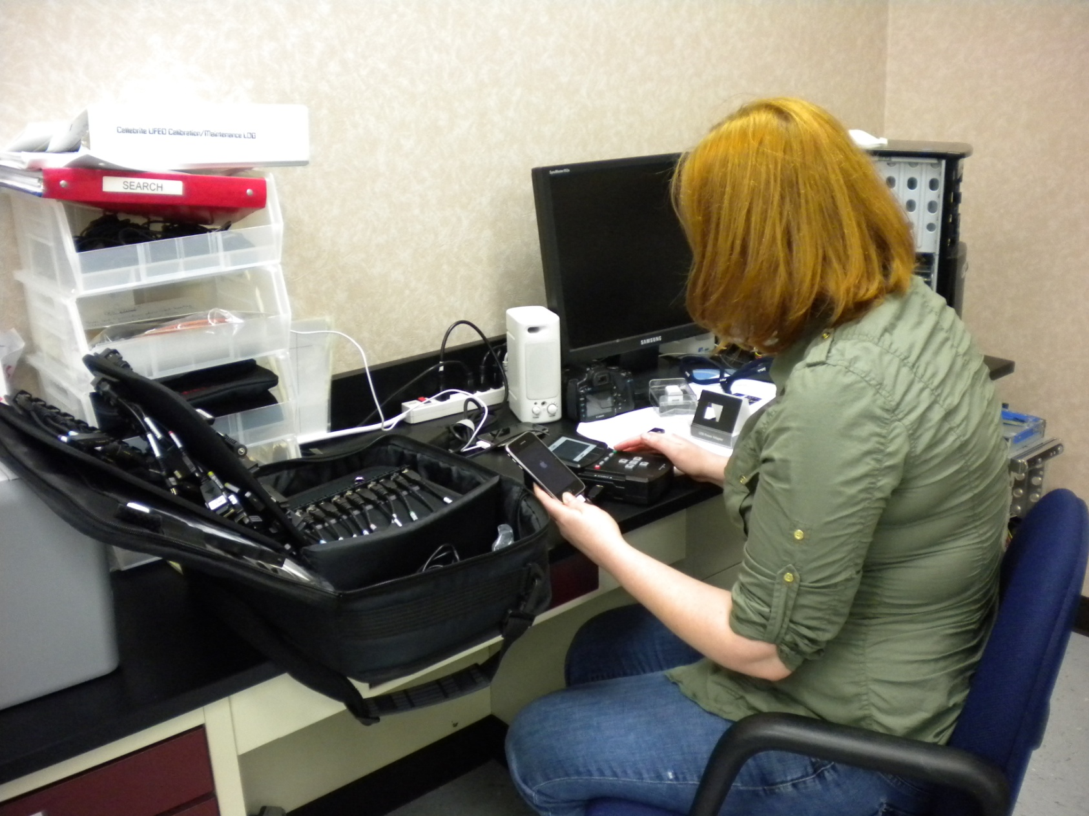
Use of CelleBrite UFED to extract evidence from a cell phone
Notes:
Cell phone examination is not necessarily always a “forensic” process.
Careful documentation is necessary, communication with officer/prosecutor is key.

Slide 20
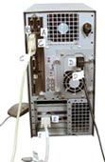
ON/OFF Rule
Computers
Officers on scene are instructed to never do a “normal shutdown” on a computer, unless advised by an examiner.
We instruct officers to unplug stand-alone computers from the back of the computer, not the wall outlet.
Cell Phones
If the device is ON:
  Write down all information on display and photograph
  Power down prior to transport (take any power supply cord, charger and data cable)
If the device is OFF, leave it OFF
  Turning it on could alter evidence on device (same as computers)
  Make every effort to locate any instruction manuals pertaining to the device
Wire Tap Considerations

Slide 21
Transporting Digital Evidence
Keep away from magnets, radio transmitters and otherwise deleterious environments such as the trunk of a patrol car where the radio receiver is stored
Minimize jarring the equipment
Store and seal in boxes if possible to limit access and exposure

Slide 22
Recoverable Data
Homicides
  Address books
  emails
  cell phone information
  related documents on computer
  time and date issues
  last email sent
  last user on the computer
  In these types of cases, the examiner will likely view millions of files in order to recover that one piece of evidence needed

Slide 23
Recoverable Data
Sexual Assault (adult or child, child pornography)
  Image / Movie files contained on media
    Cell phones, cameras, web cam, computer
  Text files, emails/chats concerning event
  Emails / Peer-to-peer sharing of images or contraband
  Internet history and searches

Slide 24
RESOURCES
United States Secret Service, Best Practices for Seizing Electronic Evidence
File System Forensic Analysis, by Brian Carrier
How Computers Work, by Ron White
National Center for Missing and Exploited Children (NCMEC)
  www.missingkids.com

Slide 25
National Center for Missing and Exploited Children (NCMEC)
We continue to work with NCMEC on several cases in order to further identify child victims involved in our casework.
We offer the service of forwarding images of identified victims so they can be included in the NCMEC database.

Slide 26
Questions/Comments

